Slide 1
Staged Development Tool (SDT) for NPHIs
Facilitator’s Guide
Notes:
The following slides provide details about planning to use the SDT and running SDT assessment and work-planning sessions. It is designed for use by individuals who intend to facilitate the SDT.

Slide 2
Topics
Advance work
Using the SDT
Notes:
This slide lists the topics covered in ‘Facilitator’s Guide’.

Slide 3
Advance Work
Get to know the NPHI and its people as much as possible
Get expectations in writing – make sure goals and expected outputs are clear
Check plans and logistics
Will the right people be available? Try to have a mix of perspectives, including decision-makers
Is the room and set-up conducive to discussion? A U-shape, open rectangle, or hollow square is better than classroom style seating
Will you be able to print, or do you need to bring hard copies?
What are the plans for AV? Do you have all the needed supplies?
Notes:
The more that you know the NPHI and that you establish trust with key people, the easier and more successful the SDT process will be. Make sure you build in enough time either before you visit the NPHI or when you arrive to understand the priorities of leadership, as well as the political, financial, administrative, and other contexts that impact the NPHI.
Getting expectations in writing is useful for clarifying goals and setting the agenda. They can suggest which Discussion Guides will be used and who needs to participate. If you do not identify at least some of the high-priority topics in advance, you are unlikely to be able to arrange for all the critical individuals to attend the relevant assessment and planning meetings.
A bad room setup can inhibit conversation. Have the room set up so that people are facing each other, so they can interact easily.
It is helpful to have a point person at the NPHI who is responsible for logistic support. Ideally, you will work with that person before you travel to ensure issues related to room setup and supplies are addressed.

Slide 4
In Advance: Gather Supplies
Computer files
SDT Overview PowerPoint
Discussion Guides
Assessment and Work-Planning forms
Print materials
Discussion Guide: Definitions and Notes
Discussion Guides
If you know which Guides you are going to use, it can be helpful to print copies for each participant in advance
Flipchart stand and paper (sticky-back if possible – otherwise you need tape), markers
You will use the flipchart to record ground rules and capture “Parking Lot” items
Notes:
Once you have facilitated the SDT a few times, you will develop your own list of needed supplies. Those listed in this slide are a minimum.

Slide 5
In Advance: Planning the Agenda
In general, assessment and prioritization takes 90 minutes per Discussion Guide, and work-planning takes an additional 60 minutes per Discussion Guide
Varies with number of participants, complexity of the Guide, etc.
On average, a 3-day SDT Workshop will cover 5-8 topics
Can cover more topics if work-planning is done at a later time. For example, some NPHIs will want to conduct work-planning during the subsequent weeks

Slide 6
Using a Facilitator
The SDT process is designed to be facilitated, whether by an internal or external facilitator
We recommend using an external facilitator trained in the SDT, especially the first time
Advantages of a trained external facilitator are:
In-depth understanding of using maturity models
Familiarity with the Discussion Guides and terms used
Neutrality if difficult issues arise (e.g., in discussion of Leadership and Management)
Ability to step back and make sure participants keep the big picture in mind
Notes:
Although the SDT is envisioned as a country-owned process, it is best done with a trained facilitator, who is familiar with the underlying structure and flow of the SDT process. After an NPHI has used the SDT with a facilitator, it may be more prepared to manage the SDT process on its own.

Slide 7
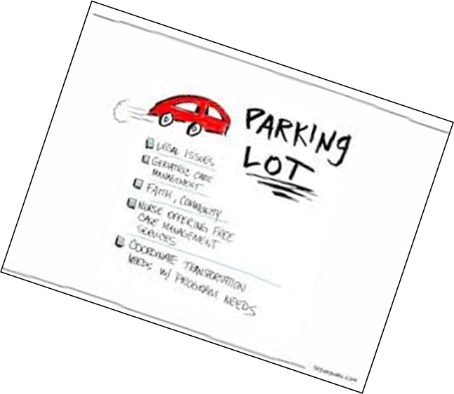
Arrive Early
Check the room setup and AV
Hang a flipchart page on the wall and label it “Parking Lot”
Use this to keep participants focused
When extraneous ideas arise, say, “Great idea. Let’s come back to that later,” and post the idea on the Parking Lot
Return to the Parking Lot at the end of the session and address all the issues
Write up to 5 Ground Rules on a flipchart page and post them. Possible Ground Rules include:
One conversation at a time
Talk about issues, not people
Stay on point, use the Parking Lot
No beating a dead (or live) horse
No electronics
Notes:
The Parking Lot and Ground Rules are among your most important tools.
Use the Parking Lot to keep the discussion focused. Tell participants they can put ideas on it at any time. When extraneous ideas arise, say, “Great idea. Is it ok to come back to that?” and post the idea on the Parking Lot. Make sure to return to all the Parking Lot issues before you end the session.
At the beginning of the session, you can demonstrate that you will be seeking participant input, and that the group has the ultimate say, by presenting the Ground Rules and asking if these are ok with the participants.

Slide 8
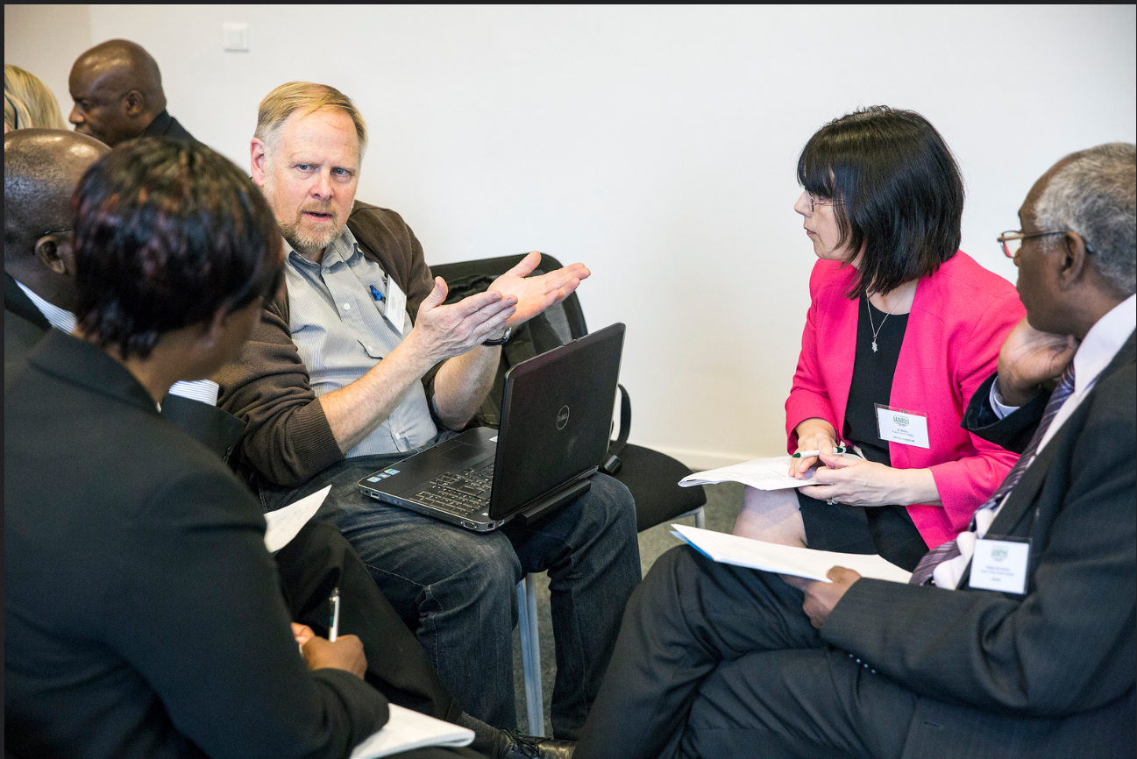
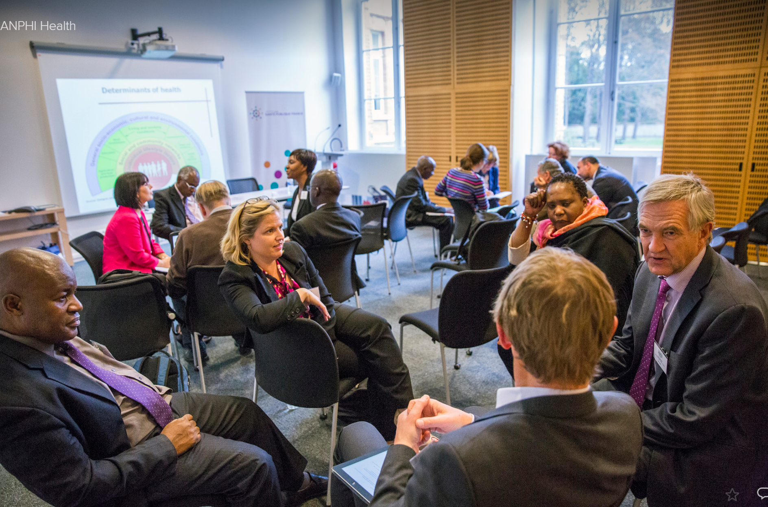
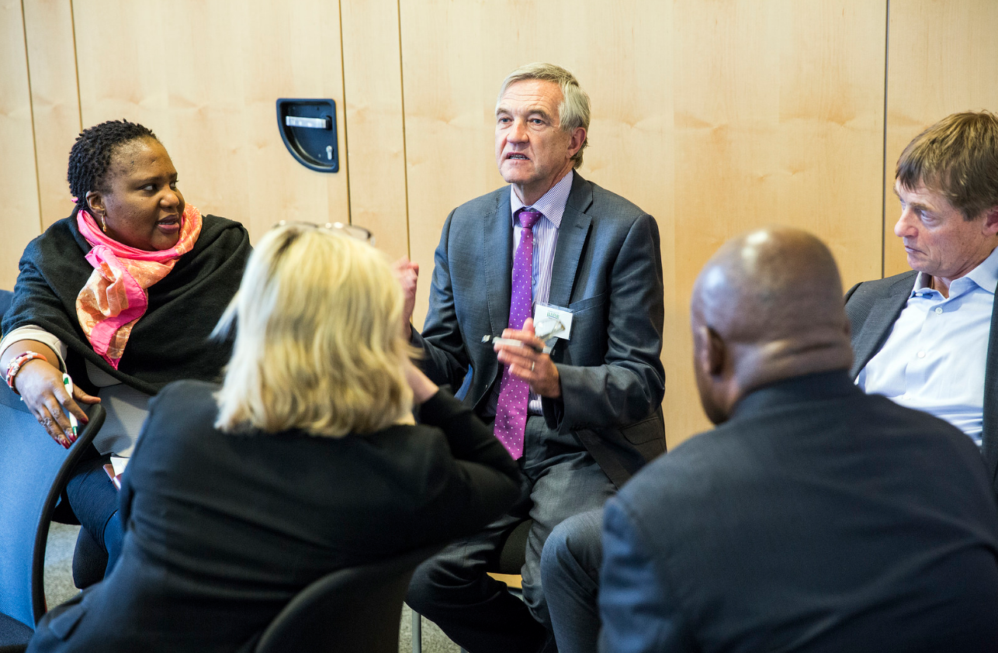
In the Beginning
Clarify roles
Facilitator: Structure discussion, help participants clarify their thoughts, summarize, keep the process moving
Participants: Provide the content
Note-taker: Record on the Assessment and Work-Planning forms
Get participants talking early and often
Notes:
You will need to record and project information on the Assessment and Work-Planning forms. Some Facilitators also act as note-takers, which ensures that what they consider the key ideas are captured. Others would rather focus on discussion and have someone else take notes. If you use a note-taker, choose someone who will be able to capture the key ideas accurately without slowing the process.

Slide 9
Explain the SDT
Use the SDT Overview PowerPoint to explain the SDT
Limit time for questions and clarifications – most questions will be answered once you start the Assessment
Notes:
Keep explanations succinct. Aim to get participants actively engaged as quickly as possible. Participants are likely to have many questions about the process. Try to answer quickly, and reassure them the process will be clear once they get started.
Emphasize that this is a self-driven process. Your job is to help them clarify their thoughts, summarize, etc. Note that you will be checking in with them frequently.

Slide 10
Start Assessment
Read the definition and notes for the Discussion Guide being covered out loud
You will find these in the ‘Definitions-for-Discussion-Guides’ document
Give participants 5 minutes to silently read the first Discussion Guide to be discussed
Prompt them to read about all the stages
Ask participants the NPHI’s stage overall – what stage predominates?
Have participants take turns reading out loud the descriptions of each Domain in the predominant stage
Notes:
The initial step of guessing the NPHI’s capacity is focused on the stage. Subsequent discussions focus on the numeric score and allow for a more refined estimate of the stage.
Don’t let participants get stuck on this step. If there is disagreement, explore the reasons for this, as it will help with identifying gaps and issues to be addressed. However, once discussions are no longer moving the process forward, record the score or scores and continue to the next steps.

Slide 11
Prompt an In-Depth Discussion
Discuss each Domain, one at a time
For each Domain, encourage in-depth discussion about the current score
Ask participants to provide justifications and examples to support their scoring and record the justifications
Capture the current score or, if there is disagreement, scores selected after discussion
Discuss the desired score
Identify the gaps that need to be filled to move from the current to desired score
Sometimes discussion of activities to move to the desired score will flow naturally during the assessment stage
After all the Domains are discussed, discuss overall score
If there is disagreement, discuss reasons for this
It is not necessary to achieve consensus
Notes:
In a given Domain, it is not unusual for an NPHI to have achieved some aspects of more than one stage. So, for example, an NPHI might have half of the elements described in “developing” and a couple from “leading edge.” In general, the NPHI score should reflect where the NPHI has most or all elements in place. For example, if an NPHI has achieved most but not all of the components of the “developing” level and a couple of “leading edge,” it might score on the higher end of “developing.”
Participants often prefer to score themselves within the range included in a higher stage, for example, where they have achieved some but not most items. Point out that if they overstate the current score, it will be harder to show progress made from implementing the plans developed using the SDT. But don’t get bogged down with scoring. The main purpose of scoring is to prompt discussion and clarify the difference between the current and desired states.
Participants from NPHIs that are “leading edge” on some Domains might be reluctant to admit that they are “developing” in others. NPHIs that see themselves as world leaders might struggle with admitting they are “developing” in some topics covered by the Discussion Guides. Or a low-resource NPHI may be surprised that it is “leading edge” in some topics. If this is an issue, the facilitator can point out that no NPHI is leading edge in every topic. Even NPHIs with low resources can be leaders in some topics.

Slide 12
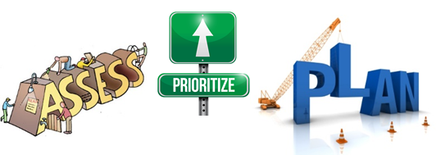
Move to Prioritization or to Another Discussion Guide
If the same group will be conducting another assessment, continue to the next Discussion Guide
Otherwise, move to prioritization
Multi-voting, criteria matrices, or other structured approaches may be helpful
If planning will be done later (e.g., in subsequent weeks), develop the plan to plan – what are the next steps, who is responsible, what is the timeline, etc.
Notes:
The next step is to decide on highest priorities for planning. Whatever approach is used, it is important to review the identified gaps to ensure they cover the most important issues and are actionable, as well as any proposed activities, to ensure that they will be a good basis for work-planning.

Slide 13
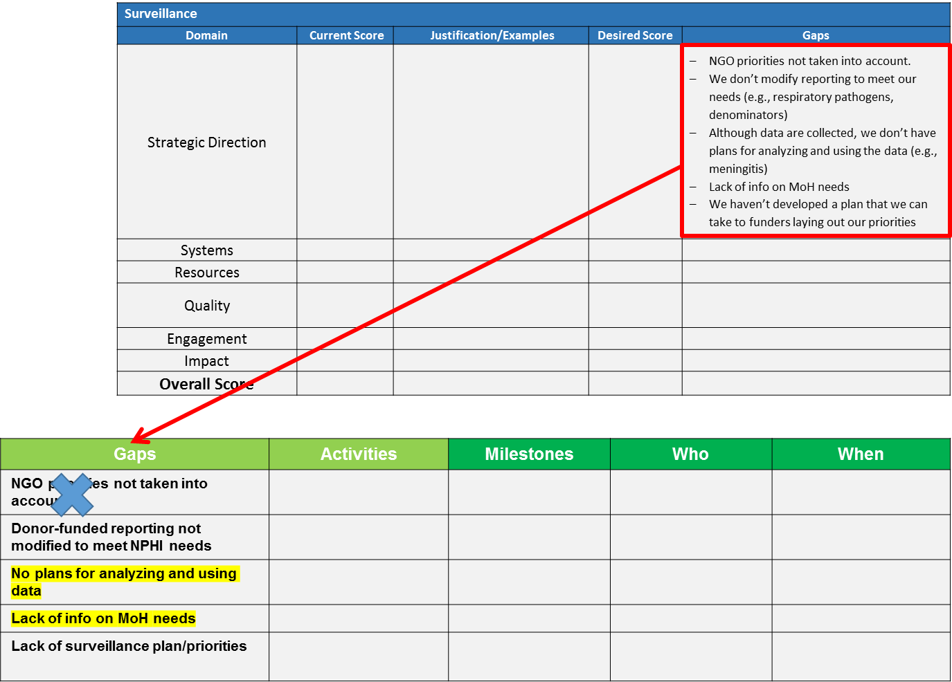
Using Facilitated Discussion to Prioritize
The SDT forms can be used as a basis for discussions about prioritizing gaps
Copy gaps from the Assessment Form to the Work-Planning Form
Highlight high-priority gaps and cross out those of lower priority
If the group is unsure about a gap, revisit it after work-planning for the highest priorities
Review the gaps to make sure they cover the key issues and are actionable
Notes:
The group can either use the SDT forms or another template to record the gaps and indicate which are priorities.
Make sure the list of gaps covers the key issues and that the gaps are “actionable.” An important role of the facilitator is to make sure the gaps identified are the critical ones. For example, often participants will call for activities that are relatively easy, such as distribution of documents or training to address performance issues. However, if the underlying problems are poorly designed systems or too few staff, documents and training will not lead to better performance. Discussions about how to address systems or staffing issues are difficult, but understanding these issues and developing approaches to addressing them is often critical if the NPHI is to achieve its goals. Facilitators should continue to probe until they are satisfied that the gaps identified are the significant ones. Facilitators can make it a point to repeatedly check by asking, “If this gap is addressed, will it solve the problem, or are there other issues to explore?”
In some cases, activities will have been discussed during Assessment. If this is the case, as you prioritize, you will have revisit the proposed activities to make sure that they address the most important gaps and will solve the underlying issues needed to be addressed for the NPHI to move to the next stage.

Slide 14
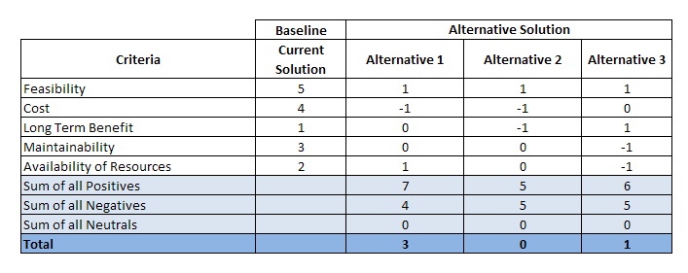
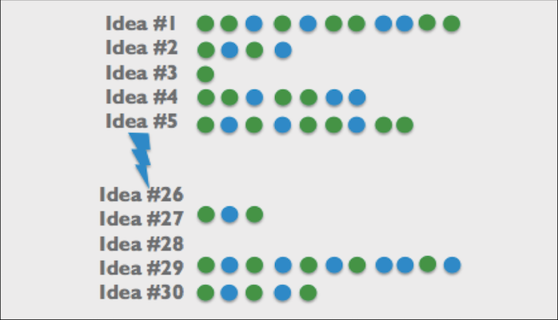
Using Structured Approaches to Prioritize
Structured approaches can be used with the SDT forms or on their own to help with prioritization
Two commonly used approaches are multi-voting and criteria matrices
In multi-voting, each person gets a fixed number of votes to distribute however they want. This allows participants to communicate the “weight” they give to each of the options
A criteria matrix forces the group to identify the characteristics that make something a priority and then to rate each option
Any approach or combination of approaches can be used, as long as they allow all voices to be heard and provide a good basis for work-planning

Slide 15
After Prioritization: Work-Planning
Decide if work-planning will be done immediately following prioritization or later (e.g., in subsequent weeks)
Issues to consider when deciding whether to conduct work-planning immediately after prioritization or at a later time:
Can you get the right people in the room?
Do you have access to the needed information?
Are participants worn out?
If work-planning will not be completed during your visit, agree on next steps and timelines for completing planning
Be clear about the “what, when, and who” for each step, as well as who has overall responsibility to ensure planning is done

Slide 16
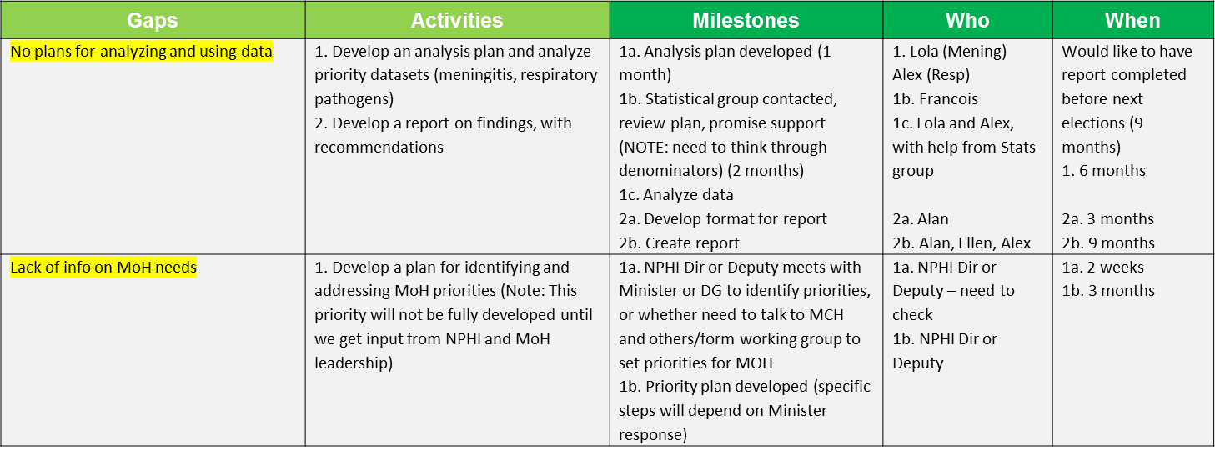
Work-Planning
You can use the SDT forms or another form to specify the “what, when, and who” of the plan
Identify the activities needed to fill the gaps
If you identified activities during Assessment phase, make sure that they address the most important gaps and will solve the underlying issues needed to be addressed for the NPHI to move to the next stage
Make the form work for you; modify it as needed. For example, you can capture timelines under Milestones instead of the “When” column or to record notes and comments
Notes:
Work-planning using the SDT flows directly from the list of priorities identified in the assessment.
Note that the Work-Planning Form is easily adaptable. It is also fine to use other ways to record work plans, as long as they make explicit what will be done, who is responsible, and the timeline.
While you are work-planning, you may identify potential barriers to completing the work-plan that relate to NPHI-wide issues, such as the need for further resource development or enhancing internal communications. Sometimes you can use Discussion Guides to develop plans for these. Even if you can’t address them during the week you are at the NPHI, identifying and understanding them can suggest further work the NPHI leadership should consider.

Slide 17
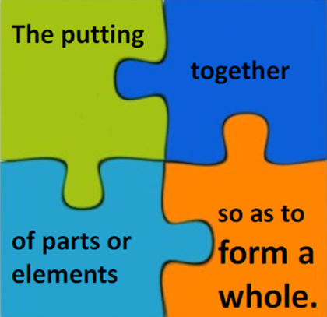
Synthesis
When you have finished work-planning for a topic, review the session
Describe what has happened?
“First we guessed at the stage…”
Note some of the key areas of discussion – where was there agreement? Disagreement?
What did the group produce?
Review the plan
Ask: Will it lead to the desired results?
Review the next steps
Your goal is to leave the participants with a shared sense of what has transpired and confidence in and commitment to their plan

Slide 18
Exit Meeting
On the last day of your visit, if possible, hold an exit meeting with leadership to ensure buy-in
Review the results of the visit, including from the SDT
Results of assessment, prioritization, and planning
If plans were not developed, share next steps and plans for completing planning
Next steps
To complete planning, if not yet complete
For implementation of the plan, if the plan has been completed
Discuss support the NPHI might need to carry out its plans
Technical support
Potential donors
Notes:
The exit meeting is a good opportunity to highlight key achievements from the visit and get leadership commitment to developing or implementing the plan.
Depending on the focus of the planning, the exit meeting might be with the NPHI Director or a senior member of the MOH. This meeting can make the difference between the NPHI following up on next steps and not.
If possible, it is good to develop a one- or two-page summary for the meeting. Since the process is participant-led, some aspects might be best presented by NPHI members.

Slide 19
Good Luck with Planning Using the SDT!
If you have any comments or questions about this material, please contact
CDC’s NPHI Program
nphisdt@cdc.gov
Or
IANPHI
info@ianphi.org

