Slide 1
The Global Field Epidemiology Roadmap A Report of the Meeting held at the Rockefeller Foundation Bellagio Center, June 11-15, 2018 November 2018

Slide 2
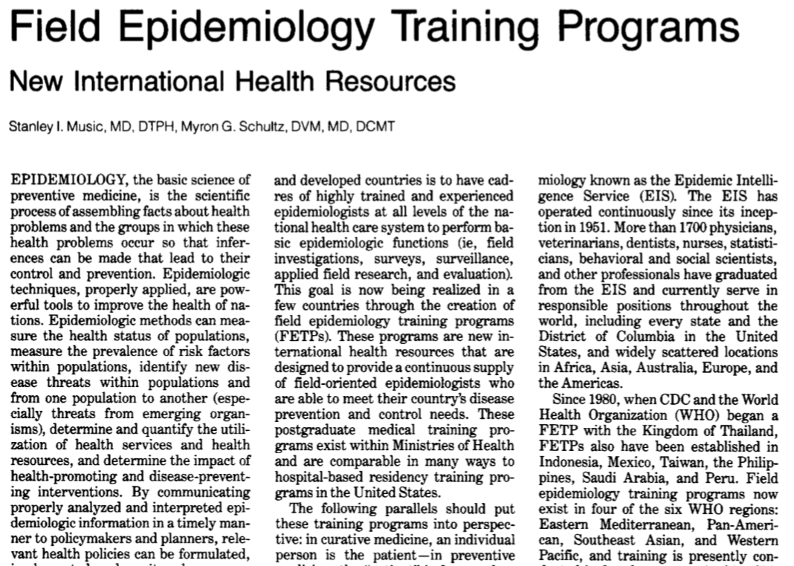
FETPs = Training and service programs, designed to develop field epidemiologists in countries throughout the world
First and largest sponsor: US CDC (EIS model)
Goal: Country-owned, sustained epidemiology capacity
Approach: Training through Service

Slide 3
Goal: Develop a comprehensive roadmap for the global FETP partnership, that will guide all partners as we address current challenges and strengthen our collaboration into the future.
Notes:
TFGH secured support from the Rockefeller Fdn. for a meeting at Bellagio Conference Center

Slide 4
19 Participants, by Agency affiliation
FETPs – Ms. Bracebridge, UK; Dr. Kamaludin, Malaysia; Prof. Kirk, Australia; Dr. Ospina, Colombia; Dr. Reddy, South Africa
REGIONAL NETWORKs – Dr. Al Nsour, EMPHNET; Prof. Tshimanga, AFENET
TEPHINET – Dr. Herrera CDC – Dr. Baggett; Dr. Bloland; Dr. Jafari
ECDC – Dr. Ekdahl
WHO – Oliver Morgan
FAO, UNITED NATIONS – Dr. Kalpravidh
IANPHI – Dr. Koplan
GATES FDN – Mr. Lubinski
DELOITTE CONSULTING – Dr. Stansfield
TASK FORCE for GLOBAL HEALTH – Dr. O'Carroll; Dr. Ross; Ms. Wild
Notes:
Dr. Morgan had to cancel his attendance at the last moment, due to the need to respond to the DRC Ebola outbreak.

Slide 5
We developed our common vision:

Slide 6
Recommendations
Institutionalize Strategic Management – monitor evolving needs, develop options, recommend action to network partners
Develop country-specific epi workforce targets, for each program level (basic, intermediate, advanced)
Accelerate institutionalization: the full integration of FETPs into country PH systems
Develop the framework for cross-border mobilization of FETP fellows and alumni
Improve program quality →expand FETP accreditation process
Assure sustainable funding

Slide 7
Questions?

Slide 8
Functions of the FETP Enterprise
Strengthen public health system
Educate, train, mentor, provide experience
Mobilize to provide mutual assistance
Assure and improve quality
Institutionalize FETPs
Manage projects
Provide accountability
Evaluate impact
Monitor, evaluate impact, conduct operational research
Strategically manage the FETP Enterprise

Slide 9
Recommendation #1
A broadly representative group of key partners and stakeholders should be explicitly tasked with the strategic management function of the FETP enterprise.
The Strategic Management group should be empowered to monitor the need for action and change; consider options; and recommend or take actions.

Slide 10
Recommendations (cont’d)
Identify needed changes in all aspects of the FETP enterprise, and adapt the system incrementally while preserving core principles
Develop country-specific epi workforce targets, for each program level (basic, intermediate, advanced)
Accelerate institutionalization: the full integration of FETPs into country PH systems
Develop the framework for cross-border mobilization of FETP fellows and alumni

Slide 11
Recommendations (cont’d)
Improve program quality → Continue and expand FETP accreditation process
Assure sustainable funding
Develop a compelling, evidence-based narrative to support investment in FETP enterprise
Develop mechanism for private sector contributions
Document the actual costs of the current FETP enterprise;
Improve efficiencies wherever possible

