Slide 1
ECDC actions to strengthen NPHI’s and address gaps in pandemic prevention, preparedness and response in the EU/EEA and beyond
Vicky Lefevre, Public Health Functions Unit, ECDC
Conference of the G20 National Public Health Institutes, September 9th, 2024, Rio de Janeiro, Brazil

Slide 2
EU Health Task Force
ECDC new mandate establishes the EU Health Task Force to provide effective operational response and crisis preparedness support to EU/EEA Member States (MS) and wider global health security
ECDC coordinates the EUHTF with support and collaboration of the European Commission, EU/EEA MSs, EU partners and WHO-GOARN
Pools of experts from: i) ECDC; ii) ECDC Fellowship; iii) external experts
Flexible body, mobilised for remote support as well as rapid in-country field deployment

Slide 3
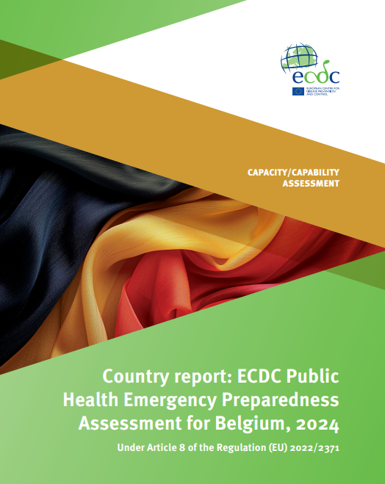
Public Health Emergency Preparedness Assessment Under Article 8 of the SCBTH regulation
“Every three years, the ECDC shall assess the Member States’ state of implementation of their national prevention, preparedness and response plans”
A. IHR-2005 capacities
Capacity 1. | IHR implementation and coordination
Capacity 2. | Financing
Capacity 3. | Laboratory
Capacity 4. | Surveillance
Capacity 5. | Human resources
Capacity 6. | Health emergency management
Capacity 7. | Health service provision
Capacity 8. | Risk communications and community engagement (RCCE)
Capacity 9. | Points of Entry (PoEs) and border health
Capacity 10. | Zoonotic diseases and threats of environmental origin, including those due to the climate
Capacity 11. | Chemical events
B. Additional capacities for EU/EEA MS reported as per article 7 of the regulation
Capacity 12. | Antimicrobial resistance (AMR) and healthcare associated infections (HAIs)
Capacity 13. | Union level coordination and support functions
Capacity 14. | Research development and evaluations to inform and accelerate emergency preparedness
Capacity 15. | Recovery elements
Capacity 16. | Actions taken to improve gaps found in the implementation of prevention, preparedness and response plans
Phase 1 – desk review
Phase 2 – In-country visit
Phase 3 – ECDC assessment report
Phase 4 – MS action plan

Slide 4
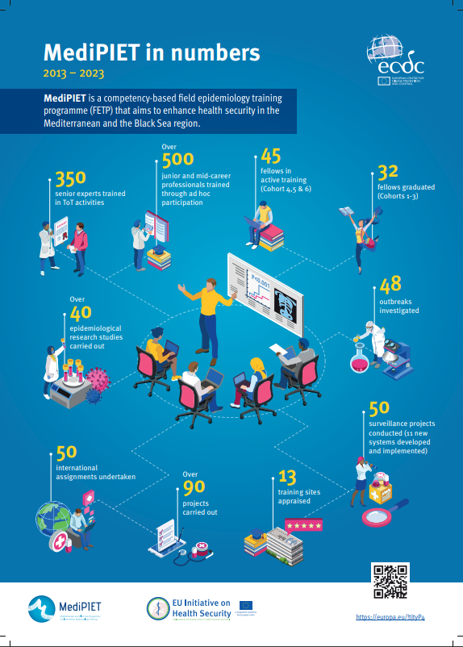
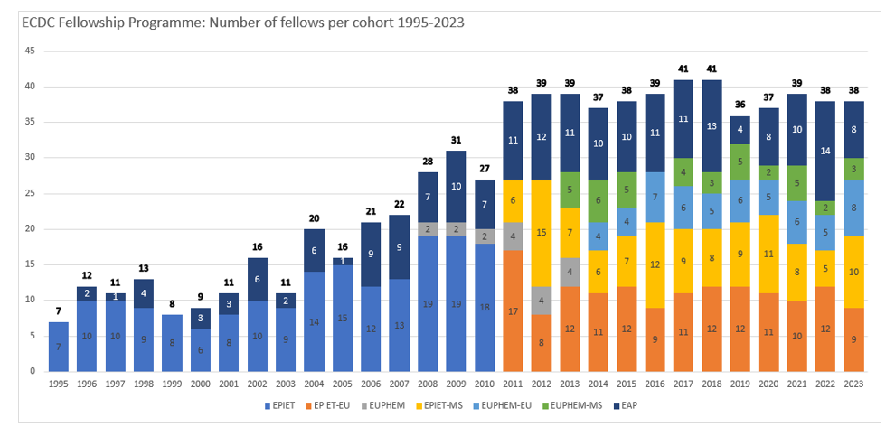
Fellowship training programmes in Field Epidemiology and Public Health Microbiology
Two-year in-service advanced level training
Competency based curriculum
Fellows based in public health settings in partner countries

Slide 5
Emergency preparedness and response training for workforce capacity building
Improve EPR capacities to respond to SCBTH
Targeting mid-career professionals in EU/EEA, West Balkans, and Türkiye
ECDC Preparedness cycle
5
5
each edition
editions
months
One-week face-to-face training
14 weeks remote online activities
2005 2026 2027
Notes:
With this training we aim to improve EU/EEA, West Balkans, and Türkiye’s capacities to respond to SCBTH, supporting the development of a common language and cooperation in Emergency Preparedness and Response.
The target audience is mid-level on-the-job health professionals currently employed in public health organisations and Ministries of Health within the EU/EEA Member States, Western Balkans, and Türkiye.
There will be a total of 5 editions between 2025-2027.
Each edition lasts 5 months, with a one week in-person meeting and online work the rest of the time. A maximum of 30 trainees will be accepted onto each edition.
The curriculum/content covers the entire ECDC Preparedness cycle, with main topic areas:
Introduction to EPR: Overview of the training curriculum, key terminology, global EPR frameworks, and the ECDC EPR cycle.
Health System Strengthening in the Context of EPR: Essential EPR concepts, strategic and operational planning, and integration of Health System Strengthening with emergency frameworks.
EPR Planning: Legal and financial preparedness, risk assessment, stakeholder analysis, and cross-sectoral coordination for effective emergency planning.
EPR Response (Part I): Rapid risk assessments, resource management, and community engagement during an emergency response (Part II): Operational research, non-pharmaceutical interventions, and medical countermeasure management.
EPR Recovery: After action reviews, post-event evaluations, health systems strengthening after a crisis, adaptation of plans and strategies
This 112-hour programme spans five months and it employs a blended learning approach, combining a one-week face-to-face training with 14 weeks of remote online activities.

Slide 6
GenEpi-BioTrain: Cross-border capacity-building support programme in genomic epidemiology
Objectives:
Support countries in building up their capacity in genomic epidemiology and bioinformatics for public health
Increase the interdisciplinary collaboration between bioinformaticians, epidemiologists and microbiologists
Facilitate the routine use of genomic information for surveillance, preparedness and outbreak investigations
Consortium includes DTU & SSI (DK), Institut Pasteur (FR), Research Center Borstel (DE), THL (FI), Karolinska (SE)
Trainings are divided into “pathogen waves”
Notes:
Training target groups:
Professionals working in public health institutions with a background in computational biology/bioinformatics
Professionals working in public health institutions who do not have a specific background in bioinformatics (i.e. microbiologists, epidemiologists, professionals in public health response and surveillance)
Training activities:
Face-to-face trainings for beginners & advanced bioinformaticians and interdisciplinary trainings
Face-to-face trainings on specific topics (depending on training needs/interests)
Exchange visits for bioinformaticians
Open virtual training sessions on ECDC Virtual Academy (https://eva.ecdc.europa.eu/)
Pathogen waves are decided based on interests from Member States
Very successful:
For wave 1, ECDC received ~300 applications from 27 countries
For wave 2, ECDC received ~270 applications from 25 countries

Slide 7
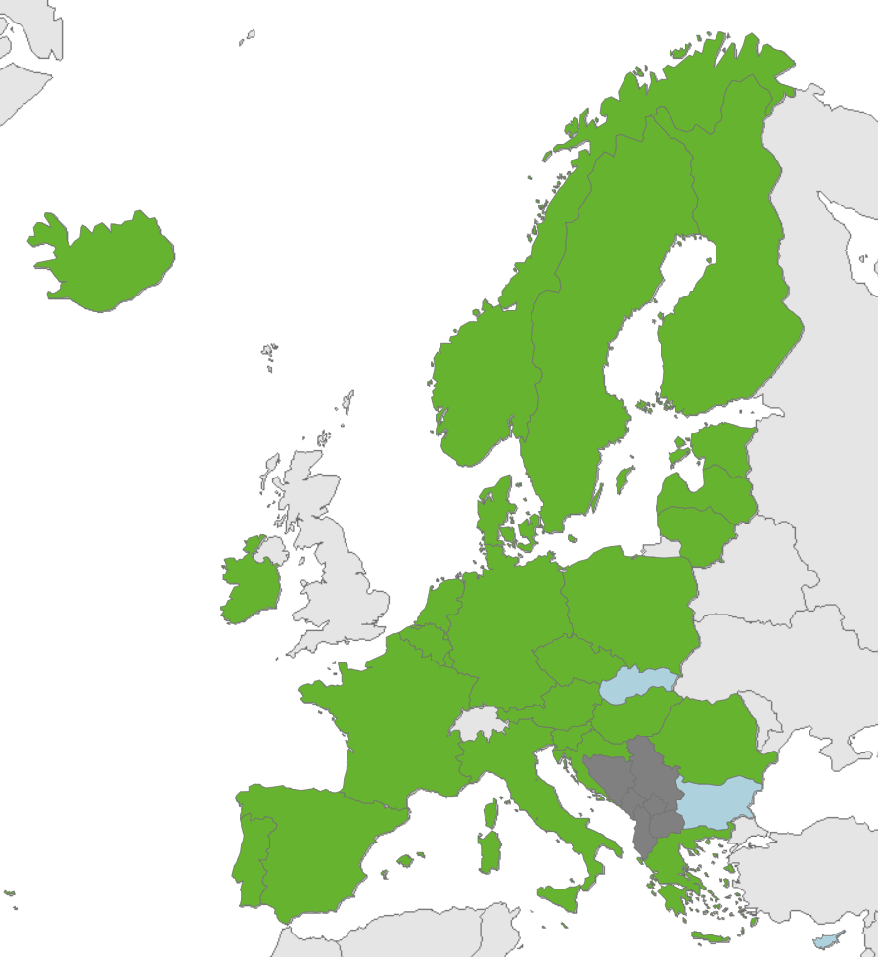
National WGS infrastructure support programmes 2021 & 2022
Aim: Supporting activities via the award of grants for action that directly lead to enhanced and/or improved national public health WGS and/or RT-PCR capacity
Implemented as a grant schemes, first by ECDC and then by the European Commission
In 2021, ECDC allocated 77.1 M EUR to 24 national projects (under HERA Incubator)
In 2022, the European Commission allocated 39 M EUR to 21 national projects, a majority of which were follow-up grants to the 2021 projects

Slide 8
Laboratory support: EU Reference laboratories (EURLs) for public health
Will provide support to national public health laboratories to promote good practice and alignment by Member States on diagnostics, testing methods, use of certain tests for the uniform surveillance, notification and reporting of diseases
Set up by European Commission in collaboration with ECDC
EURLs will be integrated into disease / laboratory networks operated by ECDC
ECDC will also set up and coordinate a network of EURLs for public health
Collaboration is being established with WHO and their relevant reference laboratories
First six EURLs for public health formally designated on 22 March 2024
Designation of second set of EURLs expected by end of 2024
Will be gradually designated over a number of years
Neither operationally nor financially feasible to implement all EURLs in one year
ECDC laboratory support will be gradually transitioned to EURLs

Slide 9
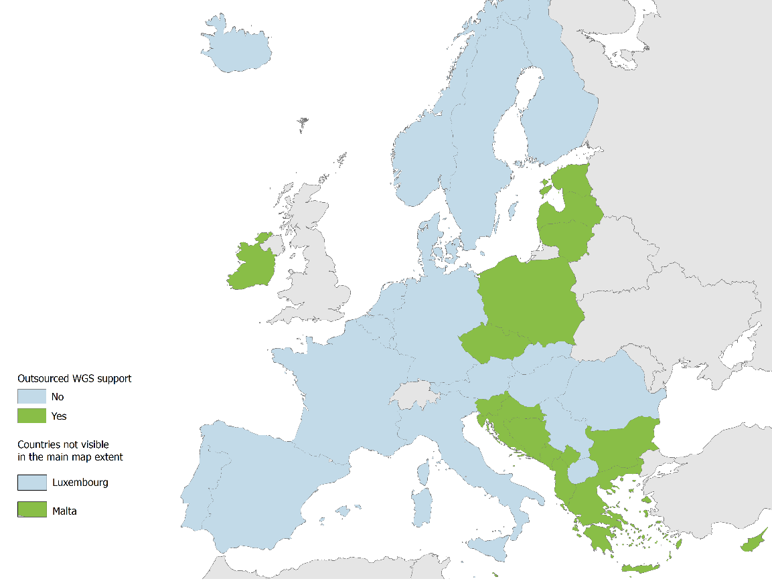
Access to WGS support through outsourced laboratory service
High-capacity SARS-CoV-2 sequencing support has been provided to EU/EEA countries and Western Balkans through access to a WGS service contract
Since Feb 2021, over 250,000 SARS-CoV-2 samples have been sequenced from 12 EU/EEA countries and 4 Western Balkans
WGS support is also provided for other pathogens during multi-country outbreak investigations and for other relevant objectives

Slide 10
EpiPulse - EU surveillance portal for infectious diseases
EpiPulse Events
Event-based surveillance
Notification of outbreaks and events (Member States, third countries)
Documentation of signals, events and threats (ECDC)
EpiPulse CDTR
Report production, clearance and publication
Communication to stakeholders (ECDC, outputs accessible to selected users)
EpiPulse Cases
Indicator-based surveillance
Notification of communicable disease cases or isolates (Member States, some third countries)

Slide 11
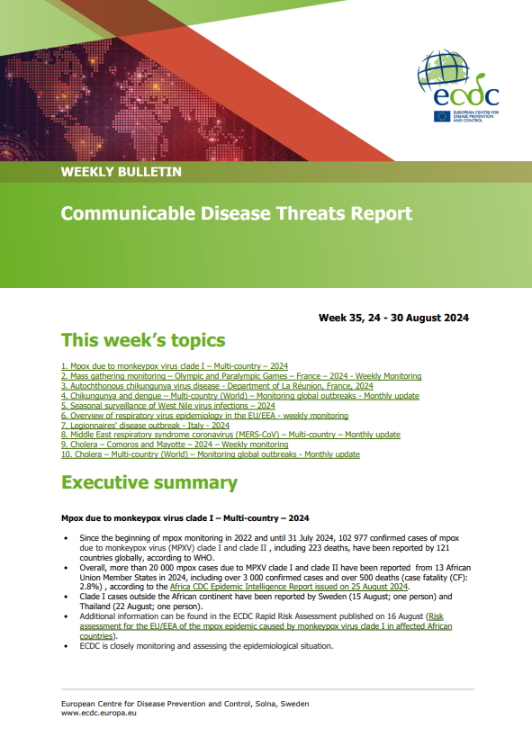
Epidemic Intelligence

Slide 12
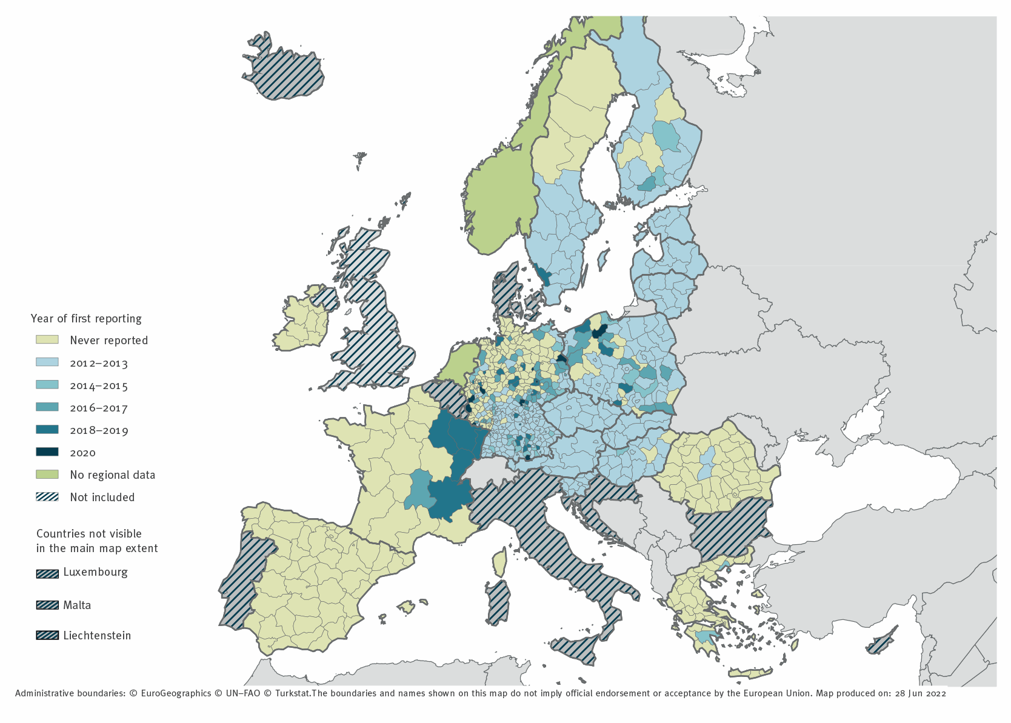
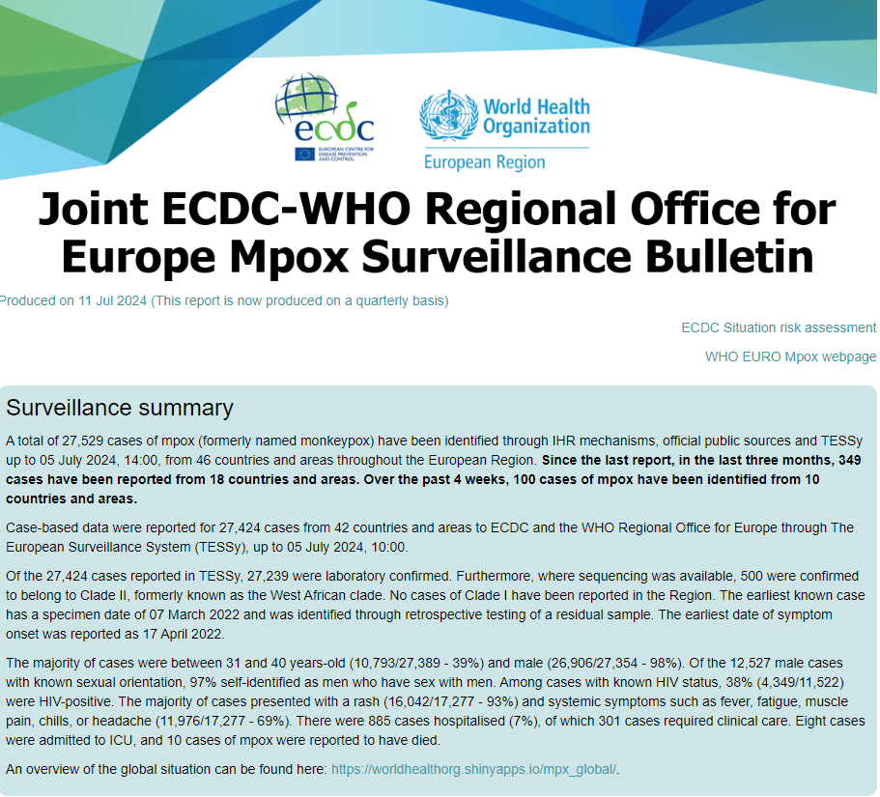
EU/EEA indicator-based surveillance
Disease trends and burden
Multi-country outbreak detection and assessment
Risk factors for infection and severity
Evaluation of interventions
Tick-borne encephalitis cases by year of first reporting, EU/EEA countries, 2012–2020
Surveillance objectives should add value at EU/EEA level

Slide 13
ECDC eHealth programme – SUREHD project
Design and implementation of multinational surveillance systems using routinely collected electronic health records in EU/EEA
EHR-SARI 2022-2026 (16 countries)
EHR-BSI 2023-2026 (17 countries)
EHR-STI 2024-2026 (10 countries)
Developing EHR-based case definitions/proxy case definitions
Producing generic and country-specific EHR-based surveillance protocols
Informing updates in surveillance metadata and reporting protocols
Improving sensitivity, timeliness, and representativeness of the surveillance systems
June 2022 Sep 2022 2023 2024 2025
Sexually Transmitted Infections
eHealth Framework contract
SARI
Bloodstream infections
EHR-SARI
EHR-BSI
EHR-STI

Slide 14
HealthData@EU Pilot - ECDC Use Case
European Health Data Space (EHDS)
Primary Use (MyHealth@EU)
Data use for healthcare delivery
Secondary Use (HealthData@EU)
Data use for public health surveillance and research
Common requirements
Single market for interoperable EHR systems
ECDC Use Case [HealthData@EU Pilot]
Belgium
Finland
Croatia
AMR Data
AMR Data
AMR Data
EHDS Secondary use (HealthData@EU) architecture:
Network of federated nodes;
Services for electronic health data access and use;
ECDC Use Case:
Assess feasibility of this architecture to support ECDC public health surveillance activities;
Focusing on AMR surveillance data reporting and analysis;
Assess legal challenges and technological tools;
Test federated data access and analysis;
SPE
Node
Data
Holder
SPE
Node
Data
Holder
SPE
Node
Data
Holder
Data
User
Data discoverability and secure processing environment
Federated data access and analysis
Notes:
EHDS main components
The European Health Data Space (EHDS) is a central component of the European Health Union.
The EHDS aims to promote health data exchange and support research and innovation.
The EHDS will become both a legal framework of trusted EU and Member State governance mechanisms as well as a system for health data exchange and access, governed by common rules, procedures, and technical standards.
The EHDS has been designed to facilitate the cross-border exchange of both health data for primary (cross-border health provision) and secondary purposes (research and public health).
The EHDS includes three main elements:
-‘MyHealth@EU’ means the cross-border infrastructure for primary use of electronic health data formed by the combination of national contact points for digital health and the central platform for digital health;
- ‘HealthData@EU’ means the infrastructure connecting national contact points for secondary use of electronic health data and the central platform;
- ‘Common requirements’ for EHR systems, which will define the specifications and standards for setting an interoperable EU single market for EHR systems.
EHDS Secondary use (HealthData@EU) architecture
This architecture comprises a network of federated nodes of organisations providing services for health data access and use.
These services are used by data users, organisations or individuals using data, such as public or private research organisations.
The nodes are linked to several data holders, organisations responsible for maintaining data, such hospitals, that have generated data when delivering healthcare.
Nodes also provide secure data processing environments for health data analysis.
​
ECDC Use Case on AMR Surveillance
Two-year (2023 - 2024) use case incorporated in the HealthData@EU pilot, that intends to test the proposed EHDS infrastructure for the secondary use for public health surveillance purposes;
The ECDC Use Case intends to demonstrate the feasibility of this infrastructure to carry out or complement EU/EEA-level AMR surveillance;
In this Use Case, ECDC has worked as a data user testing AMR data discoverability (AMR data holders in each country provide data to its national node) and federated analysis of AMR data in three country-level nodes (Belgium, Croatia, Finland).
-------​
Supplementary glossary
Secure processing environment​
Secure data processing environment fulfilling appropriate requirements to process sensitive personal data. Computing resources may be independent trusted computing nodes or controlled by a node, data provider (register controller) or the data consumer organisation. For example, when federated learning is enabled the computation resource is closely linked with the data provider. ​
Data holder
Organisation responsible of maintaining the original data. This can be any type of data provider having data resources related with the health and wellbeing of an individual. Most typically: data generated in healthcare delivery and social services processes, health and social sciences research, data extracted from biosamples (biobank data) and self-generated data (e.g., recorded by personal devices or personal health services. The “data provider” in the overall architecture may also refer to a “data partner” managing one or more original data sources under contract with their data controllers. ​
(EHDS) Node​
An organisation providing processes and functions needed to enable secondary use of data as defined be the EHDS. The node provides interconnected services supporting various functions for data access (see ”high-level service process”). Depending on future definitions to be made (not in the scope of WP7) there maybe one node per country or less or more. Also depending on future definitions (not in the scope of WP7) the network of nodes can be a true peer-to-peer network or there may be one master node for centralized functions. ​
​Data user
Organisation using the EHDS data. For example, a public research organisation (university, university hospital, research institute), other public organisation, not-for-profit 3rd sector organization or a private company. ​
Data subject​
Identifiable natural person whose data is used. As identified by the GDPR, identifiable natural person is one who can be identified, directly or indirectly, in particular by reference to an identifier such as a name, an identification number, location data, an online identifier or to one or more factors specific to the physical, physiological, genetic, mental, economic, cultural or social ​

Slide 15
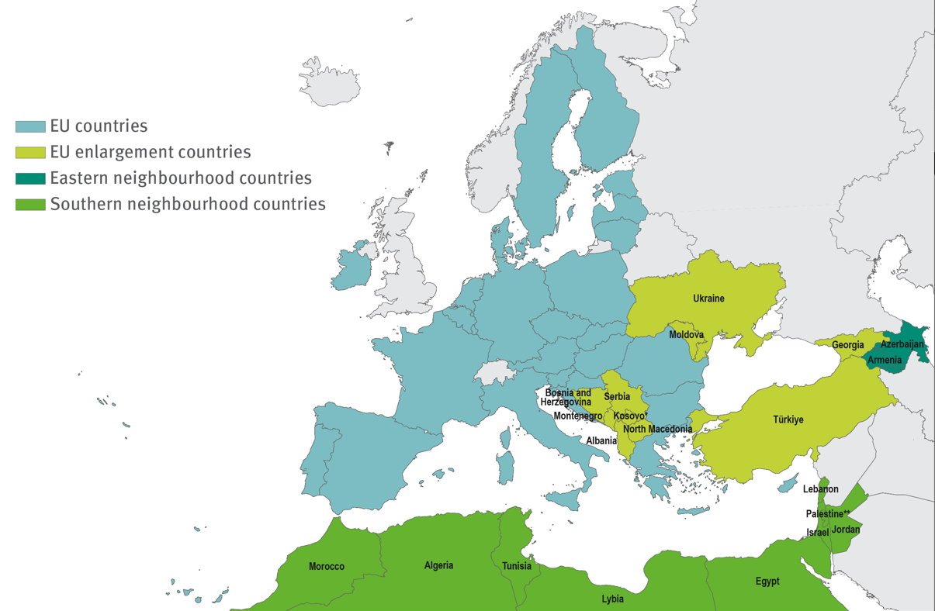
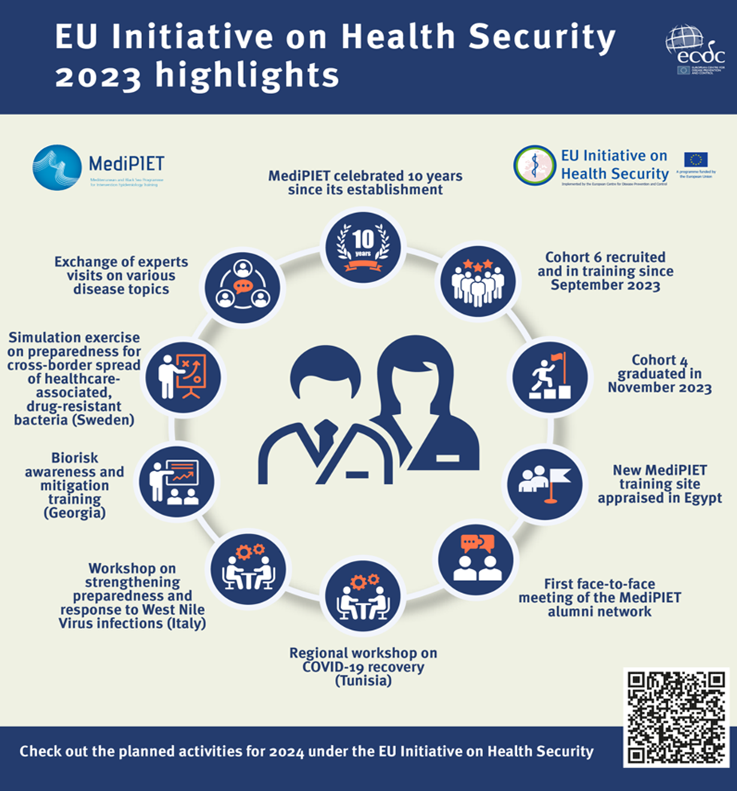
Health security strengthening with NPHIs in EU candidate countries and European Neighbourhood Policy countries
Instrument for Pre-Accession Assistance (DG NEAR)
EU Initiative on Health Security (DG NEAR)

Slide 16
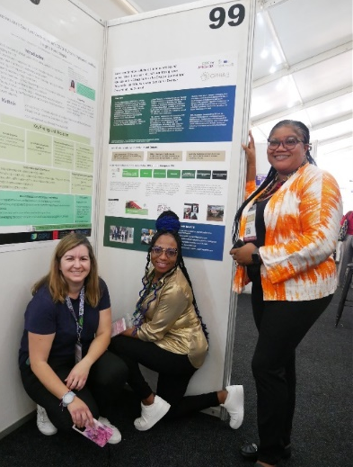
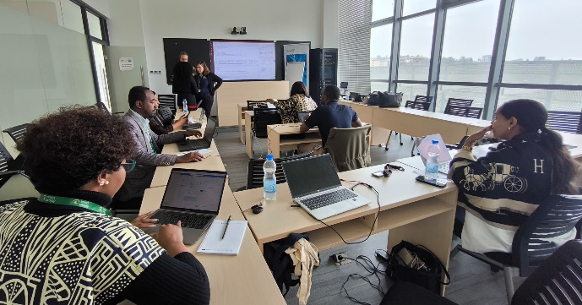
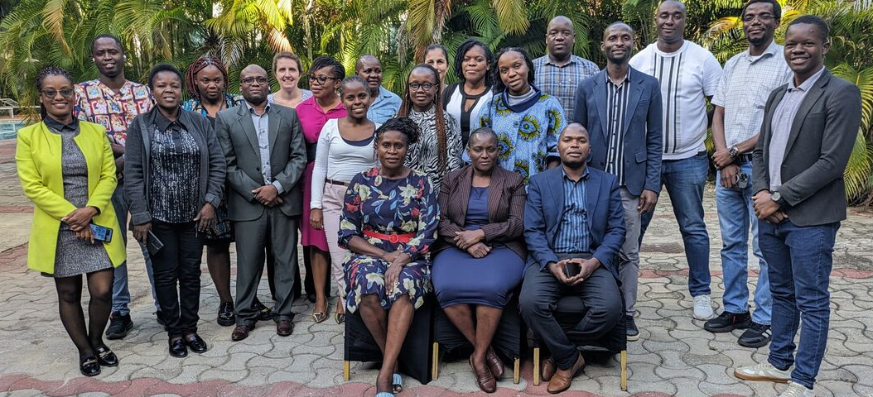
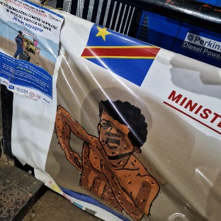
Africa CDC - ECDC partnership
Preparedness and response
Epidemic intelligence
Surveillance
Workforce development
Deployments
Notes:
Duration: 48 months, 2021 – 2024 (to be extended to April 2026)
Overall aim: to contribute to health security in Africa by sharing EU practices and strengthening Africa CDC to respond to health threats posed by communicable diseases
Funding authority: Directorate General for International Partnerships (DG INTPA)
Apart from the strategic collaboration, the last year we engaged in operational activities and had experts deployed for outbreak response (cholera, mpox)
Preparedness and response activities:
-Simulation exercises
-In and after action reviews
-Risk ranking development of methodology, development of risk-ranking tool, Delivery of regional implementing workshops and train-the-trainer workshops
-Public Health Emergency Management Fellowship
Epidemic intelligence
-Development of tools/guidelines (e.g. risk assessments)
-Expanding digital health (data analytics platform)
-Foster information-sharing (monitoring events of interest, R trainings)
Surveillance
-Mapping of supranational indicator-based surveillance, relying on clinical / laboratory data
-Supporting ACDC Development of region-specific HAI definition
-Development of list of key indicators for AMC and dashboard for antimicrobial consumption (AMC)
Workforce development
-Mapping FETPs
-Learning Management System
-Africa Epidemic Services
-Scientific writing webinars

Slide 17
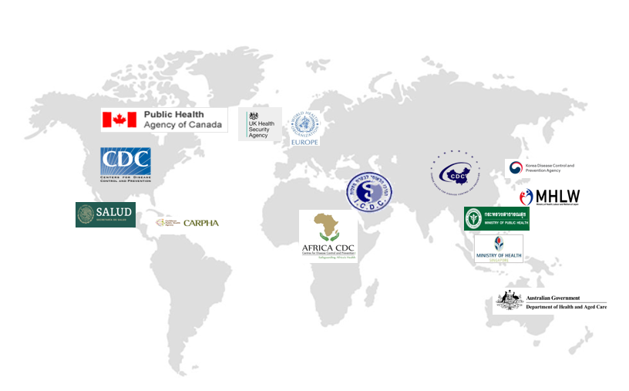
Collaboration with international partners

Slide 18
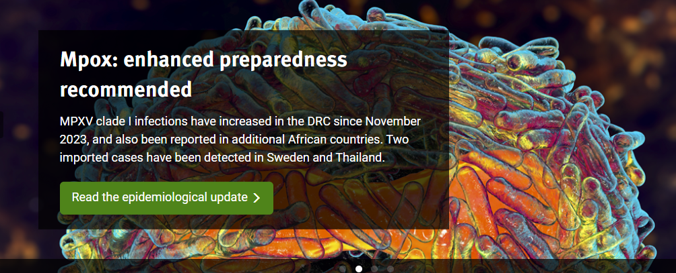
Thank you

Slide 19
Overview ECDC actions to strengthen NPHI’s and address gaps in pandemic prevention, preparedness and response in the EU/EEA
EU Health Task Force (EUHTF)
Public Health Emergency Preparedness Assessments (PHEPA)
ECDC Fellowship Programme
Emergency preparedness and response training for workforce capacity building
GenEpi-BioTrain: Cross-border capacity-building support programme in genomic epidemiology
National WGS infrastructure support programmes
Network of EU Reference Laboratories
EpiPulse - EU surveillance portal for infectious diseases
Epidemic Intelligence for Global Screening
ECDC eHealth programme – SUREHD project
HealthData@EU Pilot – ECDC Use Case European Health Data Space
International collaboration and partnerships

Slide 20
Overview actions for strengthening surveillance
Updated legal framework (SCBTH and mandate)
Development of surveillance standards and evaluation
eHealth-based surveillance for SARI, HAI, and STI
Building of WGS infrastructures and bioinformatic training
Leveraging COVID-19 developments (reporting of lab detections)
EU initiatives
HealthData@EU (EHDS)
Joint Action United4Surveillance
National Grants for Surveillance

