Slide 1
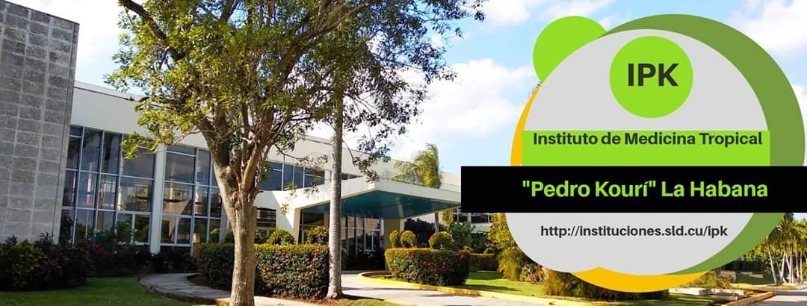
National perspectives on NPHI’s and health emergencies
ROLE OF THE INSTITUTE OF TROPICAL MEDICINE PEDRO KOURI (IPK) IN CONFRONTING HEALTH EMERGENCIES
Dra. Vivian Kourí Cardellá, PhD, DrCs
Director IPK
vkouri@ipk.sld.cu

Slide 2
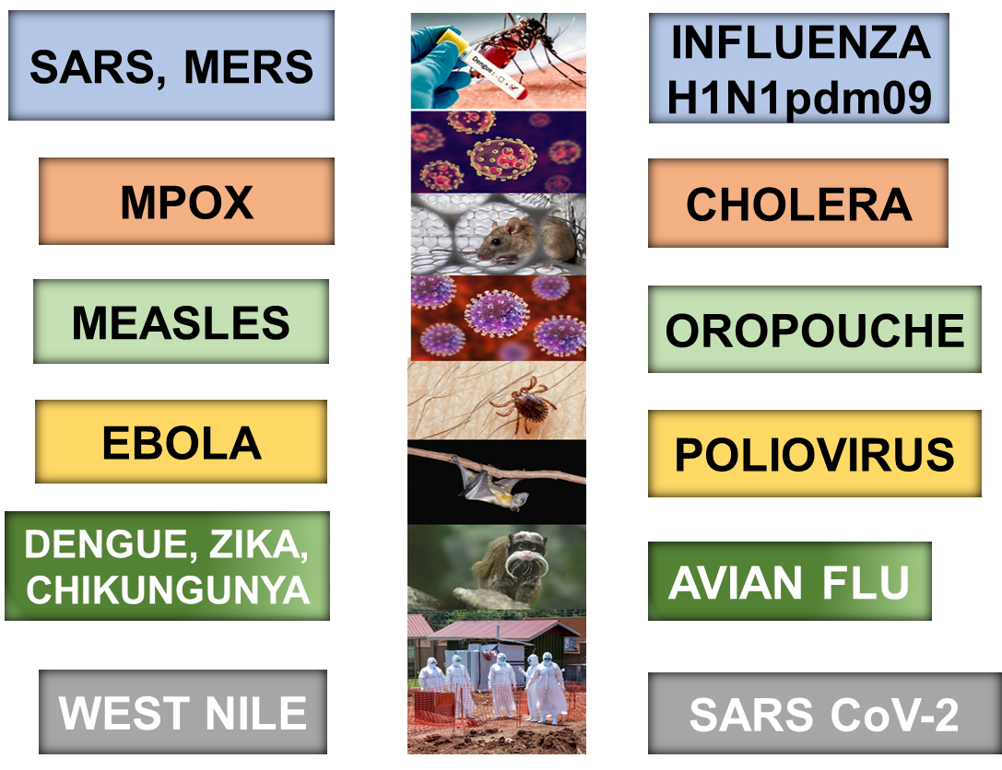
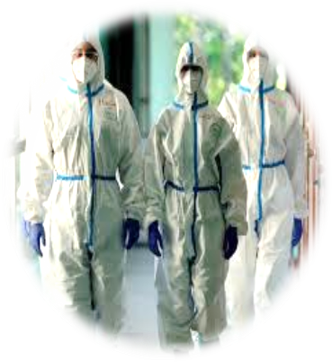
EPIDEMICS AND PANDEMICS.
XXI CENTURY
THE NEW PANDEMIC PATHOGEN??
DISEASE X
Notes:
Epidemics and pandemics have become more frequent in recent decades. In the 21st century alone, there have been emerging and re-emerging diseases such as SARS, MERS, Zika, Dengue, Chikungunya, Cholera, Influenza, and many others.
Recently, we have witnessed the rapid spread and devastating impact of new viruses, highlighting the need for advanced response strategies. The COVID-19 pandemic will be a defining event in history. Moreover, in 2022 and 2023, new emergencies such as Mpox, Avian Influenza, polio, and equine encephalitis have been added to the list.
Las enfermedades transmisibles afectan desproporcionadamente a las comunidades con recursos limitados y se vinculan con una compleja variedad de determinantes de la salud que se superponen, como la disponibilidad de agua potable y saneamiento básico, las condiciones de la vivienda, los riesgos del cambio climático, las inequidades por razones de género, los factores socioculturales y la pobreza, entre otros.

Slide 3
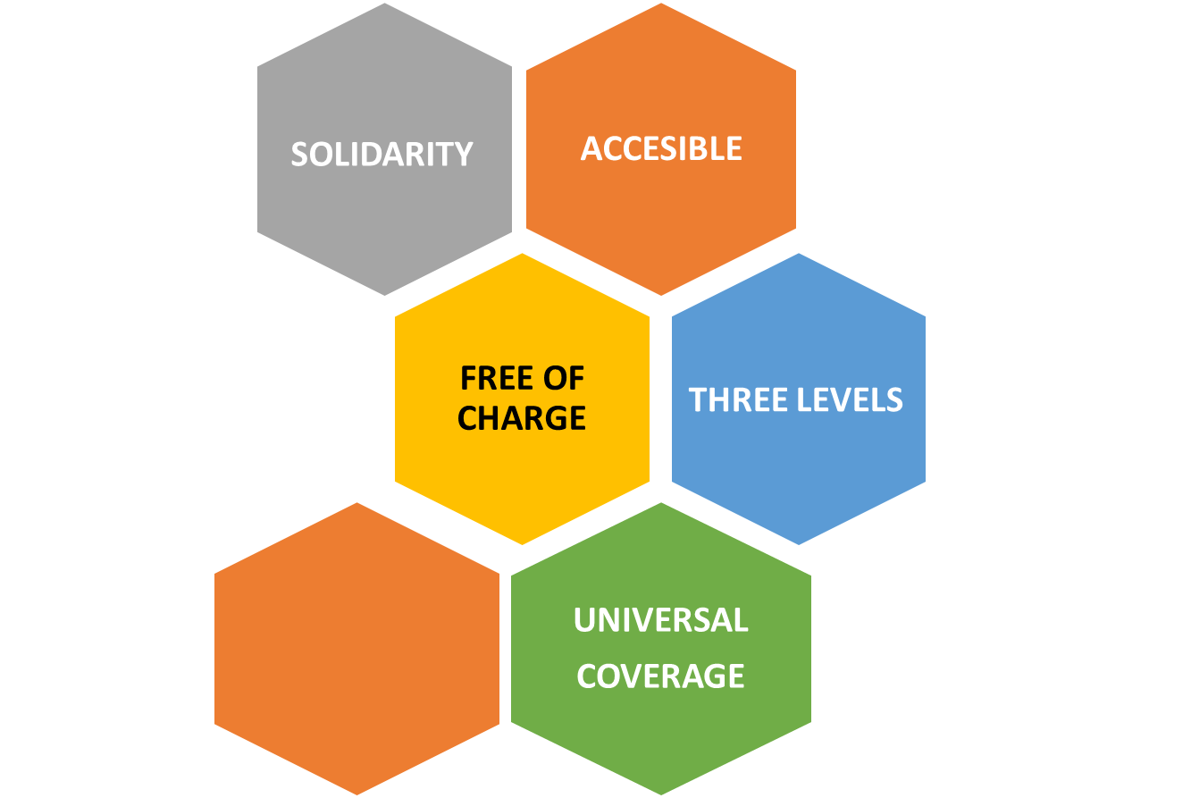
NATIONAL HEALTH SYSTEM IN CUBA

Slide 4
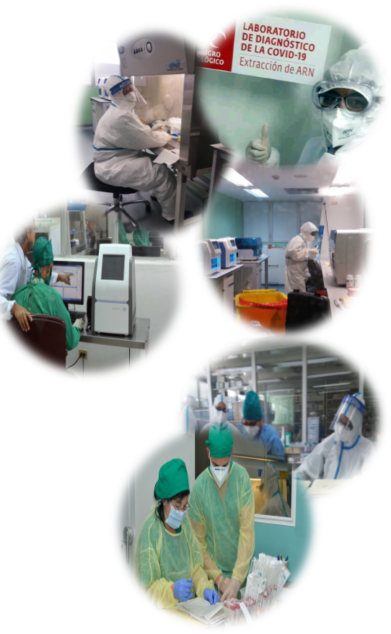
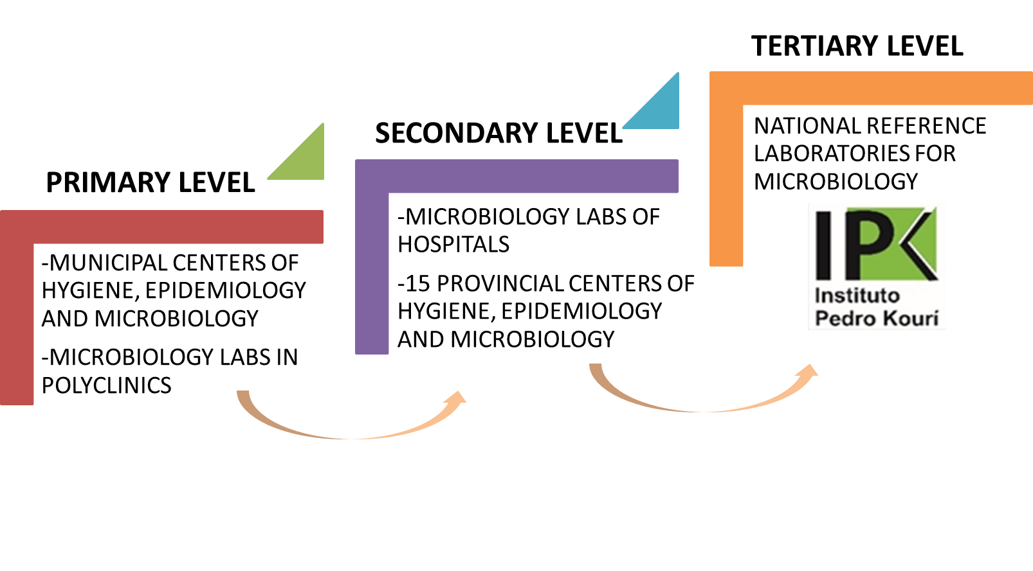
MYCROBIOLOGY NETWORK
MOLECULAR BIOLOGY NETWORK
ENTOMOLGY NETWORK
MYCROBIOLOGY LABORATORIES IN CUBA
Notes:
The National Health System in Cuba comprises a network of healthcare institutions. It is organized into three levels of healthcare primary, secondary and tertiary level. In this same mode the laboratory network of microbiology labs has been organized, from primary level, which includes the municipal centers of H, E, M and polyclinics, the secondary levels with hospitals and provincial centers of HEM and the tertiary level, with the National Reference Laboratories for microbiology, located at IPK
Additionally there are two more networks, the Molecular microbiology and entomology, which follow the same mode of organization
The Ministry of Public Health is represented at the municipal, provincial, and national levels.

Slide 5
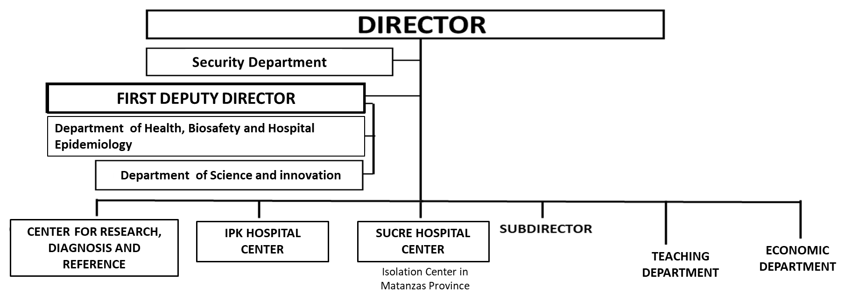
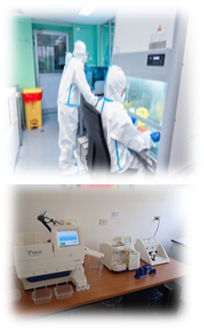
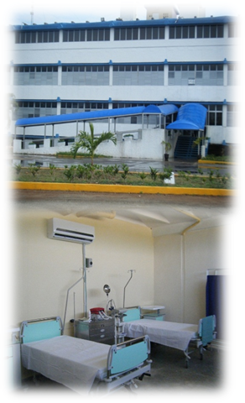
3 CENTERS

Slide 6
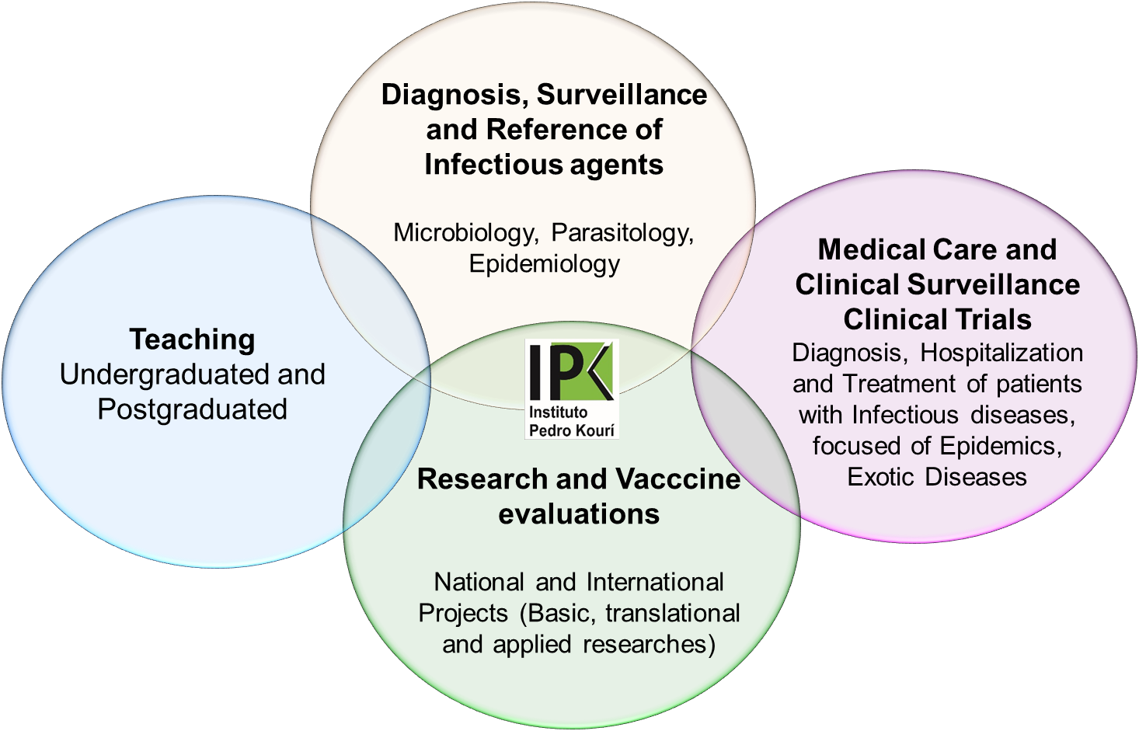
MAIN ACTIVITIES OF IPK
Notes:
IPK is a tertiary level health institution. The misión of the institution is to Contribute to improving the quality of life of the Cuban population and the rest of the international community, offering fast, specialized and high-tech services in research and innovation, diagnosis, medical care, teaching and epidemiological surveillance; with the aim of prevention, control and elimination of infectious diseases
Para alcanzar este objetivo, la institución integra las actividades de vigilancia y diagnostico de agentes infecciosos que afectan a la población cubana y aquellos con potencial pandémico, con la atención medica especializada en enfermedades infecciosas, las investigaciones y la formación continua de profesionales de la salud.
It has a Center for research, diagnosis and reference and two hospital Centers, one located at IPK for patients with infectious diseases and other Isolation center for asymptomatic individuals that need to be quarantine during pandemic or epidemic settings

Slide 7
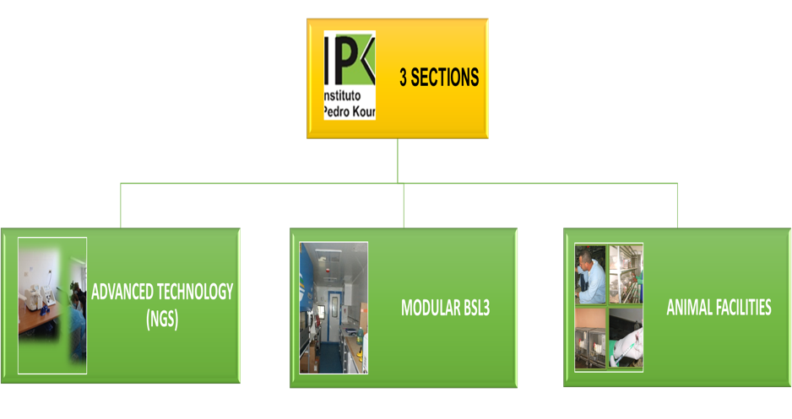
NATIONAL REFERENCE LABORATORIES (NRL)
7 DEPARTMENTS
23 NRL: Surveillance, Reference and Specialized Diagnosis of Pathogens
ACCREDITED BY WHO-PAHO
TWO WHO COLLABORATOR CENTER: FOR DENGUE AND FOR TB

Slide 8
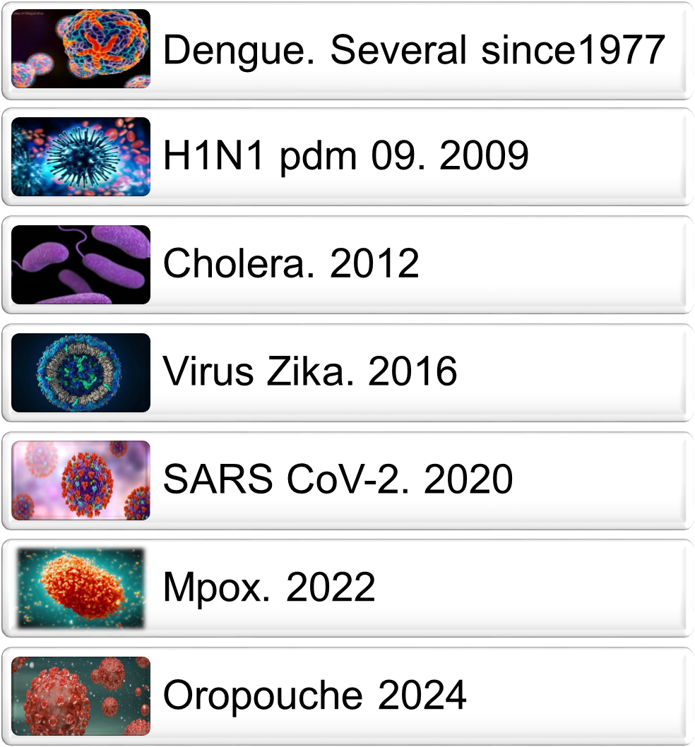

Slide 9
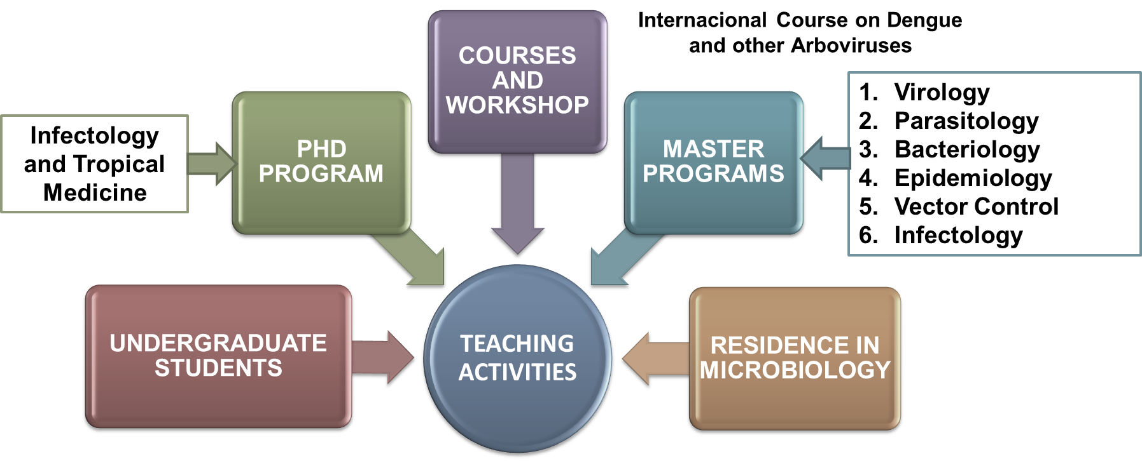
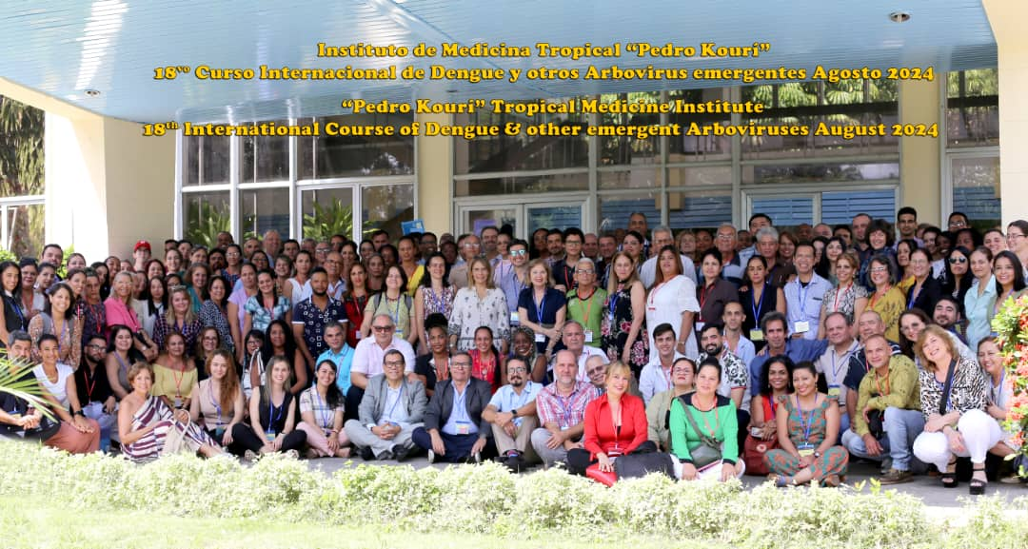
TEACHING ACTIVITIES
Since 1979 - 2024
93 514 TRAINED PROFESSIONALS FROM 115 COUNTRIES

Slide 10
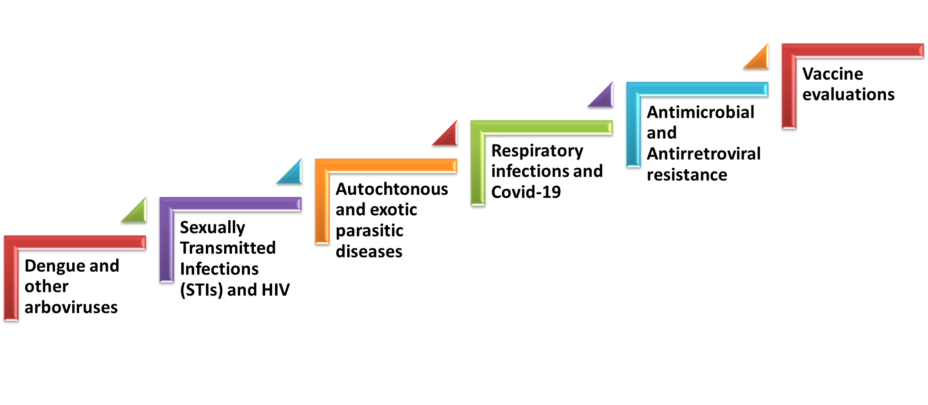
MAIN LINES OF RESEARCH
DEVELOPED THROUGH RESEARCH PROJECTS ACCORDING TO MAJOR HEALTH PROBLEMS
NATIONALS
72
INTERNATIONALS
13
WHO, Universities, EU, NIH, AFD, other agencies

Slide 11
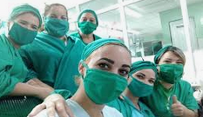
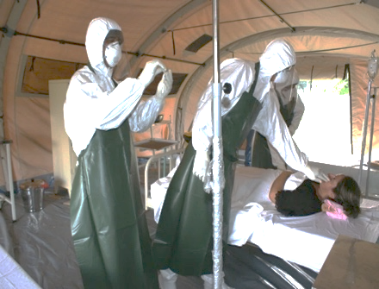
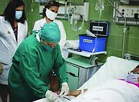
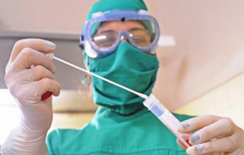
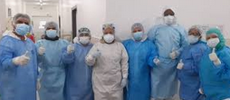
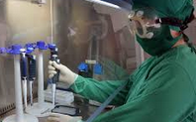
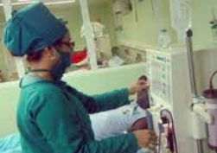
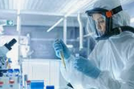
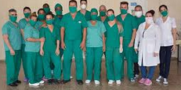
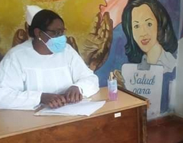
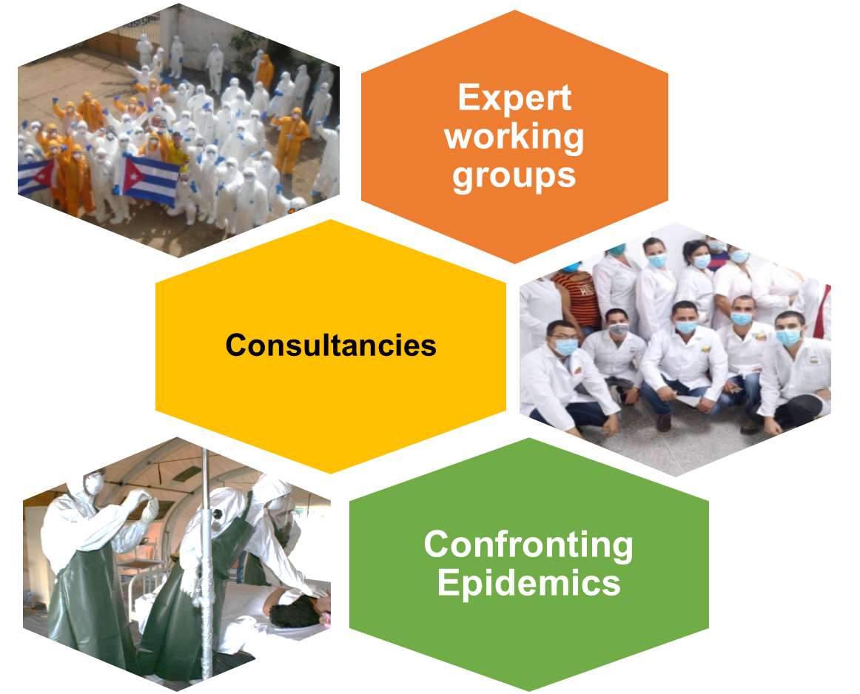
GLOBAL COOPERATION
IPK professionals in Expert Groups: WHO, PAHO, TDR, IANPHI
Training of Cuban doctors who served during the Ebola outbreaks
IPK personnel provided collaboration in medical care, diagnosis and epidemiological surveillance during the COVID-19 epidemic

Slide 12
IPK IN THE FIGHT AGAINST COVID-19

Slide 13
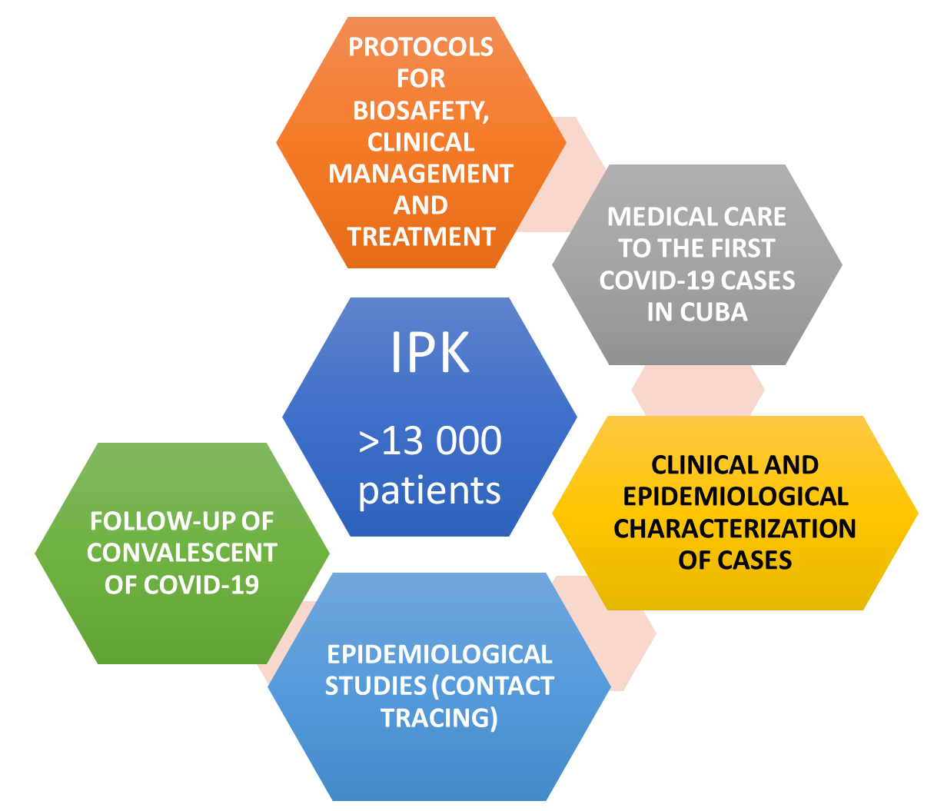
IPK HOSPITAL DURING COVID-19

Slide 14
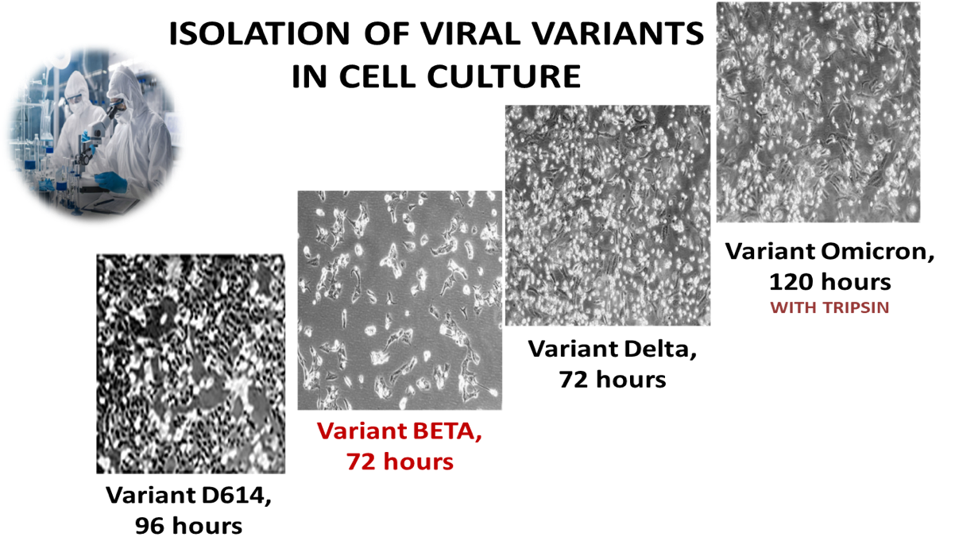
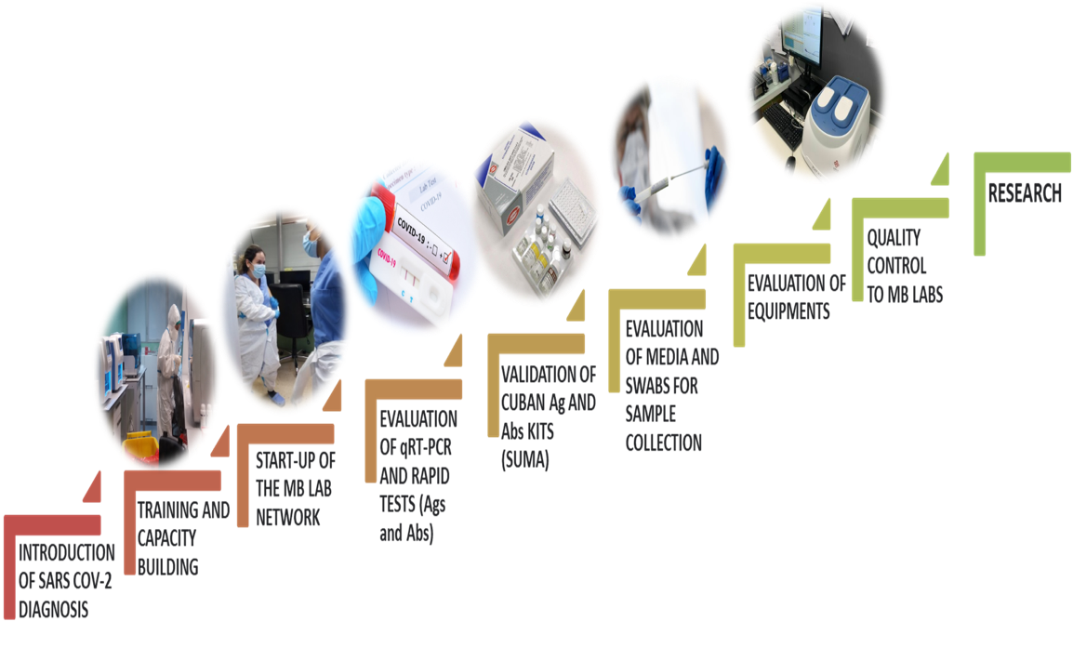
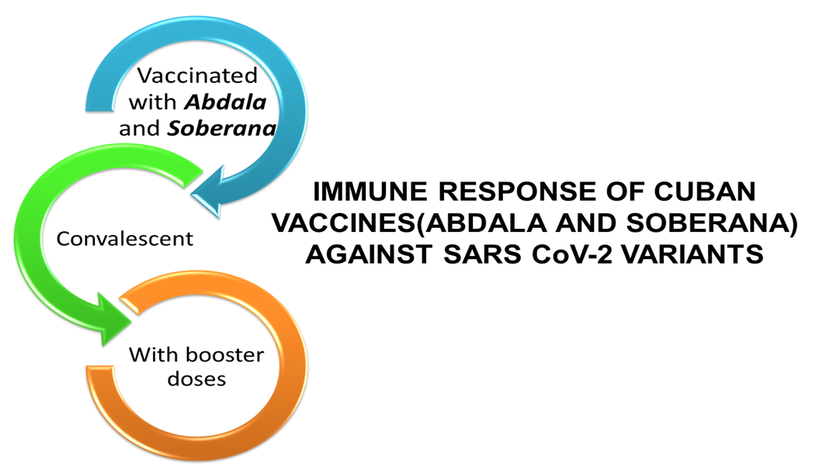
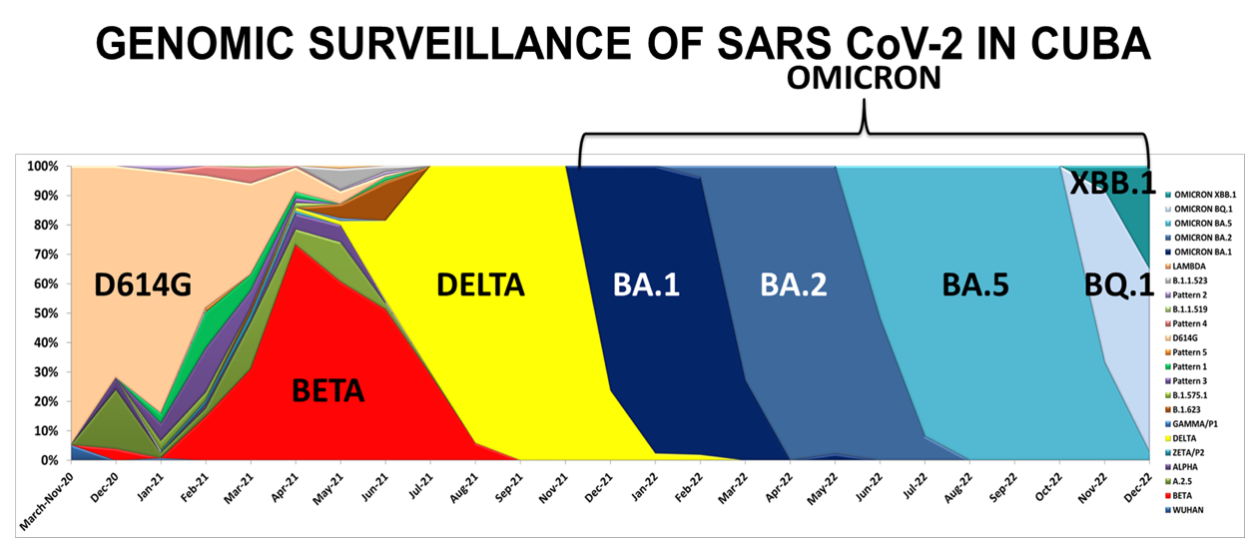
NATIONAL REFERENCE LABORATORY. IPK
DIAGNOSIS, SURVEILLANCE AND REFERENCE
Notes:
Se han estudiado, mediante secuenciación nucleotidica (gen S) del SARS CoV-2 , 1917 muestras
Identificadas 18 variantes, incluidas las 5 VOC y la cepa Wuhan
En 2020 D614G
En 2021 PREDOMINIO DE D614G, BETA, DELTA, OMICRON
En 2022 OMICRON

Slide 15
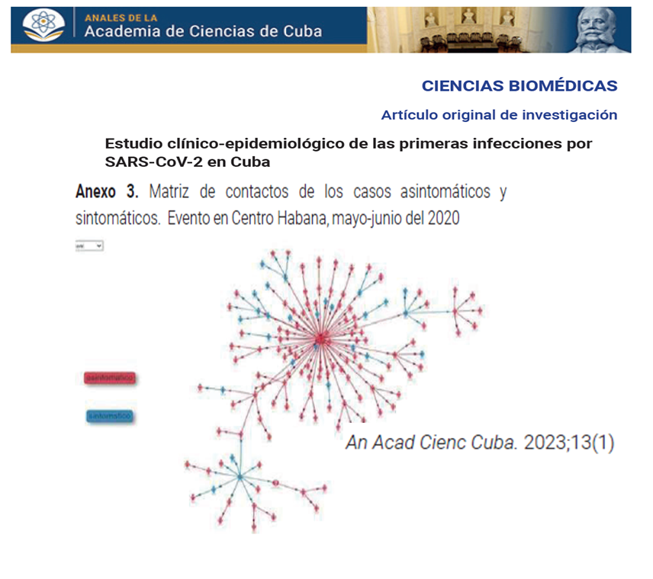
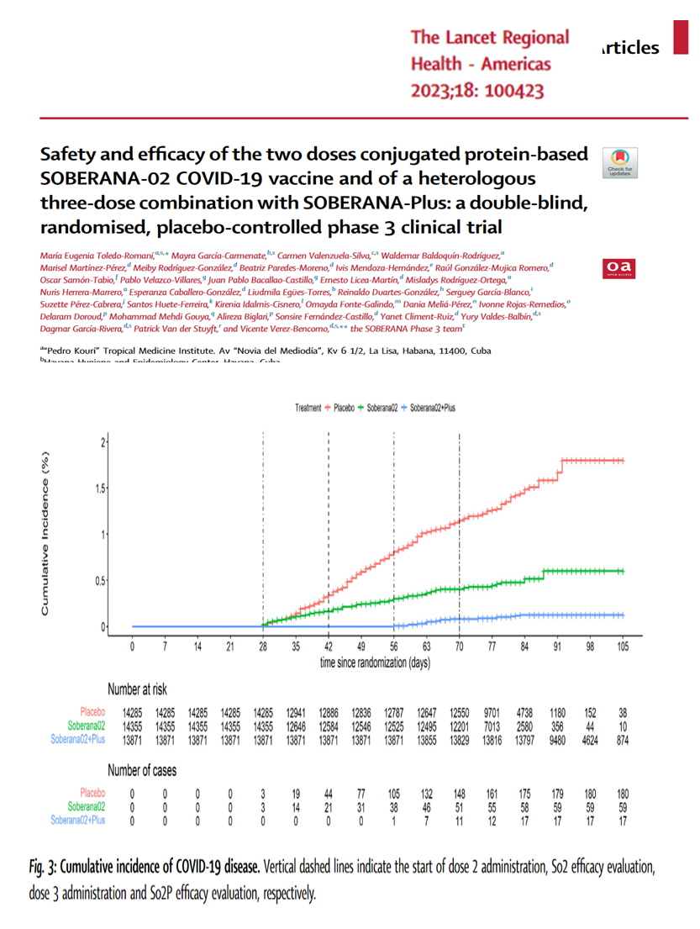
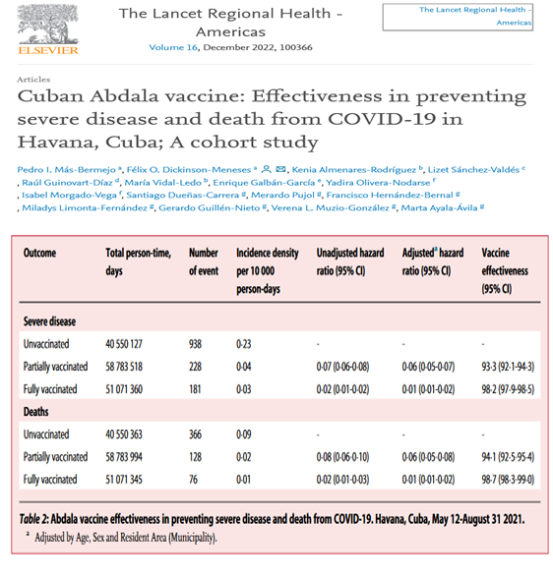
EPIDEMIOLOGICAL STUDIES AND CLINICAL TRIALS WITH CUBAN VACCINE CANDIDATES AGAINST COVID-19

Slide 16
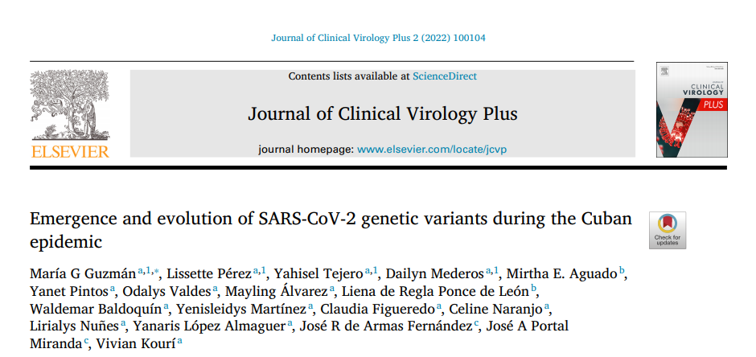
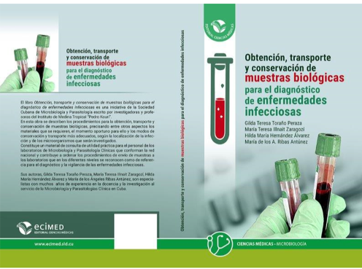
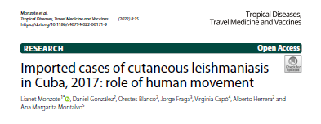
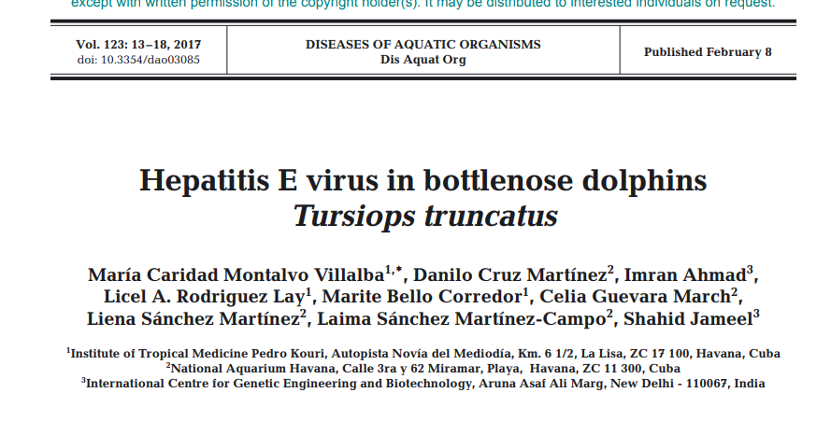
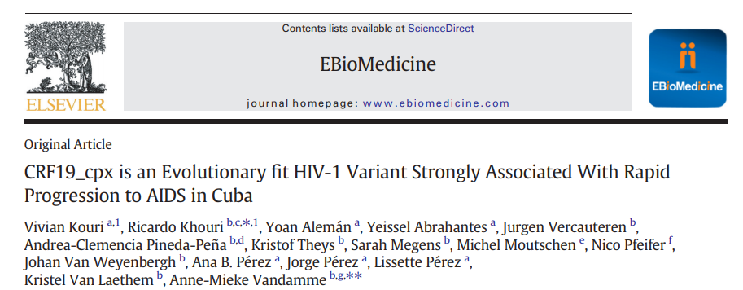
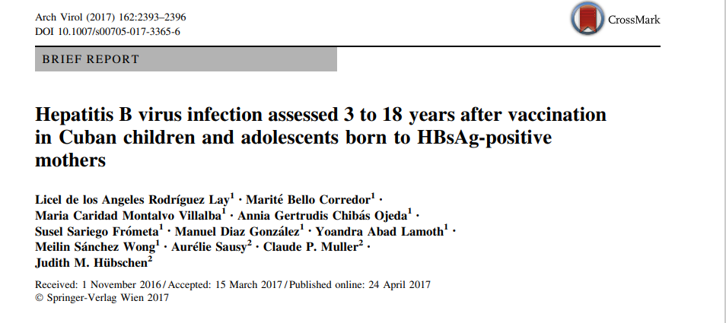
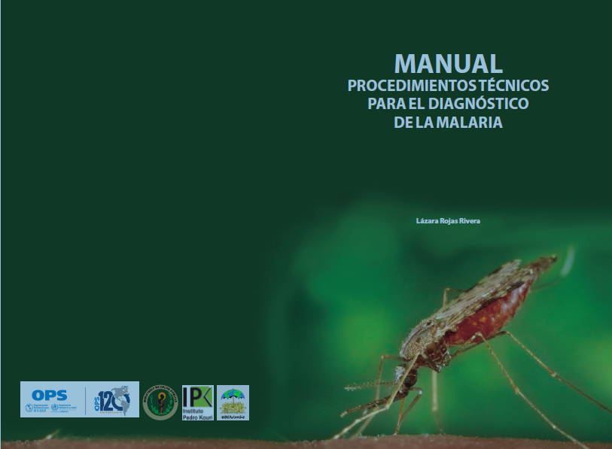
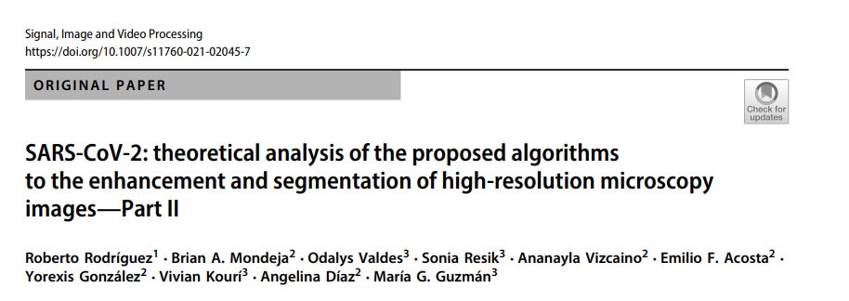
SCIENTIFIC PRODUCTION
Notes:
Muchos de estos resultados, representan aportes cientificos al conocimientos, primeros reportes y alertas alsistema de salud. Los cuales han sido divulgados en Cuba e internacionalmente a ttraves de publicaciones y premios

Slide 17
FINAL CONSIDERATIONS
The NPHI significantly contributes to the health systems in the surveillance of infectious diseases and confronting epidemics, thus they should be continuously supported to guarantee the strengthening of them
The collaboration between nations mobilized during the emergency’s response needs to be continued and enhanced
Fostering alliances between countries, with multisectoral approach, will contribute to build a future where early detection, rapid response, and global collaboration are the cornerstones of our defense against emergent diseases
Notes:
Genomic surveillance stands as a transformative tool in our fight against emergent diseases and pandemic preparedness
The integration of genomics with epidemiology and public health practices holds tremendous potential for unraveling critical insights into disease emergence. By augmenting our understanding of pathogens, we can proactively respond to these evolving threats and safeguard public health more effectively.
Fostering alliances between countries will contribute to build a future where early detection, rapid response, and global collaboration are the cornerstones of our defense against emergent diseases

Slide 18
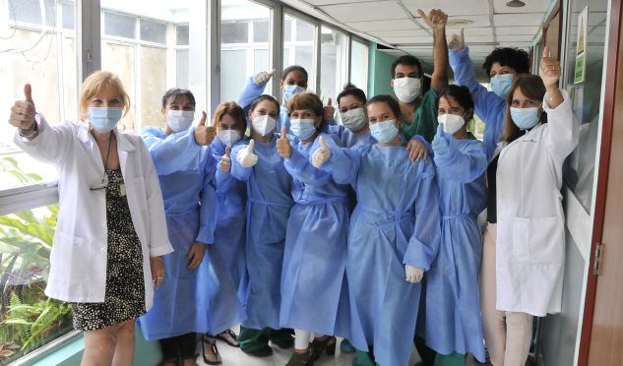
THANK YOU

