Slide 1

Tânia Maria Peixoto Fonseca, M.D, PhD
Coordenadora de Vigilância em Saúde e Laboratórios de Referência
Fundação Oswaldo Cruz - Brasil
Preparação e Resposta a Emergências em Saúde

Slide 2


Notes:
The International Association of National Public Health Institutes was first envisioned in 2001 by Jeffrey Koplan former director of CDC and Pekka Puska (director general of Finland’s National Institute of Public Health and Welfare – THL ) and chartered in 2006. IANPHI was initially supported through grants from the Rockefeller Foundation and the Bill & Melinda Gates Foundation.
Professional and independent network of NPHIs, or “CDC’s of the world”, which provides a unique forum for peer-to-peer support and strategic exchanges amongst directors and senior staff
IANPHI’s mission is to collectively build public health capacity by connecting and strengthening NPHIs worldwide
The IANPHI Annual Meeting is the only worldwide forum where NPHI directors and partners come together to establish and strengthen relationships and share ideas and best practices on areas of mutual concern

Slide 3

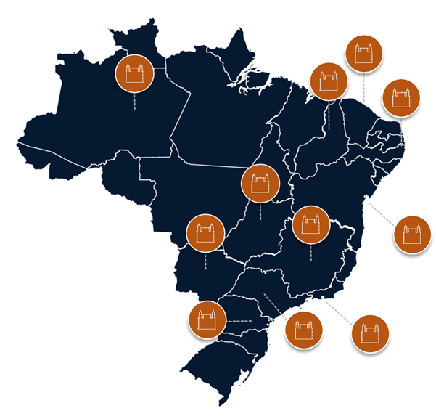
Fundação Oswaldo Cruz
11 estados
16 unidades técnico-científicas
5 escritórios
13 mil trabalhadores
Notes:
The International Association of National Public Health Institutes was first envisioned in 2001 by Jeffrey Koplan former director of CDC and Pekka Puska (director general of Finland’s National Institute of Public Health and Welfare – THL ) and chartered in 2006. IANPHI was initially supported through grants from the Rockefeller Foundation and the Bill & Melinda Gates Foundation.
Professional and independent network of NPHIs, or “CDC’s of the world”, which provides a unique forum for peer-to-peer support and strategic exchanges amongst directors and senior staff
IANPHI’s mission is to collectively build public health capacity by connecting and strengthening NPHIs worldwide
The IANPHI Annual Meeting is the only worldwide forum where NPHI directors and partners come together to establish and strengthen relationships and share ideas and best practices on areas of mutual concern

Slide 4

Fundação Oswaldo Cruz
Ecossistema de P&D
Produção
Complexo Industrial de Biotecnologia em Saúde
Assistência
Hospitais de referência e
Atendimento ambulatorial comunitário
Pesquisa,
Desenvolvimento
e Inovação
Educação
Acadêmica e profissional
Órgãos de vigilância, regulatórios e de conformidade; Laboratórios de Referência; Controle de Qualidade,
Informações e
tecnologias de comunicação
Notes:
The International Association of National Public Health Institutes was first envisioned in 2001 by Jeffrey Koplan former director of CDC and Pekka Puska (director general of Finland’s National Institute of Public Health and Welfare – THL ) and chartered in 2006. IANPHI was initially supported through grants from the Rockefeller Foundation and the Bill & Melinda Gates Foundation.
Professional and independent network of NPHIs, or “CDC’s of the world”, which provides a unique forum for peer-to-peer support and strategic exchanges amongst directors and senior staff
IANPHI’s mission is to collectively build public health capacity by connecting and strengthening NPHIs worldwide
The IANPHI Annual Meeting is the only worldwide forum where NPHI directors and partners come together to establish and strengthen relationships and share ideas and best practices on areas of mutual concern

Slide 5
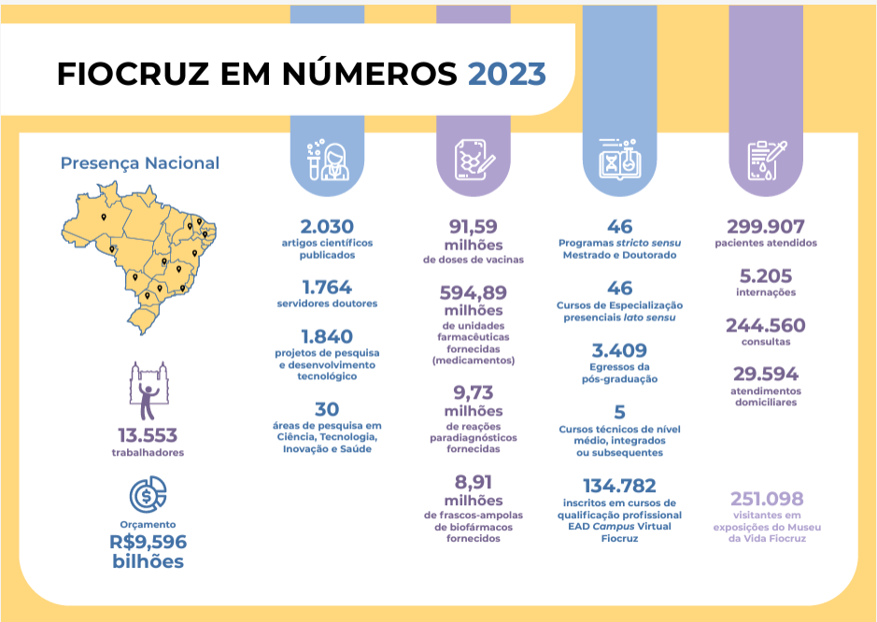
Fundação Oswaldo Cruz
Ecossistema de P&D
Notes:
The International Association of National Public Health Institutes was first envisioned in 2001 by Jeffrey Koplan former director of CDC and Pekka Puska (director general of Finland’s National Institute of Public Health and Welfare – THL ) and chartered in 2006. IANPHI was initially supported through grants from the Rockefeller Foundation and the Bill & Melinda Gates Foundation.
Professional and independent network of NPHIs, or “CDC’s of the world”, which provides a unique forum for peer-to-peer support and strategic exchanges amongst directors and senior staff
IANPHI’s mission is to collectively build public health capacity by connecting and strengthening NPHIs worldwide
The IANPHI Annual Meeting is the only worldwide forum where NPHI directors and partners come together to establish and strengthen relationships and share ideas and best practices on areas of mutual concern

Slide 6


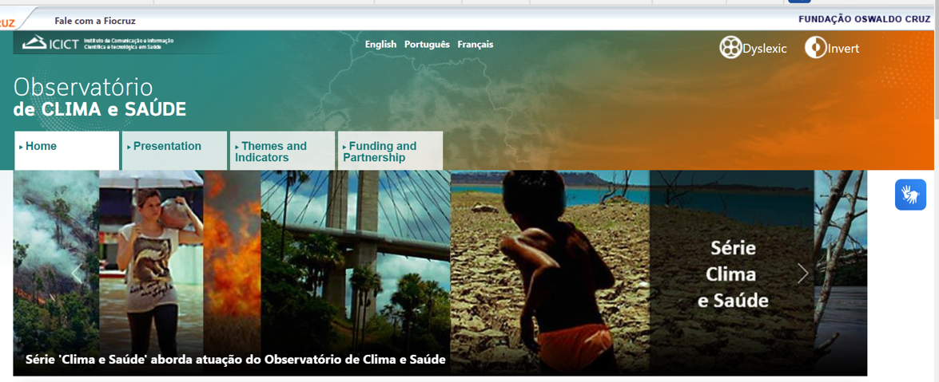
Preparação e Resposta a Emergências em Saúde
1- Modelagem e Análise de dados
Programa de Computação Científica da Fiocruz (PROCC): https://info.dengue.mat.br/
Observatório de Clima e Saúde: https://climaesaude.icict.fiocruz.br/

Slide 7




Preparação e Resposta a Emergências em Saúde
1- Modelagem e Análise de dados

Slide 8

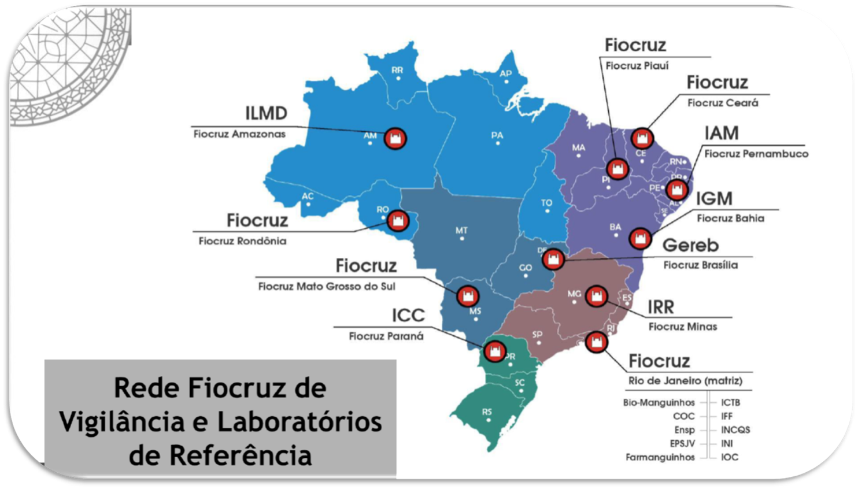

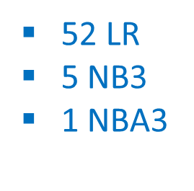
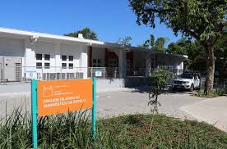
Preparação e Resposta a Emergências em Saúde
2- Oferta diagnóstica

Slide 9
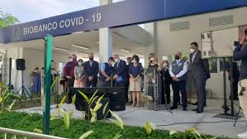
Preparação e Resposta a Emergências em Saúde
2- Oferta diagnóstica

Slide 10



Preparação e Resposta a Emergências em Saúde
3. Ensino
Disciplinas, cursos de atualização e aperfeiçoamento
Webinários

Slide 11

Preparação e Resposta a Emergências em Saúde
4. Manejo Clínico

Slide 12
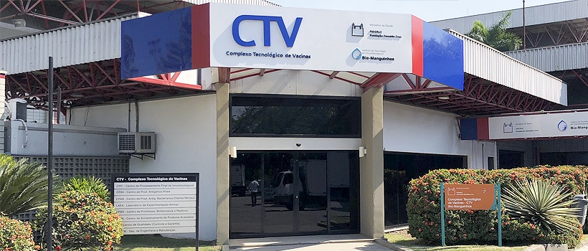



Preparação e Resposta a Emergências em Saúde
5. Produção

Slide 13
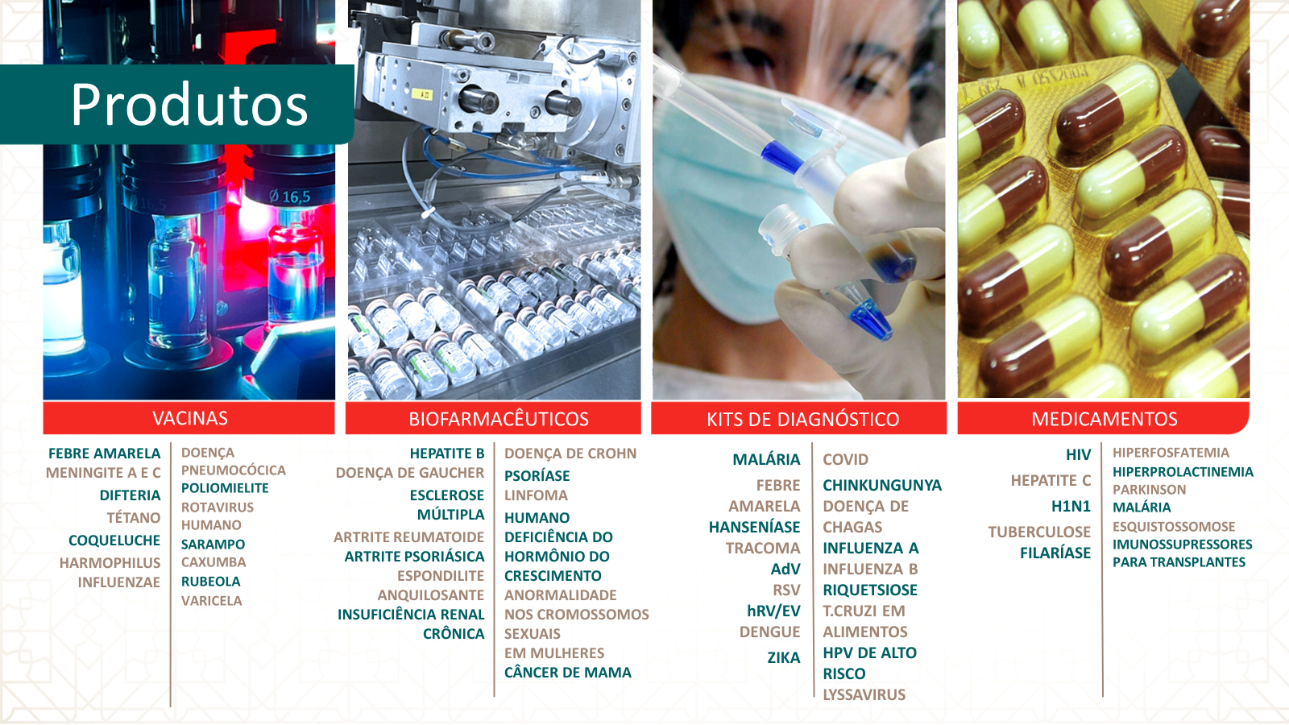
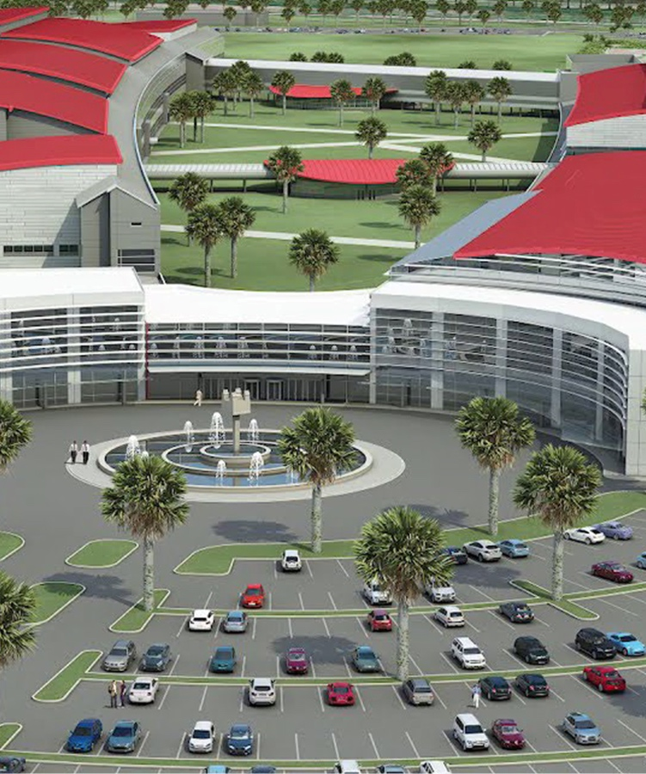
Preparação e Resposta a Emergências em Saúde
5. Produção

Slide 14
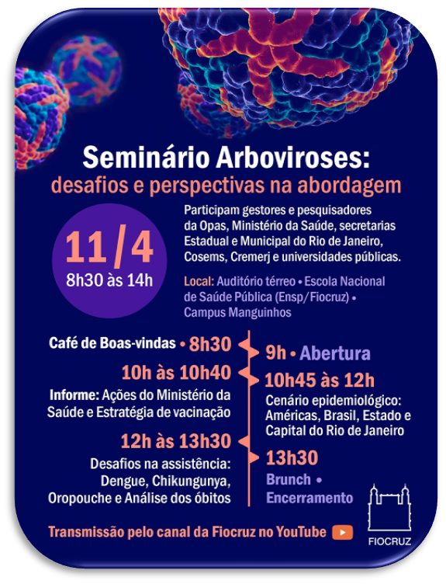


Preparação e Resposta a Emergências em Saúde
6. Comunicação e informação

Slide 15
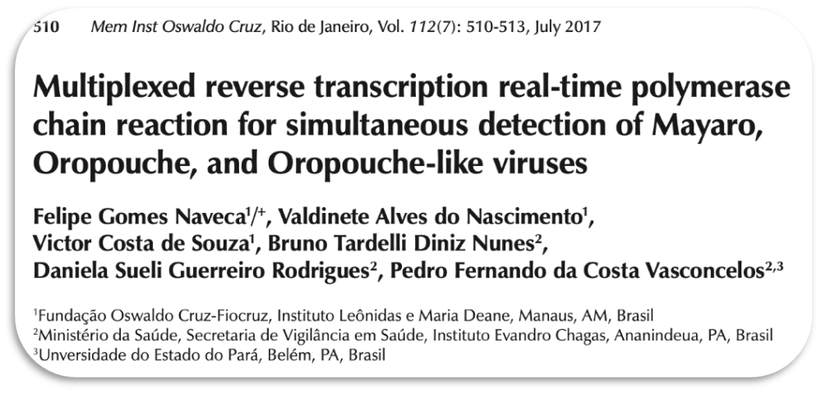

Preparação e Resposta a Emergências em Saúde
7. Pesquisa
Exploring the Resurgence of a Neglected Disease: Lessons From the 2023–2024 Mpox Outbreak in Rio de Janeiro, Brazil
Mayara Secco Torres Silva, Carolina Coutinho, Thiago Silva Torres, Monica Avelar Magalhães, Carolyn Yanavich, Amanda Echeverría-Guevara, Matheus Oliveira Bastos, Pedro Silva Martins, Maira Braga Mesquita, Paula Pereira de Souza Reges ... Show moreAuthor Notes
Clinical Infectious Diseases, ciae290, https://doi.org/10.1093/cid/ciae290
Published: 16 July 2024 Article history

Slide 16

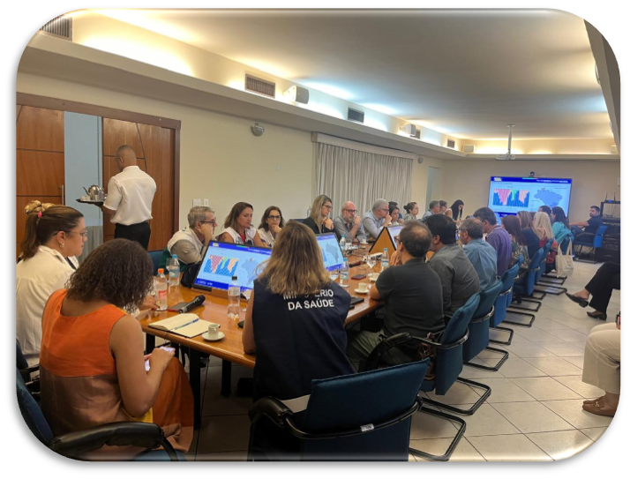
Preparação e Resposta a Emergências em Saúde
Estratégias:
Ações Coordenadas (interna)
Sala de situação (externa): gestores, sociedades científicas, universidades, pesquisadores e a comunicação.
Participação no Centro de Operações de Emergência e Sala Nacional de Situação (MS).
GOARN; OPAS/OMS

Slide 17
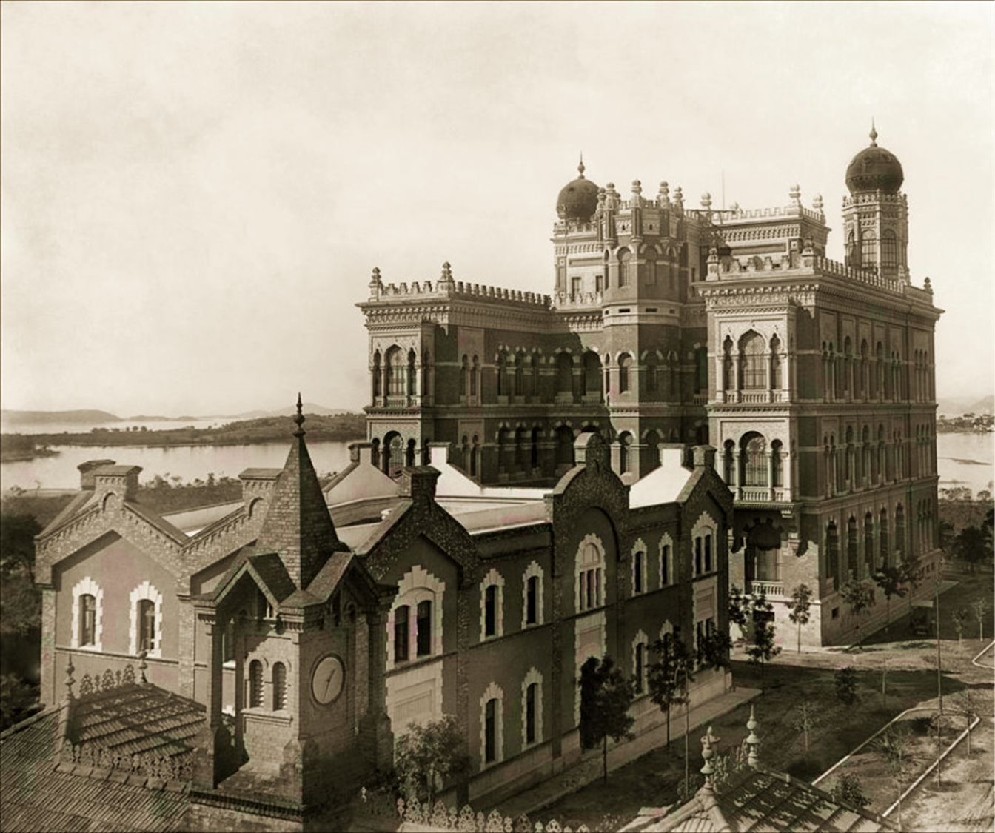
Obrigada tania.Fonseca@fiocruz.br

