Slide 1
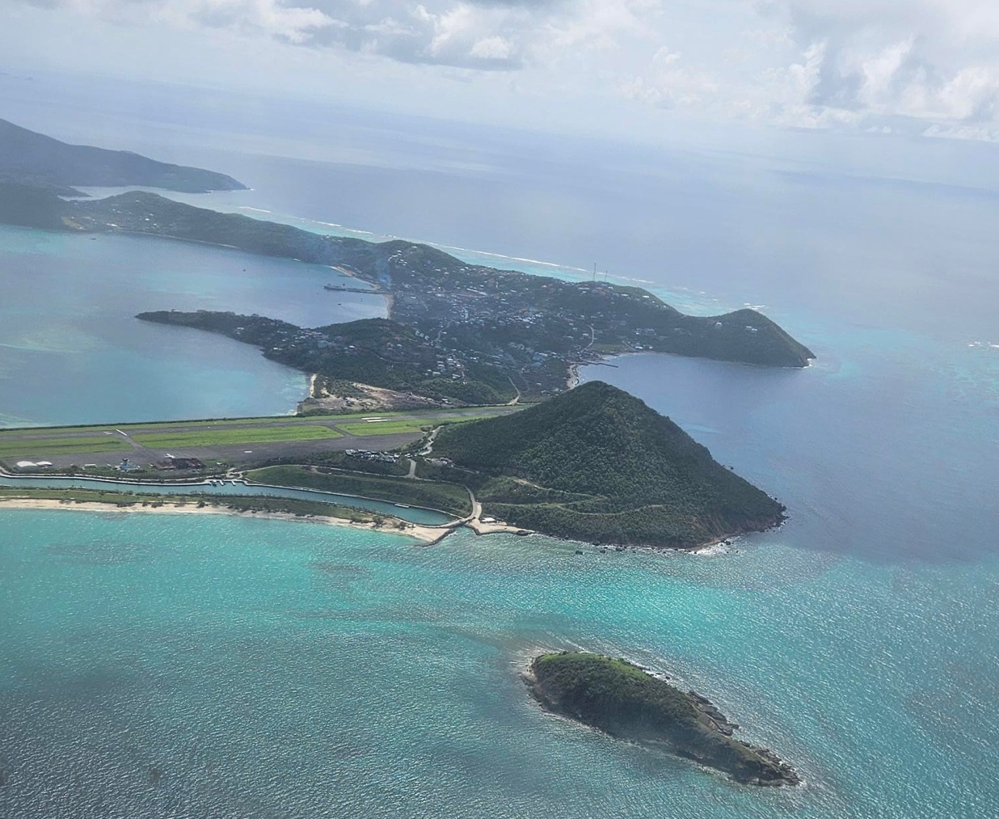


Dr. Lisa Indar
Ad Interim Director
Caribbean Public Health Agency
09-09-2024
A Public Health Perspective on Climate Change And Small Island Developing States
The Caribbean Region

Slide 2
Caribbean : high Vulnerability to disasters, climatic change
RHS: Strengthening capacities and systems in CMS to prepare for and respond to public health threats and issues that transcend national boundaries & potentially impact on economic stability, trade, tourism, & access to goods & services
P& R and RHS is impacted by
Caribbean’s unique situation:
Under-resourced population
Interconnected, porous borders
Varying capacities levels
High dependence on tourism
Vulnerability to disasters, climatic change
Global & Regional diseases trends
Increases Region's exposure & risk to public health threats
&
rapid spread of infectious diseases across boundaries
Can possibly result in epidemics/ pandemics
Hurricanes:
Beryl (2024)
Dorian (2019),
Maria & Irma (2017)
Mathew (2016),
Notes:
The International Association of National Public Health Institutes was first envisioned in 2001 by Jeffrey Koplan former director of CDC and Pekka Puska (director general of Finland’s National Institute of Public Health and Welfare – THL ) and chartered in 2006. IANPHI was initially supported through grants from the Rockefeller Foundation and the Bill & Melinda Gates Foundation.
Professional and independent network of NPHIs, or “CDC’s of the world”, which provides a unique forum for peer-to-peer support and strategic exchanges amongst directors and senior staff
IANPHI’s mission is to collectively build public health capacity by connecting and strengthening NPHIs worldwide
The IANPHI Annual Meeting is the only worldwide forum where NPHI directors and partners come together to establish and strengthen relationships and share ideas and best practices on areas of mutual concern

Slide 3
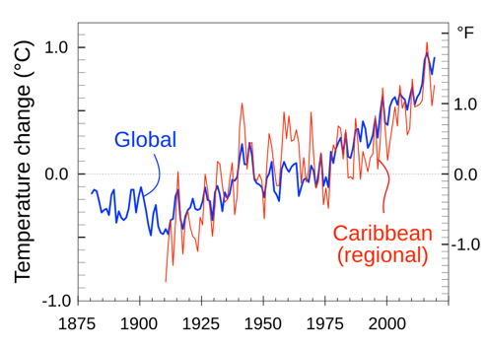
Climate Trends in the Caribbean
0.5 - 4.2 ºC from 2010 to 2099
Drier mid-year, wetter end of year
Sea level rise: 35-50 cm over the next 50 years
More intense tropical storms (10-20% wind speed increase)
Ocean acidification
Thus far….
Average annual air temp. increases, new highs - 0.5 ºC higher than previous
Sea level rise 10 cm per 100 yrs
Variations in dry/wet spells
Increasing hurricane strength
Scenarios for the Future
Notes:
Within the Caribbean and in the context of Small Island Developing States, climate change and its effects on human lives, nature and the general environment cannot be dismissed. We have seen increases in the average annual air temperatures, rises in sea level, more precipitation in some areas and drought conditions in others, and very clearly an increase in storm frequency and severity, By the end of the century we expect globally anywhere from a 0.5 to 4 deg C rise in temperatures, further changes in precipitation patterns and rise in sea levels, more severe storms and continued acidification of oceans.

Slide 4

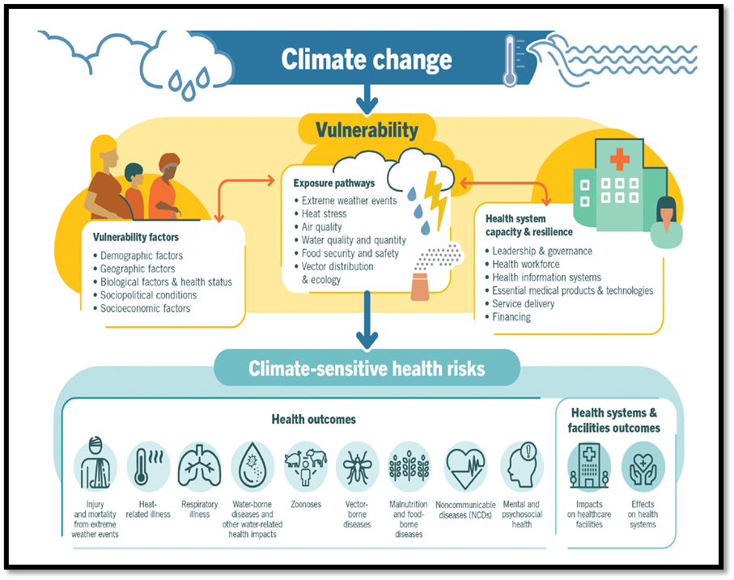
Caribbean Climate and Health Context
Caribbean populations/health systems remain highly vulnerable to impacts from climate change
Can affect health through the following two main pathways:
Effects mediated via natural systems e.g. extreme weather and climate events
Hurricanes, floods, droughts, heat waves, Saharan dust incursions
Effects on human health and social development in the Caribbean region
Water availability and safety, poor air quality, food safety and security
Adverse health outcomes: respiratory complications, heat-induced morbidity, outbreaks of vector-, food- and water-borne diseases, injuries, fatalities, mental health
Current low emphasis on gender considerations
Effects mediated via human systems
Migration/displacement of populations
Loss of livelihood, poverty
Lost/reduced work capacity and productivity
Inability to attain the Sustainable Development Goals (SDGs)

Slide 5
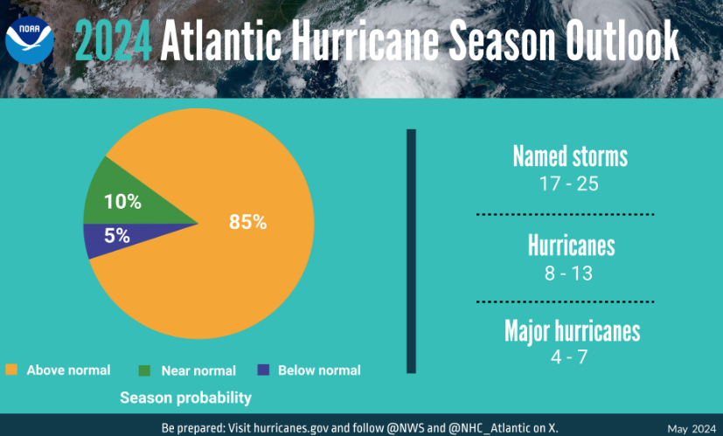
2024 Atlantic Hurricane Season
17-25 named storms (winds of 39 mph or greater)
8-13 could become hurricanes (winds of 74 mph or greater)
4-7 could become major hurricanes (winds of 111 mph or greater).
Hurricane Beryl (July 2024 Cat 4/5; earliest storm of this intensity); devasting impact on the islands of the Grenadines (60-98% infrastructural damage on some islands)
Image credit: NOAA, 2024

Slide 6
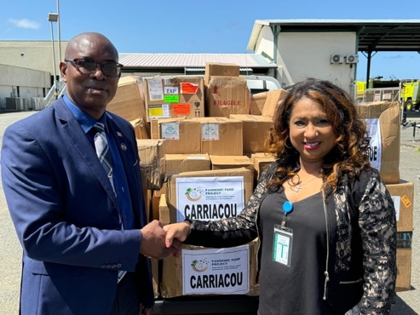
Health Response Post Hurricane Beryl
Letter of Support
Rapid health needs assessment
Laboratory, surveillance and response, technical guidelines, prevention and control of infectious diseases
Health and safety promotional materials
Shelter surveillance tools (digitalized)
Health Emergency Response Package to impacted islands
Technical Guidelines
Deployment
Public Health Emergency Supplies
Notes:
The International Association of National Public Health Institutes was first envisioned in 2001 by Jeffrey Koplan former director of CDC and Pekka Puska (director general of Finland’s National Institute of Public Health and Welfare – THL ) and chartered in 2006. IANPHI was initially supported through grants from the Rockefeller Foundation and the Bill & Melinda Gates Foundation.
Professional and independent network of NPHIs, or “CDC’s of the world”, which provides a unique forum for peer-to-peer support and strategic exchanges amongst directors and senior staff
IANPHI’s mission is to collectively build public health capacity by connecting and strengthening NPHIs worldwide
The IANPHI Annual Meeting is the only worldwide forum where NPHI directors and partners come together to establish and strengthen relationships and share ideas and best practices on areas of mutual concern

Slide 7
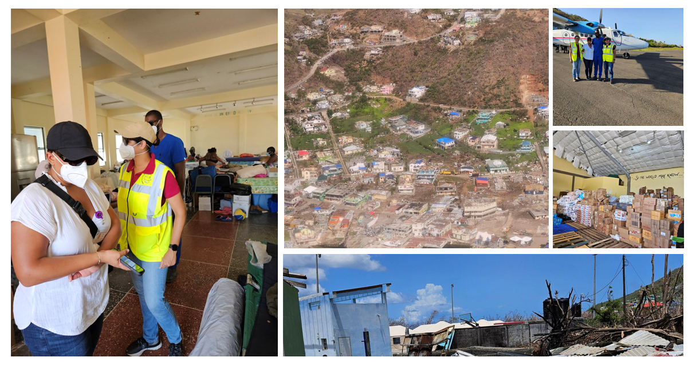
CARPHA Support to Union Island, St. Vincent and the Grenadines

Slide 8
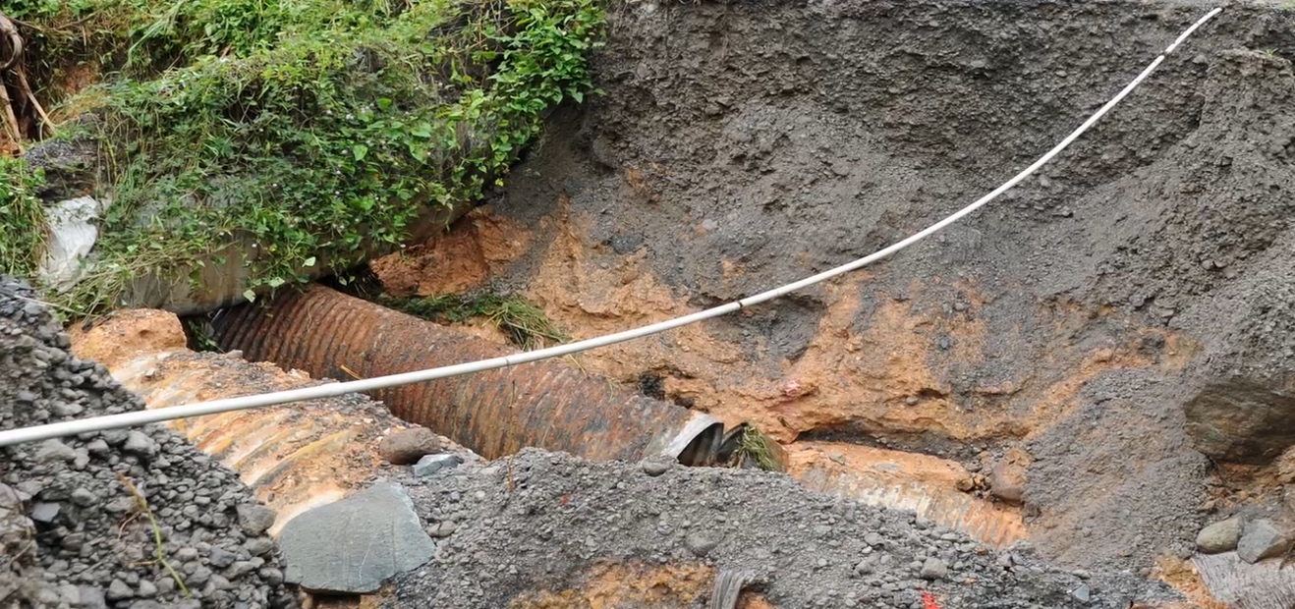
How does climate change and extreme weather events affect the region's infrastructure and capacity to respond to health emergencies
Disruption in key services of potable water, sewerage systems, solid waste collection management, destruction and contamination of agricultural produce.
Availability of adequate potable water sources.
Water scarcity, increasing drought, changes in rainfall patterns, saline intrusion into groundwater sources.
Based on buildng quality and event type:
  Damage and destruction to houses (especially those of lower social status and income); hospitals and other care facilities
  Increasing climate challenges the adequate ventilation which may increase heat related illnesses.
Notes:
The International Association of National Public Health Institutes was first envisioned in 2001 by Jeffrey Koplan former director of CDC and Pekka Puska (director general of Finland’s National Institute of Public Health and Welfare – THL ) and chartered in 2006. IANPHI was initially supported through grants from the Rockefeller Foundation and the Bill & Melinda Gates Foundation.
Professional and independent network of NPHIs, or “CDC’s of the world”, which provides a unique forum for peer-to-peer support and strategic exchanges amongst directors and senior staff
IANPHI’s mission is to collectively build public health capacity by connecting and strengthening NPHIs worldwide
The IANPHI Annual Meeting is the only worldwide forum where NPHI directors and partners come together to establish and strengthen relationships and share ideas and best practices on areas of mutual concern

Slide 9
A Case for Small Island Developing states
  Vulnerable populations, inclusive of effects of sea level rise on coastal communities
  Greater impacts felt from extreme weather events and variation in ability to respond and recover
  Heavy burden of climate sensitive diseases in tropics and sub-tropics (vector, food and water borne disease)
  Increased frequency and duration of Saharan dust incursions (Caribbean)
  SIDS have long started and continue the call for greater advocacy, supporting partnerships, evidence building, financing and climate justice.
Notes:
Currently, those who have least contributed to the climate crisis are being disproportionately affected by it (i.e. SIDS). Climate justice suggests that the responsibilities in addressing climate change should be divided according to who is contributing most to the problem, while addressing systemic, socioeconomic, and intergenerational inequalities.

Slide 10
Caribbean Climate and Health
Regional Action for Resilience to Date
Country and inter-agency collaborations with CIMH, CARPHA,CCCCC, Red Cross, PAHO, UWI/PPCR
Seeking to strengthen interactions between multisectoral professionals for creation and implementation of health national adaptation plans and policies, climate integrated surveillance and early warning systems for health, infrastructural greening of primary health care sector, food and water resilience planning.
Output: Climate integrated health tools, infrastructure, information and services that support public health decision making and resource allocation.
Notes:
Ccccc Caribbean community climate change centre

Slide 11
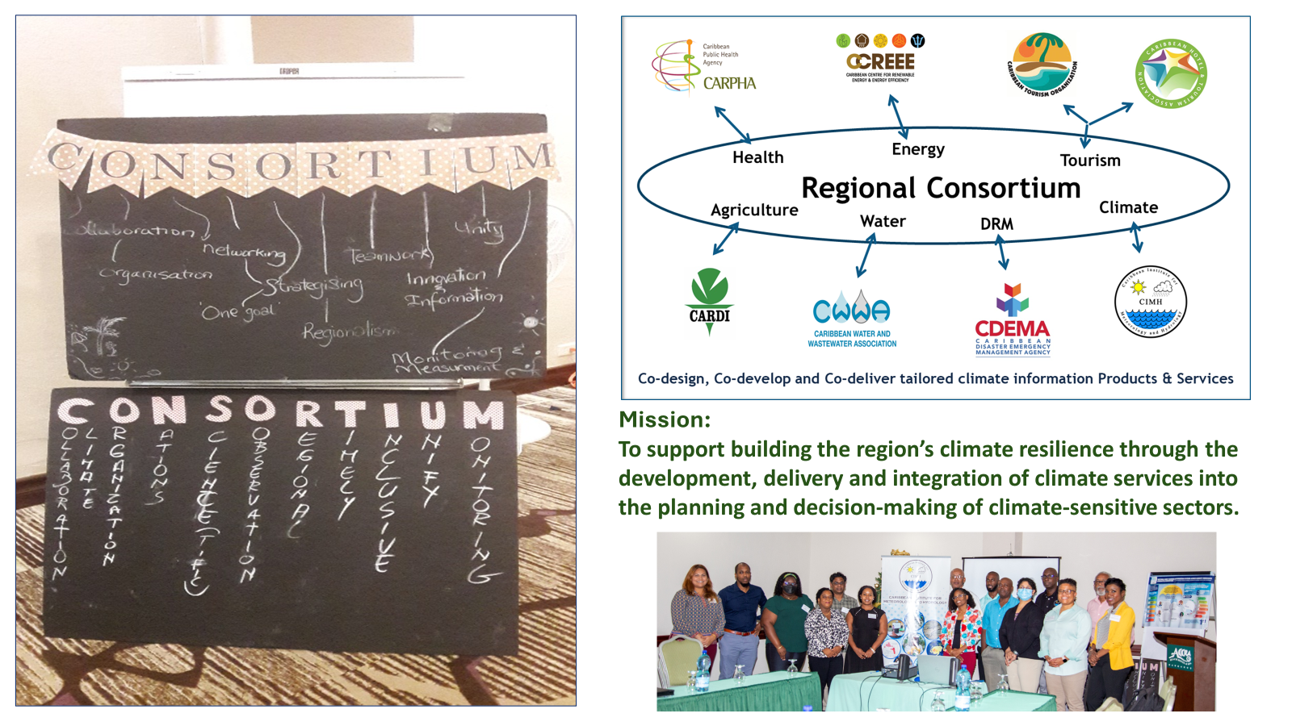
Regional Collaboration
Caribbean Agencies - EWISACTS
Prior to co-development
Notes:
A sectoral alliance for climate resilience
Since 2015, the Caribbean Institute for Meteorology and Hydrology (CIMH) in collaboration with its network of National Meteorological and Hydrological Services (NMHSs) and its Consortium of Sectoral Early Warning Information Systems Across Climate Timescales (EWISACTs) Coordination partners have been working together to increase the range of sector-specific climate products, as well as integrated decision-support processes and tools that support evidence-based and risk informed decisions in key sectors in the Caribbean.
The Consortium is an alliance of sector agencies and the CIMH – each committed to partnering on the development and integration of climate services in sectoral decision-making. As a regional climate service governance mechanism, the Consortium leverages the position and expertise of lead technical organisations such as the Caribbean Agricultural Research & Development Institute (CARDI), the Caribbean Water and Wastewater Association (CWWA), the Caribbean Disaster Emergency Management Agency (CDEMA), the Caribbean Public Health Agency (CARPHA), the Caribbean Tourism Organization (CTO) and the Caribbean Hotel and Tourism Association (CHTA).

Slide 12
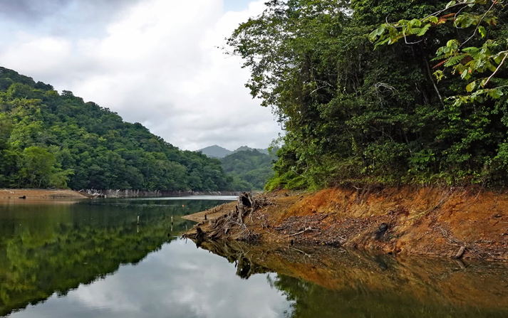
Other partnerships and collaborations to improve health security preparedness and response
CARICOF – meteorological services and health (bi-annual meeting)
CARPHA/PAHO/CIMH Climate and health quarterly bulletin
CARPHA/UKOTS MOU – Environmental laboratory network
IWEco governance partnership
CARPHA/EHSD support (specifically WASH) to CDEMA for disaster response
Notes:
Ccccc Caribbean community climate change centre

Slide 13
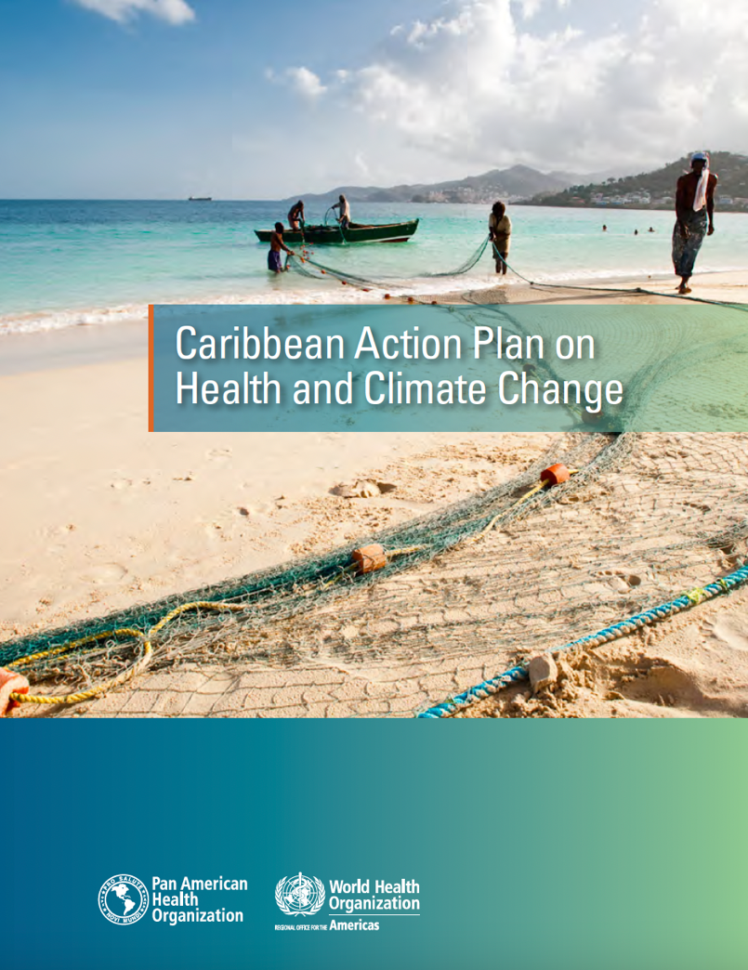
11th EDF/CARIFORUM Project -Strengthening Climate Resilient Health Systems In The Caribbean”
Regional collaboration initiative: PAHO (lead); CARPHA, CCCC, CIMH, UWI
CARPHA’s Role:
Improve surveillance capacity and building integrated assessment tools
On going work to develop EWS for climate sensitive diseases and health conditions
Improvements for enhanced usage of the Caribbean Health Climate Bulletin
Assessment and multisectoral surveillance of emerging food safety risks linked to CC
Training and Development of CR-WSP and CR-FSP
Notes:
EU/CARIFORUM Project: Strengthening Climate Resilient Health Systems in the Caribbean
The Caribbean Action Plan on Health and Climate Change was approved in 2019 by Ministers of health, Environment, and Climate Change. The aim of the plan is to protect the health of the Caribbean population from the adverse effects of Climate Change
4 pillars are
Empowerment
Evidence
Resources
Implementation
Critical actions under this Plan include:
Build regional partnerships to address climate change and health including civil society
Support growth of regional network of experts and research institutions as PAHO/WHO Collaborating Centres for climate change and health, data management and sharing of best practices
Strengthen institutional capacity to analyse climate change and health data through Health Impact Assessment (HIA) and other tools to assess health co-benefits of mitigation interventions
Implement regional public health communication, awareness and advocacy campaigns on climate change and health issues
Develop regional early warning systems for climate sensitive diseases and conditions
Strengthen regional technical capacity for preparation, management and implementation of multi-country projects on climate change and health

Slide 14
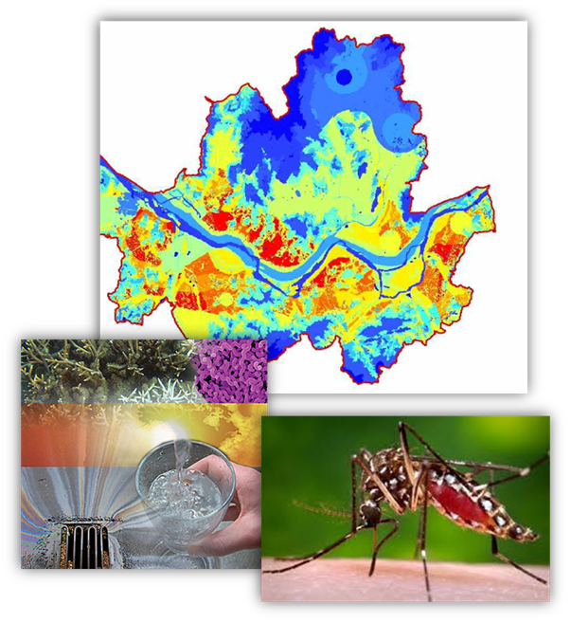
Vector Borne Disease Early Warning Systems for Health
Improve surveillance capacity and building integrated assessment tools.
On going work to develop EWS for climate sensitive diseases, specifically Dengue.
Allows predicting of potential outbreaks (infectious disease models) at least 3 months before an event can occur
Allows health sector to allocate/programme resources to mitigate the impact of outbreaks
Notes:
EU/CARIFORUM Project: Strengthening Climate Resilient Health Systems in the Caribbean
The Caribbean Action Plan on Health and Climate Change was approved in 2019 by Ministers of health, Environment, and Climate Change. The aim of the plan is to protect the health of the Caribbean population from the adverse effects of Climate Change
4 pillars are
Empowerment
Evidence
Resources
Implementation
Critical actions under this Plan include:
Build regional partnerships to address climate change and health including civil society
Support growth of regional network of experts and research institutions as PAHO/WHO Collaborating Centres for climate change and health, data management and sharing of best practices
Strengthen institutional capacity to analyse climate change and health data through Health Impact Assessment (HIA) and other tools to assess health co-benefits of mitigation interventions
Implement regional public health communication, awareness and advocacy campaigns on climate change and health issues
Develop regional early warning systems for climate sensitive diseases and conditions
Strengthen regional technical capacity for preparation, management and implementation of multi-country projects on climate change and health

Slide 15
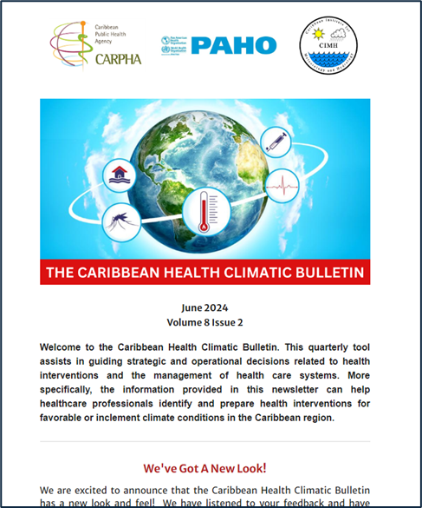
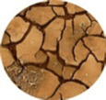

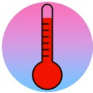






Joint health-climate risk messaging through the Caribbean Health-Climatic Bulletin
(http://rcc.cimh.edu.bb/caribbean-health-climatic-bulletin/)
Regional prevalence of health concerns sensitive to climate:
Respiratory Illness | atmospheric dust (Saharan dust + dryness/drought-induced local dust) and humidity levels, flooding
Gastrointestinal Illness | flooding
Non-communicable Diseases | heat exposure, UV radiation, flooding and drought
Vector-Borne Illness | temperature, excess rainfall/flooding and drought
Well-Being and Mental Health | extreme events (e.g., tropical cyclones), flooding and drought, heat
Co-design & Co-development
Notes:
The Caribbean Health-Climatic Bulletin is a joint collaboration initiative between CARPHA, PAHO and CIMH. The bulletin relates the upcoming 3 month climate projected outlook to potential health events related to climate sensitive communicable and non-communicable diseases. This tool allows health practitioners to prepare appropriate health interventions including health promotion messaging to reduce projected morbidity in the population.

Slide 16
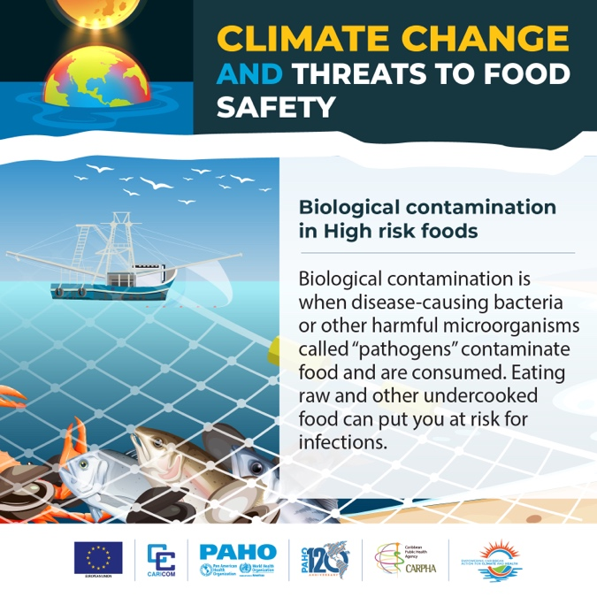
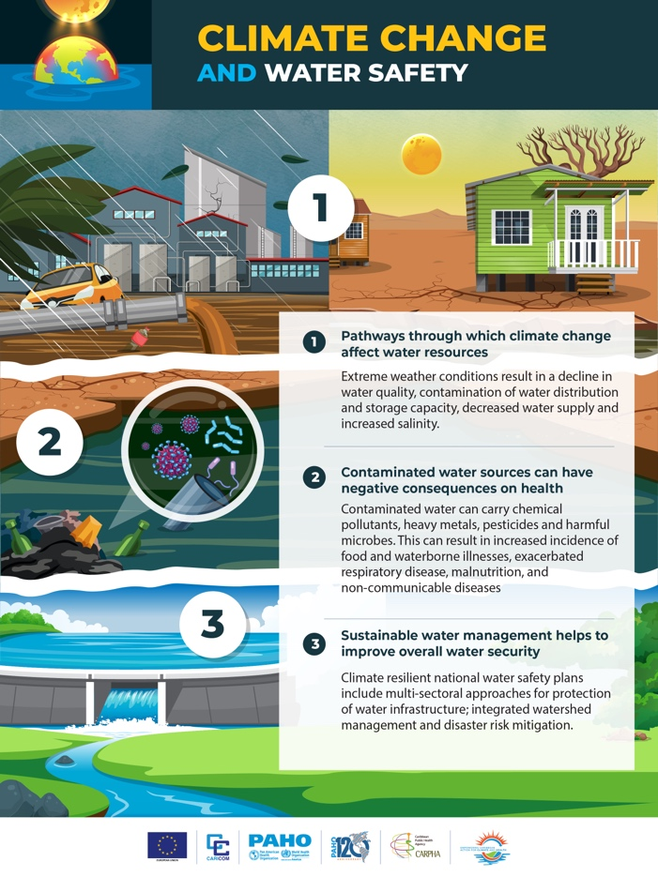

Climate and Health – Promotional activities
Notes:
EU/CARIFORUM Project: Strengthening Climate Resilient Health Systems in the Caribbean
The Caribbean Action Plan on Health and Climate Change was approved in 2019 by Ministers of health, Environment, and Climate Change. The aim of the plan is to protect the health of the Caribbean population from the adverse effects of Climate Change
4 pillars are
Empowerment
Evidence
Resources
Implementation
Critical actions under this Plan include:
Build regional partnerships to address climate change and health including civil society
Support growth of regional network of experts and research institutions as PAHO/WHO Collaborating Centres for climate change and health, data management and sharing of best practices
Strengthen institutional capacity to analyse climate change and health data through Health Impact Assessment (HIA) and other tools to assess health co-benefits of mitigation interventions
Implement regional public health communication, awareness and advocacy campaigns on climate change and health issues
Develop regional early warning systems for climate sensitive diseases and conditions
Strengthen regional technical capacity for preparation, management and implementation of multi-country projects on climate change and health

Slide 17
Resources and Sustainability for Climate and Health Interventions
  Some increased support for climate and health initiatives over past several years in the Region (EU, GCF, IWeco and others)
  Interventions incipient in nature – strong need for greater financing and international support from development partners to sustain and further build resilience
  Focus on sustainable strategies when developing and implementing climate adaptation and mitigation measures
Notes:
EU/CARIFORUM Project: Strengthening Climate Resilient Health Systems in the Caribbean
The Caribbean Action Plan on Health and Climate Change was approved in 2019 by Ministers of health, Environment, and Climate Change. The aim of the plan is to protect the health of the Caribbean population from the adverse effects of Climate Change
4 pillars are
Empowerment
Evidence
Resources
Implementation
Critical actions under this Plan include:
Build regional partnerships to address climate change and health including civil society
Support growth of regional network of experts and research institutions as PAHO/WHO Collaborating Centres for climate change and health, data management and sharing of best practices
Strengthen institutional capacity to analyse climate change and health data through Health Impact Assessment (HIA) and other tools to assess health co-benefits of mitigation interventions
Implement regional public health communication, awareness and advocacy campaigns on climate change and health issues
Develop regional early warning systems for climate sensitive diseases and conditions
Strengthen regional technical capacity for preparation, management and implementation of multi-country projects on climate change and health

Slide 18
Thank you!

