Slide 1
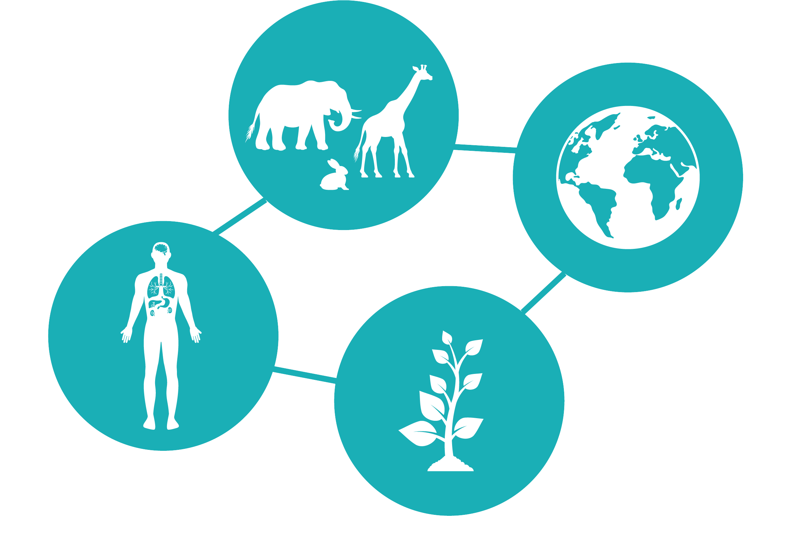
Professor Jenny Harries Chief Executive, UK Health Security Agency
One Health Approach
to Building
Resilience Health Systems

Slide 2
Essential building blocks of resilient One Health systems
Health Equity
Health Information Systems
Public Health Functions
Emergency Preparedness and Response
Community Engagement
Health Workforce
Financing
Medical supplies, technology and infrastructure
Governance and Leadership
Health Service delivery
Learning and Adapting
Human Health
Animal Health
Plant Health
Environment Health

Slide 3
Operationalising the One Health approach
Graphic adapted from Laing et al., 2023
Prevent
Prepare
Detect
Learn
Respond
Recover

Slide 4
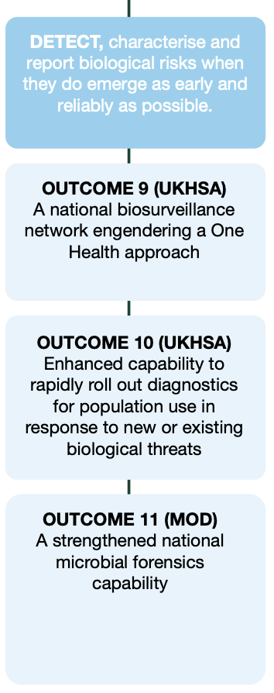
UK Government’s 2023 Biological Security Strategy (BSS)
The BSS emphasises One Health through:
Biosurveillance and threat detection
Interconnected Global Surveillance
Multisectoral collaboration
UKHSA’s role:
Leading the pilot of the National Biosurveillance Network (NBN)
Enhancing protection from high-consequence biological threats
Challenges:
Integrating One Health across previously siloed areas of Government
Requires time, resources, and subject matter expert collaboration

Slide 5
UK’s National Biosurveillance Network (NBN)
The National Biosurveillance Network (NBN) will help protect the UK’s national security from known and emerging high-consequence biological threats.​
The NBN will use a One Health approach to improve and unify surveillance data on the health of people, animals, plants and the environment; utilising a multidisciplinary group of experts to identify, assess and characterise threats faster and more effectively.

Slide 6
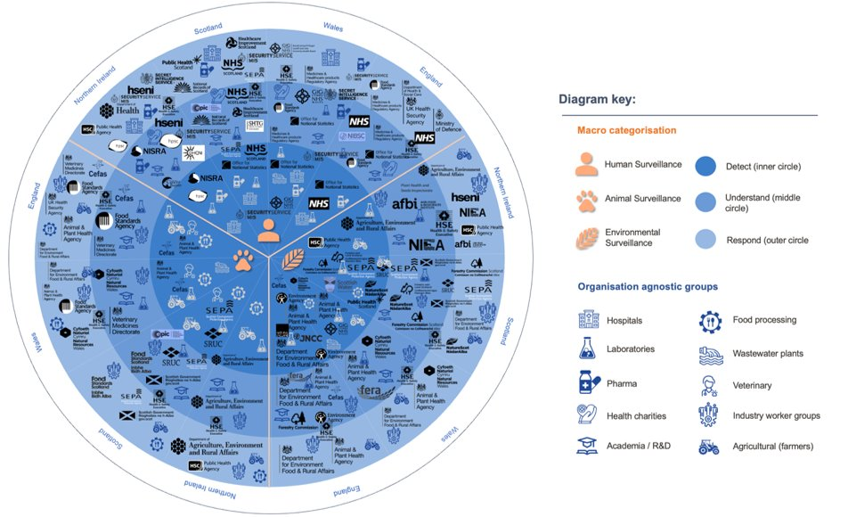
National Biosurveillance Network (NBN)
The NBN will be fit for the future: using a One Health approach to improve and unify surveillance data. It will identify, assess and characterise threats faster and more effectively. ​​
The NBN will further the UK’s G7 pledge to explore less invasive surveillance methods, establishing wastewater and air surveillance capability. Patient data, where required, will be handled in line with relevant legislation.​

Slide 7
Global One Health pledge for building resilient health systems
Share our experiences in operationalising the One Health approach to build compelling investment cases
Prioritise global peer-to-peer learning to build a cadre of professionals
Collaborate in partnerships to build resilience into our health systems together

Slide 8
Thank you!

