Slide 1

Shaping European Health Policies: Strengthening NPHIs' Role in Transnational Challenges
IANPHI Webinar
30 September 2025, 12.00-13.00 CEST
moderated by Claudia Habl, IANPHI Europe Regional Network Chair
www.ianphi.org

Slide 2
Agenda
12:00 – 12:05 Welcome and Introduction
12:05 – 12:18 What can the EU4Health Work Programme do for you? by Ralph Chan, Austrian National EU4Health Focal Point, GÖG, Austria
12:18 – 12:28 EU cross country cooperation and implementation of activities – reflections from a JA coordinator by Hanna Tolonen, Research Director, THL, Finland
12:28 – 12:55 Moderated discussion of participants, including indication of topics of interest from the current EU4Health Programme
12:55 – 13:00 Summary and Conclusion by Claudia Habl

Slide 3
What can the EU4Health Work Programme do for you?
Ralph Chan
National Focal Point EU4Health Austria
Austrian National Public Health Institute
IANPHI Webinar – Shaping European Health Policies: Strengthening NPHIs' Role in Transnational Challenges
30.09.2025
Notes:
Public health is essential to our collective well-being—it protects lives, promotes equity, and strengthens our communities. The EU4Health funding programme plays a vital role by supporting stronger health systems, better disease prevention, and improved access to care across Europe to build a healthier, more resilient future. In today's presentation, I would like to introduce you to what the EU4Health funding program and its current annual work program can do for you.

Slide 4
Agenda
What is EU4Health?
Calls in Annual Work Programme 2025
→ see full list in chat, you can indicate your potential interest there.
Role of National Focal Points in EU4Health
Notes:
If you wish please indicate your potential / non binding interest for the upcoming calls in the following table by indicating your name / institution / country. THANK YOU.

Slide 5
What is EU4Health?
Introduction and overview of the current Annual Work Programme

Slide 6
EU4Health – a vision for a healthier European Union
EU4Health sends a strong signal that public health is a top priority for Europe.
It stands as the EU’s response to the COVID-19 crisis and serves as a key driver in building a European Health Union.
Budget under the Multiannual Financial Framework (MFF) 2021-27: EUR 4.6 billion
4 key objectives
Improve & foster health
access to medicinal products & medical devices
Protect people
Strengthen health systems
Notes:
Improve & foster health in the European Union: to reduce the burden of communicable and non-communicable diseases, by supporting health promotion and disease prevention, educing health inequalities, fostering healthy lifestyles, promoting access to healthcare
Protect people in the European Union from serious cross-border threats to health and strengthening the responsiveness of health systems and coordination among the MS in order to cope with serious cross-border threats to health
Improve the availability, accessibility and affordability of medicinal products and medical devices, and crisis-relevant products in the European Union, and supporting innovation regarding such products
Strengthen the national health systems by improving their resilience and resource efficiency through: supporting integrated and coordinated work between MS, promoting the implementation of best practices, promoting data sharing, reinforcing the healthcare workforce, tackling the implications of demographic challenges, advancing digital transformation.

Slide 7
EU4Health – 10 Specific objectives
The EU4Health programme will provide financial support for delivering on the EU Health policy along ten key areas of intervention:
Health promotion and disease prevention; cancer
International health initiatives & cooperation
Prevention, preparedness & response to cross-border health threats
Complementing national stockpiling of essential crisis-relevant products
Establishing a reserve of medical, healthcare & support staff
Enhancement of availability, accessibility & affordability of medicinal products, medical devices and crisis-relevant products
Strengthening health data, digital tools & services, digital transformation of healthcare
Enhancing access to healthcare
Developing and implementing EU health legislation and evidence-based decision making
Integrated work among MS health systems

Slide 8
EU4Health – Synergies and Complementarities
Implementation & Deployment
ERDF
ESF+
InvestEU
RRF
EU4Health
Pilots
Horizon Europe
Digital Europe
EU4Health
Technical Support & Advisory Services
Technical Support Instrument
InvestEU
EU4Health
Research & Innovation
Horizon Europe
ERDF
InvestEU
EU4Health (innovation uptake)
Digital transformation
EU4Health
Horizon Europe
Digital Europe
CRISIS PREPAREDENESS & RESPONSE
EU4Health
UCPM/rescEU
ERDF
InvestEU
RRF
Notes:
An approach by policy area: many instruments contributing to the same objectives

Slide 9
EU4Health – Annual Work Programme
Five annual work programmes have been adopted (2021, 2022, 2023, 2024 and 2025), which implement Union’s legislative and non-legislative health initiatives such as:
Europe’s Beating Cancer Plan
Mental health
EU’s resilience to cross-border threats to health
European Reference Networks
European Health Data Space
Union’s health legislation (e.g. medical devices, health technology assessment, etc)
Global Health
Critical medicines
Cardiovascular

Slide 10
EU4Health – Annual Work Programme - Strands
Cancer and the new priorities 2025-2029
on cardiovascular and other non-communicable diseases
Crisis preparedness
Health promotion &
disease prevention
Health systems &
healthcare workforce
Digital transformation
Notes:
Crisis Preparedness: Protect citizens from serious cross-border health threats, Strengthen health systems response, Enhance coordination among Member States to cope with serious cross-border threats to health
Health Promotion & Disease Prevention: Improve and foster health in the EU, Reduce the burden of communicable and non-communicable diseases, Support health promotion and disease prevention, Reduce health inequalities, Foster healthy lifestyles
Health Systems & Healthcare Workforce: Improve availability, accessibility and affordability of medicinal products and medical devices, support their innovation, Strengthen resilience and sustainability of health systems, Reinforce healthcare workforce
Digital transformation: Advance digital transformation of health systems, Strengthen primary & secondary use of health data

Slide 11
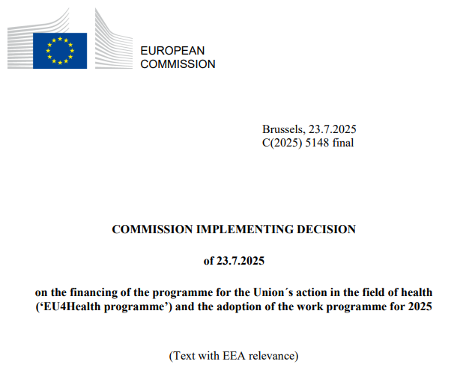
EU4Health – Annual Work Programme 2025 I
For more information about the funding programme EU4Health:
https://health.ec.europa.eu/publications/2025-eu4health-work-programme_en
For more information about the Annual Work Programme and the current Calls (e.g., Joint Actions):
https://health.ec.europa.eu/document/download/26284fbb-0c7b-4d4d-ae57-f7f2a47e493f_en?filename=funding_c2025_5148_annex_en.pdf

Slide 12
EU4Health – Annual Work Programme 2025 II
The Annual Work Programmes include:
Description of the Actions (policy context, objectives, scope, activities, expected results and impact)
Procedure type (public procurement, grants, prizes, others)
Indicative timetable
Indicative budget allocation
Details for funds applications – type of targeted applicants
→ in this session we will focus on Joint Actions
Notes:
“Grants”: Direct financial contributions from the European Union budget awarded to beneficiaries engaged in activities that serve Union policies.
Guiding principles: 1.) Equal treatment and transparency, 2.) Co-financing by the beneficiary and non-profit rule applicable, 3.) Non-cummulative, non-retroactive and absence of double financing
“Public procurement”: Contracts with economic operators to purchase services or goods on the account of the Commission, either through open tendering procedures or the use of existing framework contracts which were established following competitive procedures
“Prizes”: Contests to promote achievements of policy objectives of the Union where one or several beneficiaries are awarded a financial price following a evaluation
“other”: possible forms of funding as allowed by the Financial Regulation

Slide 13
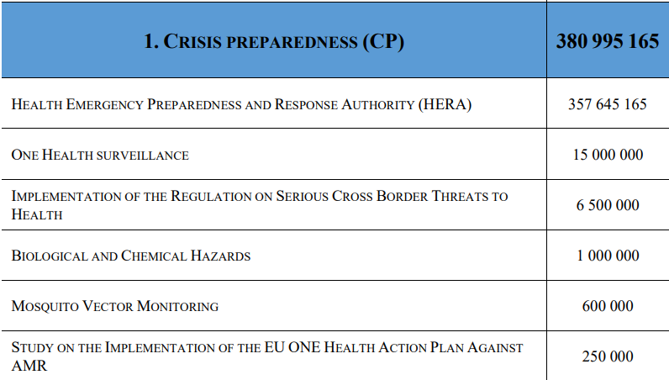
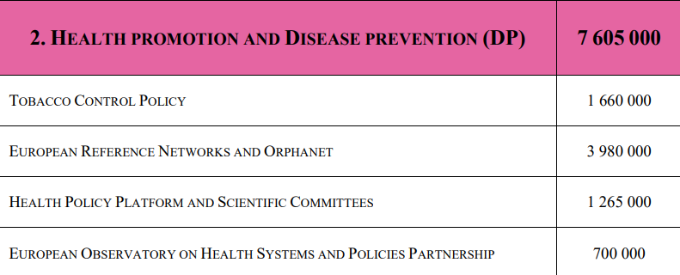
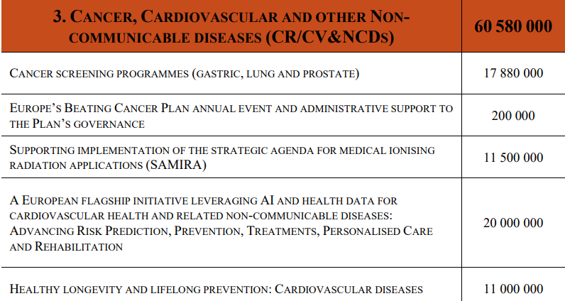
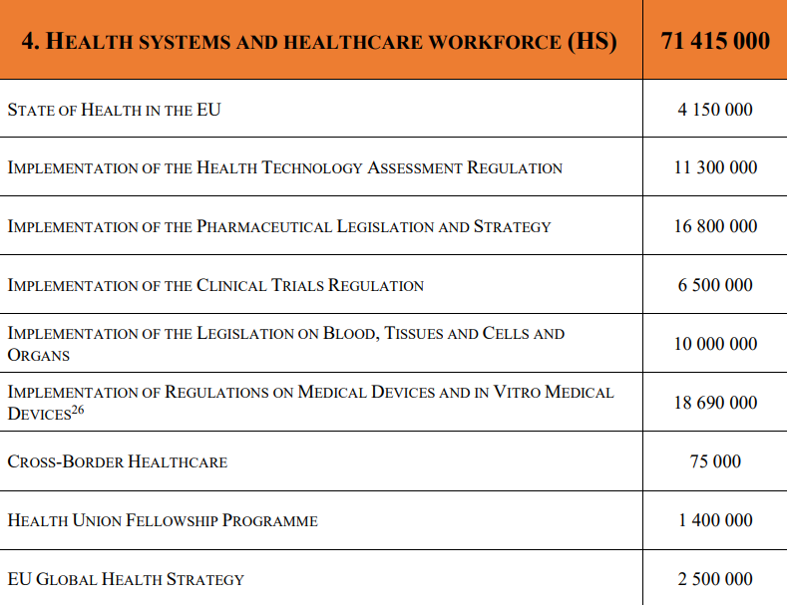
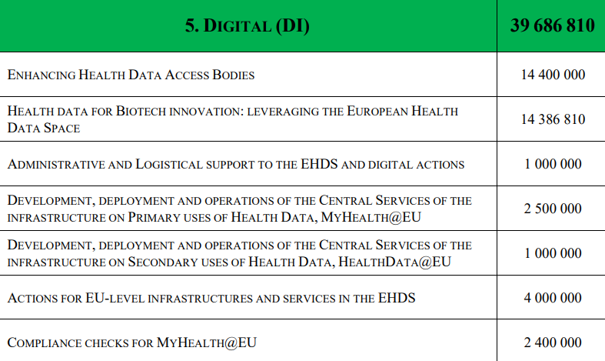
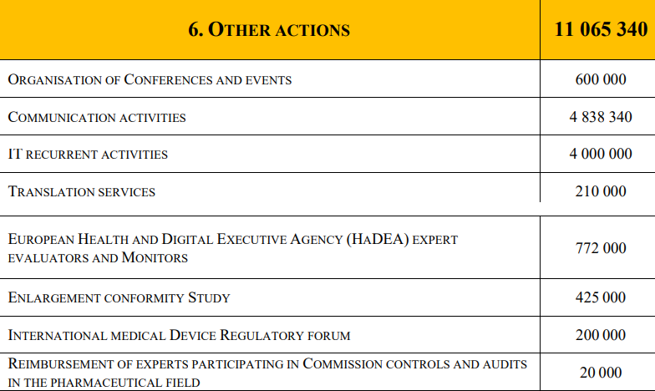
EU4Health – Annual Work Programme 2025 III

Slide 14
EU4Health – Annual Work Programme 2025 IV
Direct management
Grants
Open calls for proposals: 29
Joint actions and other DGAs
Procurement
Indirect management
Contribution agreements
With international organisations that are ‘pillar assessed’ and are included in DG BUDG list of successfully assessed organisations

Slide 15
EU4Health – Annual Work Programme 2025 – Calls I
Crisis Preparedness (CP)
CP-g-25-01 Call for proposals to support the development of innovative medical countermeasures for chemical, biological, radiological and nuclear threats (HERA), EUR 20 000 000
CP-g-25-02 Direct grants to Member States’ authorities for the scaling up of national systems for vector threat detection and control capacities (HERA), EUR 10 000 000
CP-g-25-03 Call for proposals for the development of new diagnostic tests for vector borne diseases (HERA), EUR 10 000 000
CP-g-25-04/05 Direct grant(s) to Africa Centres for Disease Control and Prevention (Africa CDC) and the African Society for Laboratory Medicine (ASLM), and to Asia Pathogen Genomics Initiative (Asia PGI) to support wastewater surveillance for health threats’ early detection (HERA), EUR 4 000 000
CP-g-25-06 Direct grant to Member States’ authorities for enhancing whole genome sequencing (WGS) and/or reverse transcription polymerase chain reaction (RT-PCR) national infrastructures and capacities to respond to the COVID-19 pandemic and future health threats (HERA), EUR 5 000 000
CP-g-25-07 Direct grants to Member States’ authorities to implement HERA’s training and exercise programme for management of medical countermeasures (HERA), EUR 2 947 923
CP-g-25-08 Direct grants to Member States’ authorities for setting up a coordinated surveillance system under the One Health approach for cross-border pathogens that threaten the Union, EUR 15 000 000
CP-g-25-09 Direct grants to EU Reference Laboratories (EURLs) to support their functioning in accordance with Regulation (EU) 2022/2371 on serious cross-border threats to health, EUR 6 500 000

Slide 16
EU4Health – Annual Work Programme 2025 – Calls II
Health Systems and Healthcare Workforce (DP)
DP-g-25-10 Direct grant to Orphanet to support disease codification knowledge and information sharing, EUR 3 500 000
Cancer, cardiovascular and other non-communicable diseases (CR/CV & NCD)
CR/CV&NCD-g-25-12 Call for proposals to pilot and implement cancer screening programmes for gastric cancer, EUR 3 000 000
CR/CV&NCD-g-25-13 Call for proposals to pilot and implement cancer screening programmes for lung cancer, EUR 7 440 000
CR/CV&NCD-g-25-14 Call for proposals to pilot and implement cancer screening programmes for prostate cancer, EUR 7 440 000
CR/CV&NCD-g-25-15 Direct grants to Member States’ authorities to support the implementation of the strategic agenda for medical ionising radiation applications (SAMIRA), EUR 11 500 000
CR/CV&NCD-g-25-16 A European flagship initiative leveraging AI and health data for cardiovascular health and related non-communicable diseases: Advancing Risk Prediction, Prevention, Treatments, Personalised Care and Rehabilitation, EUR 20 000 000
CR/CV&NCD-g-25-17 Direct grants to Member States’ authorities to support lifelong prevention for a healthy life, including through screening, with focus on cardiovascular diseases, EUR 5 000 000
CR/CV&NCD-g-25-18 Call for proposals on lifelong prevention for a healthy life with focus on cardiovascular diseases, EUR 2 000 000

Slide 17
EU4Health – Annual Work Programme 2025 – Calls III
Health Systems and Healthcare Workforce (HS)
HS-g-25-19 Direct grants to Member States’ authorities to support the implementation of a common standard for medical product identification and AI capabilities across Member States, EUR 9 000 000
HS-g-25-20 Call for proposals to support the development of a medicine pricing, reimbursement and access tracker through the EURIPID database, EUR 750 000
HS-g-25-21 Direct grants to Member States’ authorities on quality of medicines and implementation of the pharmaceutical legislation and the Pharmaceutical Strategy for Europe, EUR 2 300 000
HS-g-25-22 Direct grant to EU reference laboratories for the Union contribution on in vitro diagnostic medical devices, EUR 5 000 000
HS-g-25-23 Direct grants to Member States’ authorities for supporting the maintenance of the European Medical Device Nomenclature, EUR 1 500 000
HS-g-25-24 Call for proposals for a programme on orphan medical devices, in particular targeting paediatric patients, EUR 1 200 000
HS-g-25-25 Direct grant to Member States to provide regulatory or scientific advice to small and micro-enterprises to support development, and carrying out of conformity assessment of devices, especially innovative devices, and to facilitate the Union level coordination on medical device safety issues, EUR 4 000 000
HS-g-25-27 Direct grants to Member States’ authorities to support implementation of the Clinical Trials Regulation and to improve the clinical trials landscape with Member States and EEA countries, including through pilots and training, EUR 4 700 000
HS-g-25-28 Call for proposals to support non-commercial sponsors active in clinical trials, EUR 1 800 000
HS-g-25-29 Direct grants to Member States’ authorities to maximise the impact of the EU Global Health Strategy, EUR 2 500 000

Slide 18
EU4Health – Annual Work Programme 2025 – Calls IV
Digital (DI)
DI-g-25-30 Direct grants to Member States’ authorities for enhancing Health Data Access Bodies with particular focus on the secondary use of health data, EUR 14 000 000
DI-g-25-31 Call for proposals for health data for biotech innovation leveraging the European Health Data Space, EUR 14 386 810
Other Activities (OA)
OA-g-25-33 Call for proposals to contribute to the organisation of conferences and events, EUR 600 000

Slide 19
Joint Actions in EU4Health
Introduction and overview of current Joint Actions

Slide 20
General aspects of Joint Actions
What is a Joint Action?
Joint Actions are a form of Direct Grant to Member States‘ authorities, in which a project is aimed to be executed by a consortium spanning across all (interested) countries of EU4Health.
Who is eligible to particpate in a Joint Action?
Each State participating in the EU4Health Program (e.g. their respective Ministry of Health) must nominate one or more Competent Authority for each JA (plus Affiliated Entities, where appropriate). Foremostly national health authorities and public institutions, as well as relevant third parties with a sufficient legal/capital link are eligible.
Where to find current and upcoming Joint Actions?
  Detailed description in the annual work programme of EU4Health, publication of indicative timeline in the „Tentative Calender“ of HaDEA

Slide 21
Steps and Timeline of Joint Actions (until start of project)
Invitation letter for proposal
from EC to nominated entities
Invitation letter for nominations
from EC to MS
Grant Agreement signature and start of the action
Evaluation and feedback
by EC
Drafting of the proposal
1
3
5
7
9
2
4
6
8
Nomination of entities as competent authorities and/or affiliated entities by MS
Hands-on workshops
organised by EC
Proposal submission
Grant Agreement
negotiations

Slide 22
Overview of Joint Actions 2025
Upcoming Calls of EU4Health, including Joint Actions, can be found in the „Tentative Calender“ of HaDEA
Possible for NPO to partake but only as subcontractor of a beneficiary
From Annual Work Programme 2025 a single wave of Joint Actions will be in process
  Invitation to submit a proposal was sent July 2024
  Nomination deadline by Member State: 16 October 2025
  Submission deadline by applicant/coordinator: single wave, 16 October 2025 -12 February 2026

Slide 23
EU4Health – Joint Action Calls I
CP-g-25-02 Direct grants to Member States’ authorities for the scaling up of national systems for vector threat detection and control capacities (HERA). EUR 10 000 000
CP-g-25-06 Direct grant to Member States’ authorities for enhancing whole genome sequencing (WGS) and/or reverse transcription polymerase chain reaction (RT-PCR) national infrastructures and capacities to respond to the COVID-19 pandemic and future health threats (HERA), EUR 5 000 000
CP-g-25-08 Direct grants to Member States’ authorities for setting up a coordinated surveillance system under the One Health approach for cross-border pathogens that threaten the Union, EUR 15 000 000
CR/CV&NCD-g-25-17 Direct grants to Member States’ authorities to support lifelong prevention for a healthy life, including through screening, with focus on cardiovascular diseases. EUR 5 000 000
HS-g-25-21 Direct grants to Member States’ authorities on quality of medicines and implementation of the pharmaceutical legislation and the Pharmaceutical Strategy for Europe. EUR 2 300 000

Slide 24
EU4Health – Joint Action Calls II
HS-g-25-25 Direct grant to Member States to provide regulatory or scientific advice to small and micro-enterprises to support development and carrying out of conformity assessment of devices, especially innovative devices, and to facilitate the Union level coordination on medical device safety issues, EUR 4 000 000
HS-g-25-27 Direct grants to Member States’ authorities to support implementation of the Clinical Trials Regulation and to improve the clinical trials landscape with Member States and EEA countries, including through pilots and training, EUR 4 700 000
HS-g-25-29 Direct grants to Member States’ authorities to maximise the impact of the EU Global Health Strategy, EUR 2 500 000
DI-g-25-30 Direct grants to Member States’ authorities for enhancing Health Data Access Bodies with particular focus on the secondary use of health data, EUR 14 000 000
DI-g-25-31 Call for proposals for health data for biotech innovation leveraging the European Health Data Space, EUR 14 386 810

Slide 25
Role of National Focal Points in EU4Health

Slide 26
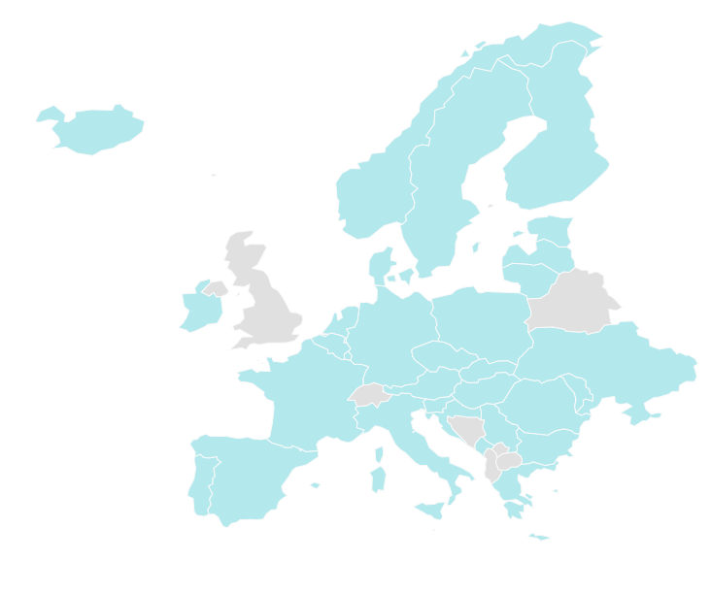
National Focal Points (NFPs)
National Focal Points (NFP) = the national experts for the EU4Health Programme
Established by 3rd Programme for the Union‘s Action the field of Health (regulation 282/2014 Article 15)
List of NFPs in EU countries and participating countries
NFPs are appointed by their respective national health ministries
Tasks of NFPs include:
  Informing and awareness raising
    Dissemination of information about EU4Health
    Organisation of promotional events, e.g. InfoDays
  Support and capacity building
    Supporting potential applicants (scope of EU4Health, trainings on e.g., financial aspects,
    finding partner organisations)
    Hands-on support of beneficiaries
  Network of NFPs, taking part in the JA NFP4Health - Joint Action on Increasing
  Capacity building of National Focal Points
EXAMPLE of Resource of NFP EU4Health in AT (mostly in German)
  Website www.nfp-eu4health.goeg.at
  Functional mailbox NFP.EU4Health@goeg.at
  Newsletter (Archiv)
EU4Health NFPs – NFP4Health

Slide 27
How to: get support from NFPs
Central task of NFPs is to support potential applicants by
Disseminating information about the EU4Health programme (vie newsletters, websites,…)
Individual support and advice on funding opportunities, proposal submission, reporting,…
Offering trainings for potential applicants (e.g. on financial aspects)
Support in finding project partners and consortia via a national and international network (JA NFP4Health)
Additional tasks of NFPs in some countries
Support in preparation of work programme
Identifying and using synergies with other health related funds and programmes
Hands-on support of projects in project preparation and administration
→ Identify the NFP in your country (List of NFPs) and contact them to find out more!

Slide 28
Contact
Ralph Chan
Team Leader of National Focal Point EU4Health Austria
ralph.chan@goeg.at
NFP.EU4Health@goeg.at
Gesundheit Österreich GmbH
Austrian National Public Health Institute
Stubenring 8-10, 1010 Wien
goeg.at

Slide 29
EU cross-country cooperation and implementation of activities
Hanna Tolonen
Director of RDI

Slide 30

Why cooperation matters
Health challenges are cross-border
EU4Health and Joint Actions allow us to scale good practives across Europe

Slide 31

We often identify good practices in one country – but transferring them EU-wide in complex.
Different systems, contexts, and capacities mean what works in one setting doesn’t automatically work elsewhere.

Slide 32

Challenges in EU-wide implementation
Barriers to scaling good practices:
  National health systems differ in structure and resources
  Policy priorities are not always aligned
  Administrative and reporting burdens slow uptake
  Limited resources for implementation and follow-up after project end

Slide 33

When scaling good practives, adaptation is key.
We need flexibility to adjust models to local context, while preserving core elements that make them effective.

Slide 34

From Joint Action deliverables, togerher for healthier populations

Slide 35
Thank you!

