Slide 1
THE ROLE OF NPHIs IN HEALTH EMERGENCIES
DISCLAIMER: The views and opinions expressed in this webinar are those of the authors and do not necessarily reflect the official policy or position of IANPHI.

Slide 2
The NPHI national health emergency corps survey and connected leaders’ interviews: brief background, objectives and methodology
Dr. Andrew Lee,
Regional Deputy Director for Health Protection with UKHSA & Technical Lead for IANPHI

Slide 3
Global Health Emergency Corps
GHEC is a framework for enhancing health emergency workforce capacity within health emergency prevention, preparedness, response and resilience (HEPR) work, and a collaboration platform for countries and health emergency networks.
The vision of Global Health Emergency Corps (GHEC) is a health emergency workforce centred in countries and coordinated regionally and globally, composed of:
Connected health emergency leaders
Health emergency surge capacities
Health emergency workforce

Slide 4
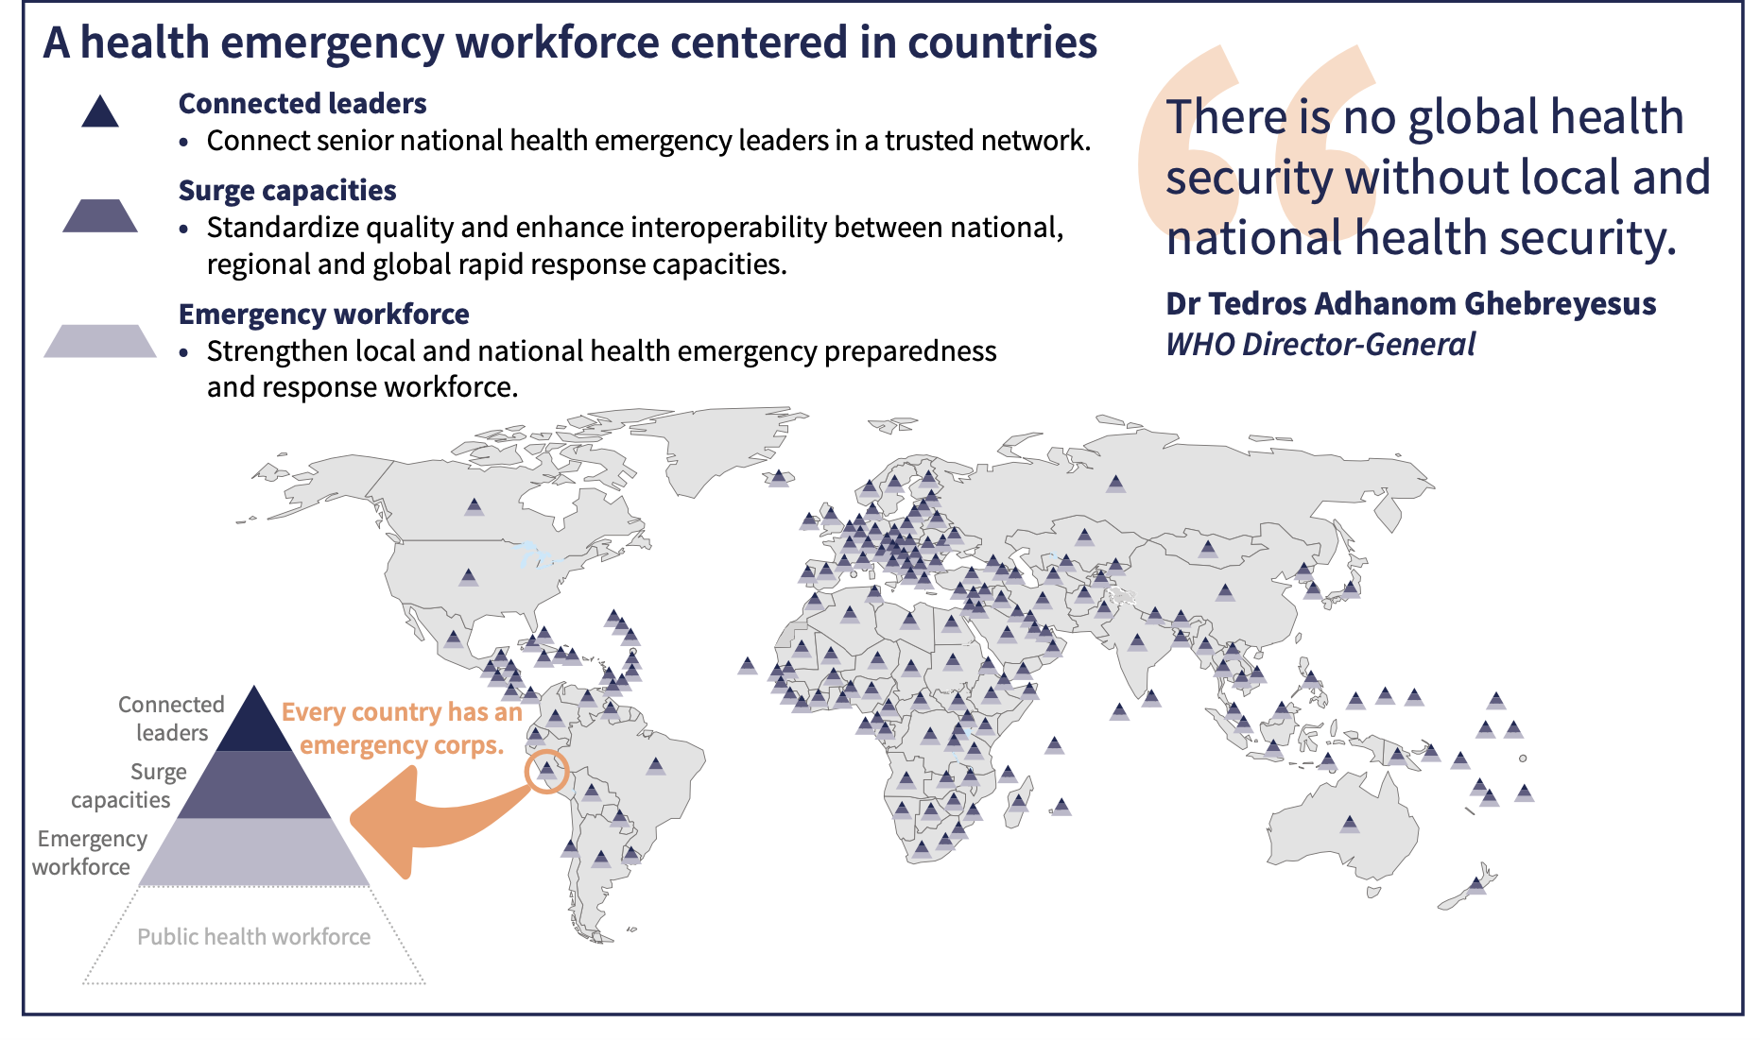

Slide 5
IANPHI GHEC Survey & Interviews
The focus of the survey and interviews was to understand
the role and functions of NPHIs, and
the extent to which the NPHI is leading or involved in the key GHEC domains.
The information collected seeks to:
Provide an overview of the current landscape and support needed for NPHIs to strengthen their roles in rapid response to health emergencies.
Provide evidence to support the development of IANPHI guidelines for NPHIs on surge response to respond to domestic, regional, and international emergencies.
Generate position papers and publications to advocate for investment, support and strengthening of the roles and responsibilities of NPHIs in health emergencies.
Identify recommendations to support further GHEC development

Slide 6
The Survey
Sent to all IANPHI members between October 2024 – March 2025.
Web-based online questionnaire using Select Survey.
Questionnaire translated in English, French, Portuguese and Spanish.
Sent to senior level focal individual in the NPHI to act as liaison / coordinator to collate the information.
59 questions asked covering
Characteristics of the NPHI
NPHI mandate and authority, and governance of health emergencies
Public health emergency workforce needs
Surge capacity and rapid response mechanisms
Nature of connected leadership in health emergencies
Analysed by WHO regions, World Bank income groups, and NPHI size.

Slide 7
Key informant interviews
Purposefully selected sample of NPHIs to reflect diversity of country income levels and WHO regions.
Online interviews carried out between January – February 2025.
Development of topic guide informed by the survey.
Interview topic guide used specifically to explore the following key themes:
What would enable NPHIs (leaders?) to engage and respond to national and international public health emergencies?
How can IANPHI help NPHIs to enable them to engage with GHEC
Focused discussion on connected leadership
Thematic analysis using an inductive approach, and triangulation with survey findings.

Slide 8
Thank you!​

