Slide 1
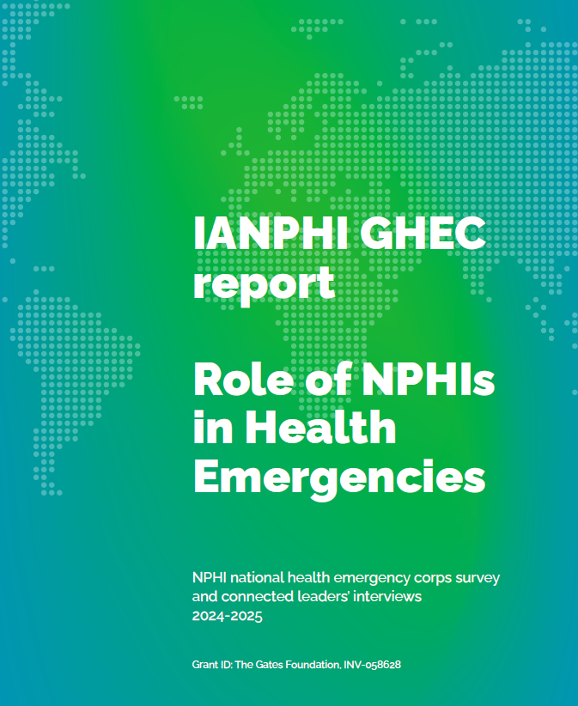
GHEC:
The role of NPHIs in health emergencies. Findings from a global survey
September 24, 2025

Slide 2
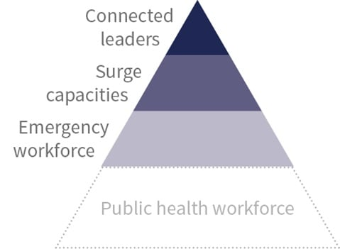
IANPHI GHEC Survey
Focus on the role and functions of NPHIs, to understand the extent to which the NPHI is leading or involved in the key domains outlined by the GHEC framework
Aims to:
Provide an overview of the current landscape and support needed for NPHIs to strengthen their roles in rapid response to health emergencies.
Provide evidence to support the development of IANPHI guidelines for NPHIs reviewing, planning or developing surge capabilities to respond to domestic, regional, and international emergencies.
Generate position papers and publications to advocate for investment, support and strengthening of the roles and responsibilities of NPHIs in health emergencies.
Identify recommendations to support further GHEC development

Slide 3
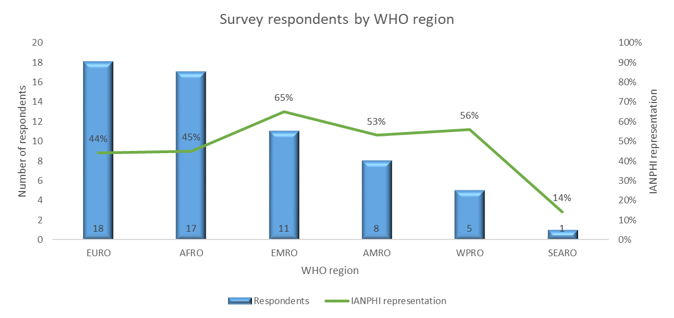
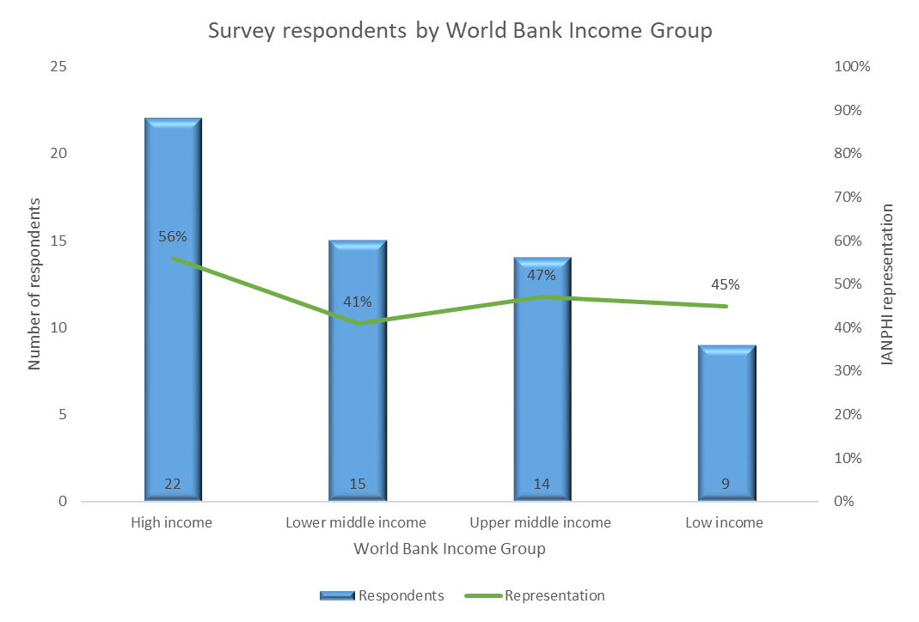
Demographics of respondents
60/127 NPHIs responded (47% response rate)
All World Bank regions, *WHO regions and **income groups were represented
Most respondents from
EURO (18)
AFRO (17)
High income (22)
Lower middle income (15)
*the African Region (AFRO), the Region of the Americas (AMRO), the Eastern Mediterranean Region (EMRO), the European Region (EURO), the South-East Asia Region (SEARO), and the Western Pacific Region (WPRO)
**HIC: High Income Group; LMIC: Lower Middle income group; UMIC: Upper Middle Income Group; LIC: Low Income Group

Slide 4
Demographics of respondents
60/127 NPHIs responded (47% response rate)
All World Bank and WHO regions were represented
Most respondents from
EURO (18)
AFRO (17)
High income (22)
Lower middle income (15)
IANPHI representation by WHO region
Highest – EMRO (65%), WPRO (56%)
Lowest – SEARO (14%)
Representation by World Bank Income Group
Highest – High income (56%)
Lowest – Lower middle income (41%)

Slide 5
Demographics of respondents
NPHIs (90%)
National member (86%)
Scope of work
National remit with teams operating at national level (95%)
International remit (29%)
HIC, AMRO
Total number of employees of less than 500 (55%)
Most NPHIs established more than 10 years ago (72%)
Demographic | Number | Percentage
Type of organization (n=58)
National Public Health Institute | 52 | 90%
Other government department | 3 | 5%
Ministry of Health | 2 | 3%
Other organization | 1 | 2%
Membership (n=56)
National Member | 48 | 86%
Associate member | 8 | 14%
Scope of work (n=59)
Local remit with teams operating at the local/provincial/state level | 25 | 42%
National remit with teams operating at the national level | 56 | 95%
International remit with teams operating internationally | 17 | 29%
Total number of employees (n=60)
< 100 | 5 | 8%
101 - 500 | 28 | 47%
501 - 1000 | 10 | 17%
1000 - 2000 | 7 | 12%
2000 + | 9 | 15%
Not known | 1 | 2%

Slide 6
Role of NPHIs in a public *health emergency
Considerable diversity in NPHI mandates and roles
85% of NPHIs had a legally mandated role (management of public health emergencies)
*Health emergency was defined as: “An emergency that requires a national, regional or international response to a public health threat that has cross-border, epidemic or pandemic potential. The public health threats of interest include: infectious diseases, non-infectious hazards such as chemical and radio-nuclear incidents, humanitarian crises and natural disasters requiring public health responses

Slide 7
NPHI mandates and functions
85% had a legally mandate role in the management of public health emergencies
Most common functions
Emergency planning (100%)
Surveillance capability (95%)
Communication to government and national agencies (95%)
Leading
Specialist laboratory or scientific capability (75%)
Surveillance capability (65%)
Mechanisms and analytical capability to carry out risk assessments (57%)
No involvement
Mobilisation of field teams (20%)
Disaster recovery planning (20%)
Post-disaster debriefing and lessons learned (13%)
Emergency needs assessment of affected populations (12%)
*Health emergency was defined as: “An emergency that requires a national, regional or international response to a public health threat that has cross-border, epidemic or pandemic potential. The public health threats of interest include: infectious diseases, non-infectious hazards such as chemical and radio-nuclear incidents, humanitarian crises and natural disasters requiring public health responses

Slide 8
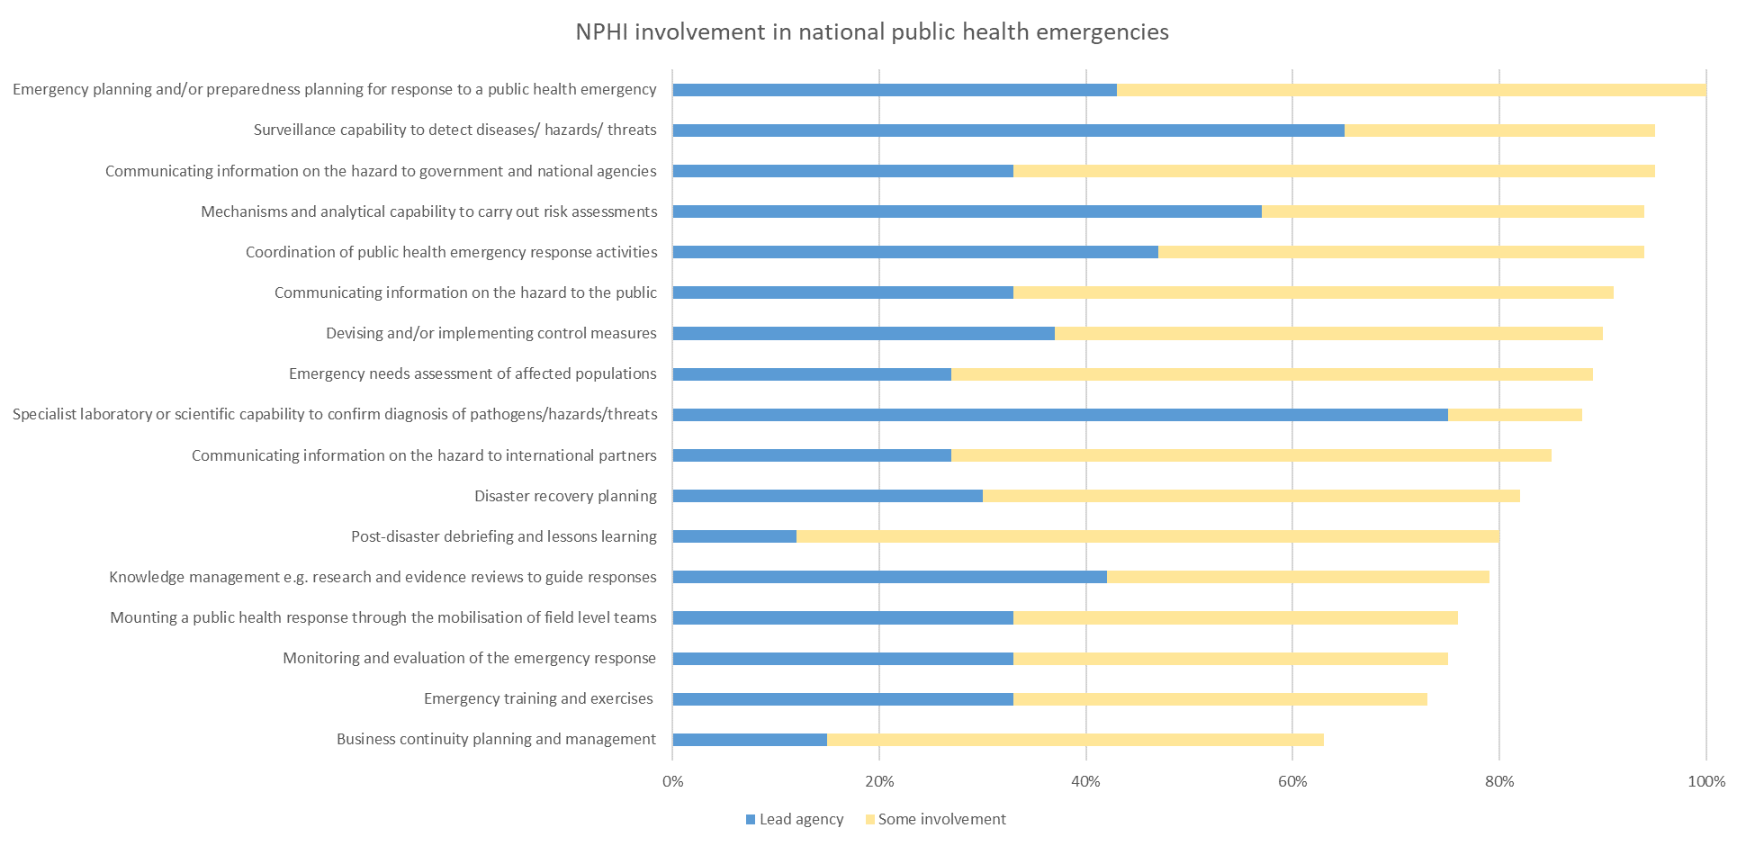
NPHI involvement in public health functions: Most common functions
Emergency planning and/or preparedness planning for response to a public health emergency (100%)
Surveillance capability to detect diseases/ hazards/ threats (95%)
Communicating information on the hazard to government and national agencies (95%)

Slide 9
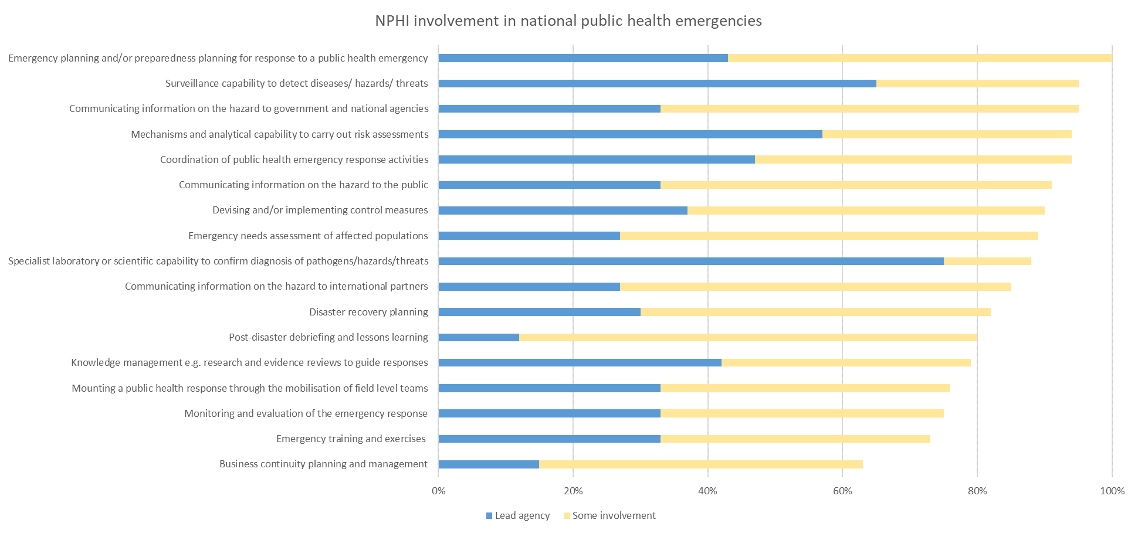
NPHI involvement in public health functions: Lead agency
Specialist laboratory or scientific capability to confirm diagnosis of pathogens/hazards/threats (75%)
Surveillance capability to detect diseases/ hazards/ threats (65%)
Mechanisms and analytical capability to carry out risk assessments (57%)

Slide 10
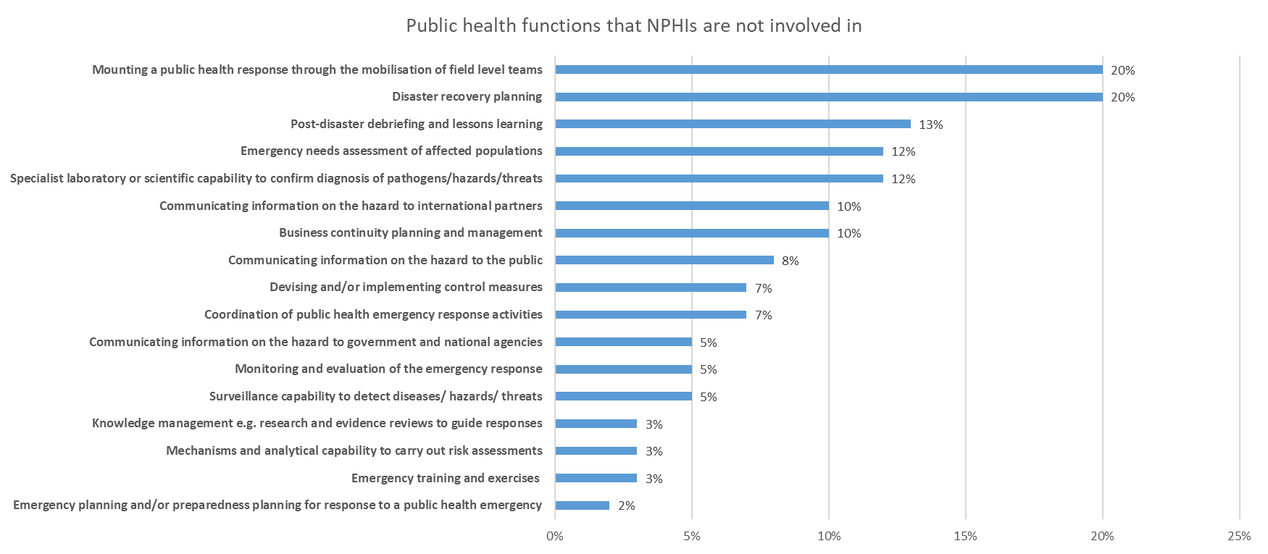
NPHI involvement in public health functions: No involvement
Mounting a public health response through the mobilisation of field level teams (20%)
Disaster recovery planning (20%)
Post-disaster debriefing and lessons learning (13%)

Slide 11
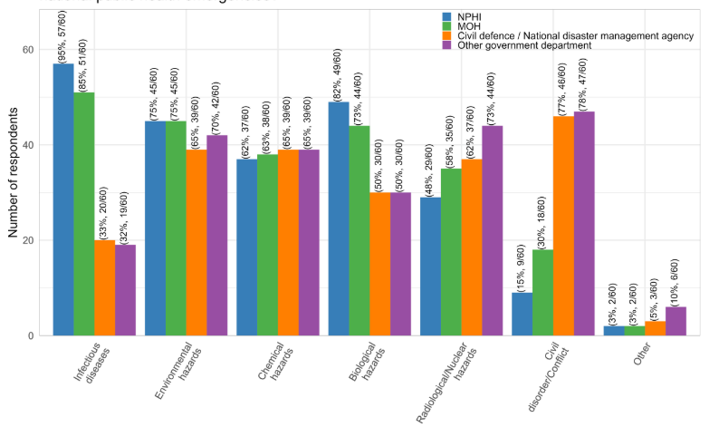
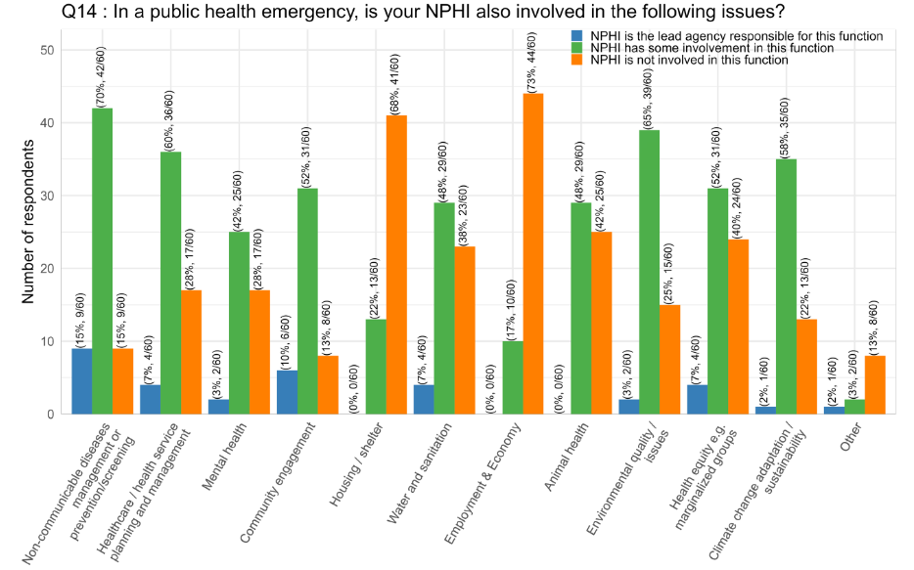
Type of hazards NPHIs are involved in
Most common
Infectious disease hazards (95%)
Biological hazards (82%)
Environmental hazards (75%)
Some involvement in non-communicable diseases (85%)
Less common
Animal health (42%)
Health equity (40%)
Water and sanitation (38%)
Environmental quality / issues (25%)
Climate change adaptation / sustainability (22%)

Slide 12
Public health emergency preparedness & response plans
Most NPHIs (78%) have a formal framework or plan in place.
Slightly higher in high income countries (86%) and larger NPHIs, and lowest in AMRO region (62%)
Most NPHIs (75%) had updated this plan since the COVID-19 pandemic.
The majority of respondents reported that this plan was collaboratively produced with other departments, agencies, or organisations (82%).
Contribution to regional or international plan
47% of NPHI reported contributing to a regional or international plan
24% of respondents reported contributing at a regional and/or international level for certain hazards only
9% reported that they did not contribute to plans for emergency preparedness and response at any of these levels

Slide 14
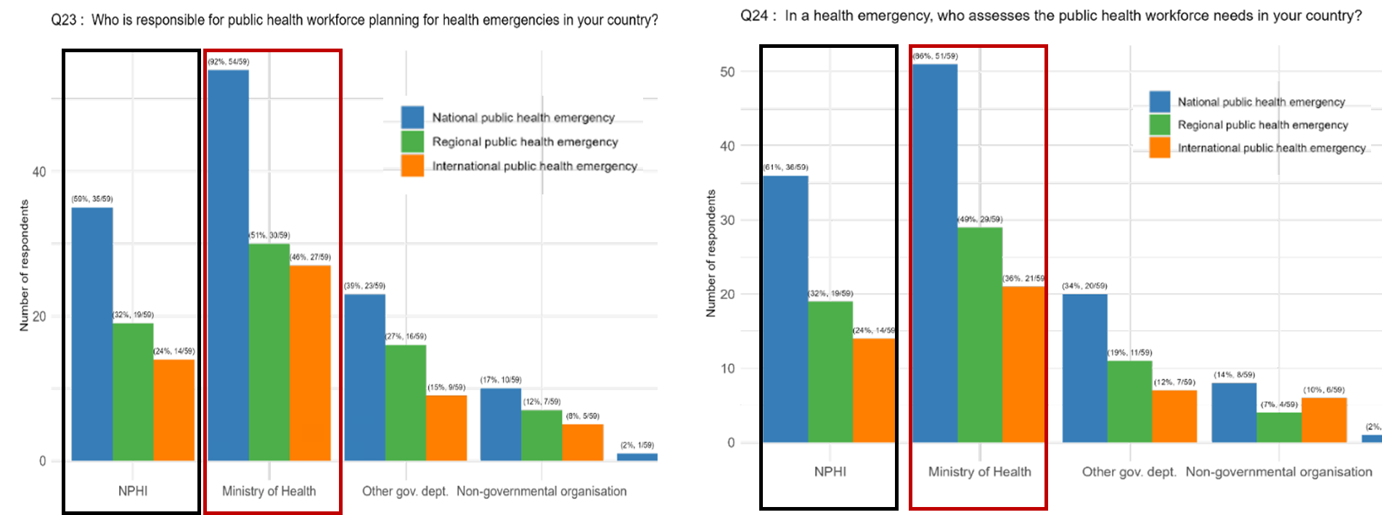
Workforce planning
54% indicated that national public health workforce strategy / plan was in place
77% indicated that the plan was developed / updated in the past 3 years
MoH followed by NPHI were responsible for health workforce planning and needs assessment for all emergency levels (National, Regional, International) (Q23 and 24)
Both MoH and NPHI will provide staff for all emergency levels
Higher response for national emergencies

Slide 15
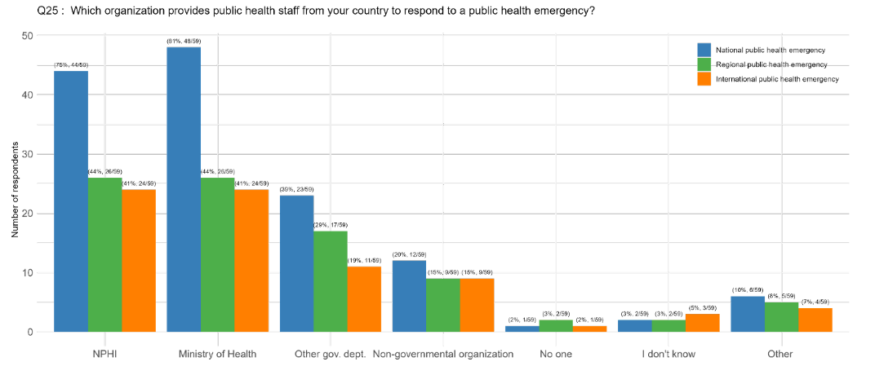
Which organization provides staff for public health emergency
Both MoH and NPHI will provide staff for all emergency levels
Higher response for national emergencies
Notes:
Most respondents indicated that MoH will provide staff for national level emergencies. However, for regional and international levels, both MoH and NPHI will provide staff

Slide 16
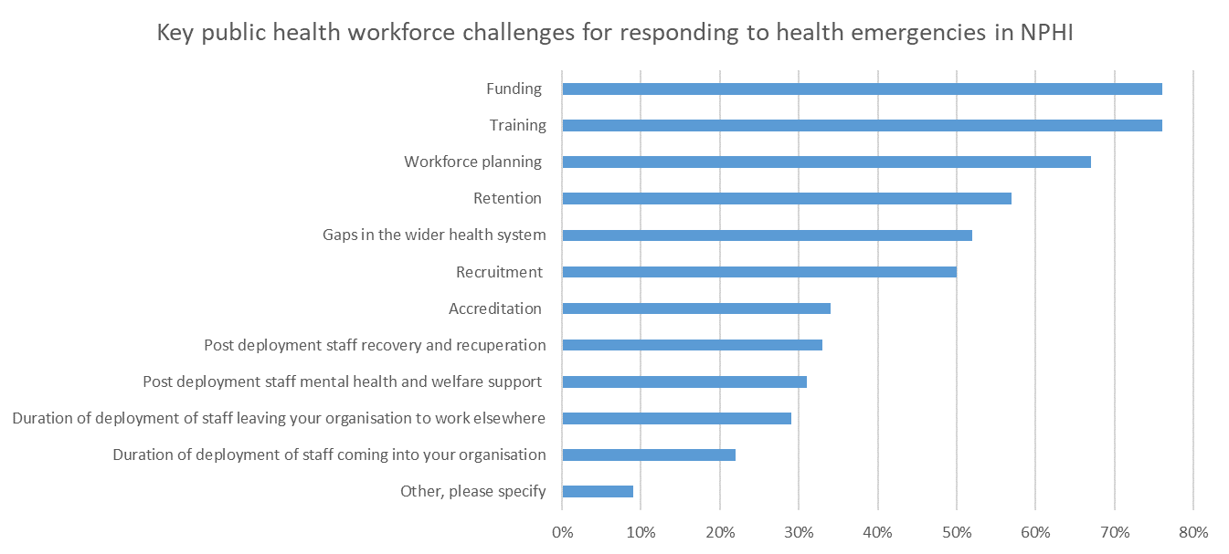
Key workforce challenges in NPHI

Slide 18
National Health Emergency

Slide 19
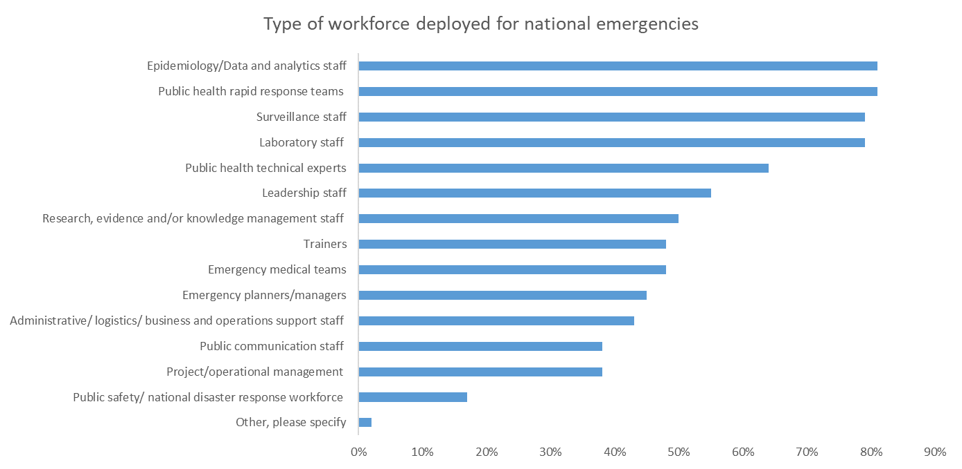
Deployment by NPHI for national emergencies
75% of NPHIs deployed workforce to national health emergencies since 2014
Workforce deployed related to NPHI mandate and expertise

Slide 20
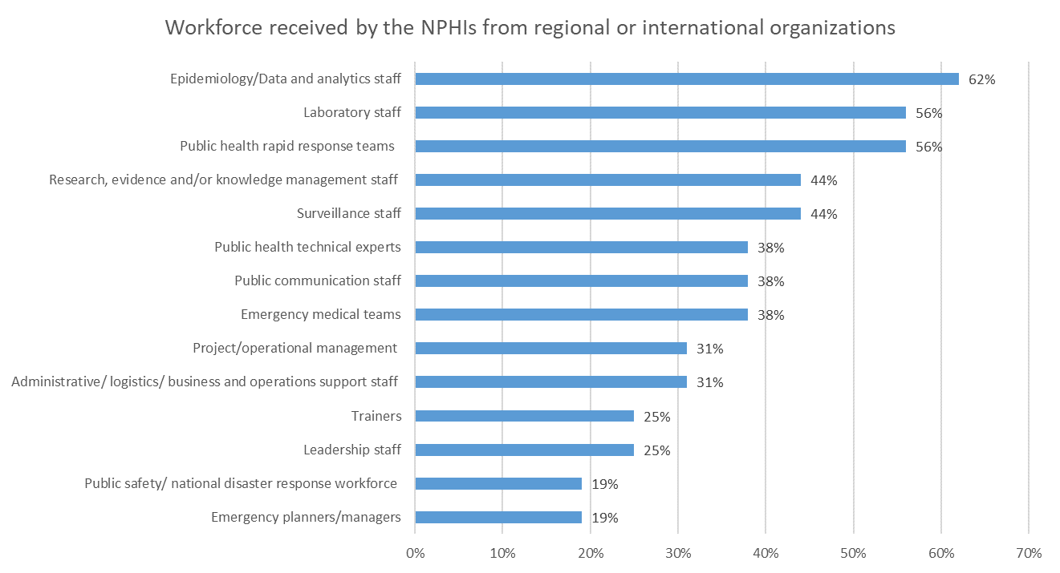
NPHI receiving staff from regional or international organizations
36% of NPHIs received staff (LICs, LMICs, AFRO, EMRO)
Workforce received mirrored workforce deployed

Slide 21
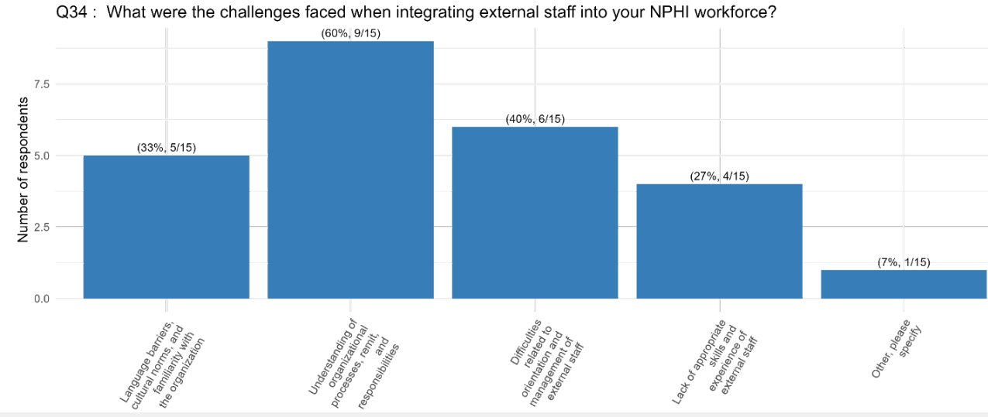
Challenges with integrating external staff into NPHI (n=15)
Understanding of organization processes, remit and responsibilities (60%)
Orientation and management of external staff (40%)
Language barriers, cultural norms and familiarity (33)
Notes:
Small sample

Slide 22
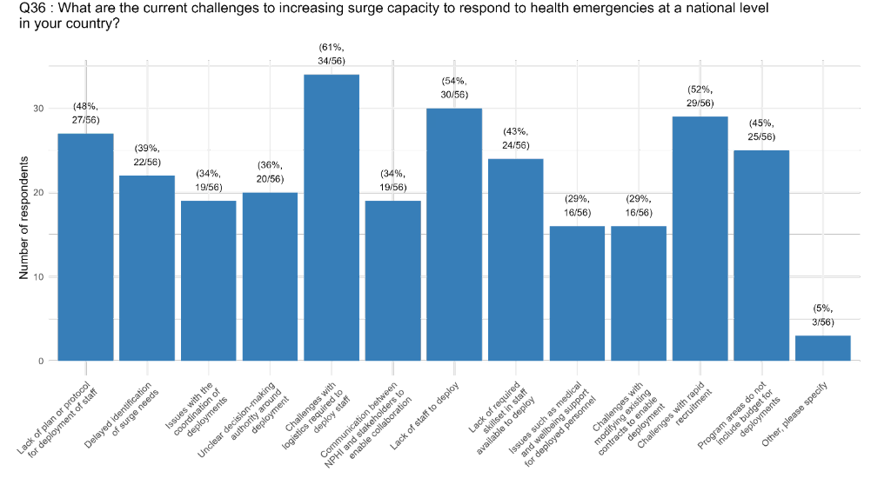
Surge capacity challenges when responding to national level emergency
Logistics required to deploy staff (61%)
Lack of staff to deploy (54%)
Challenges with rapid recruitment (52%)
Lack of plan or protocol for deployment of staff (48%)
Program area do not include budget for deployments (45%)

Slide 23
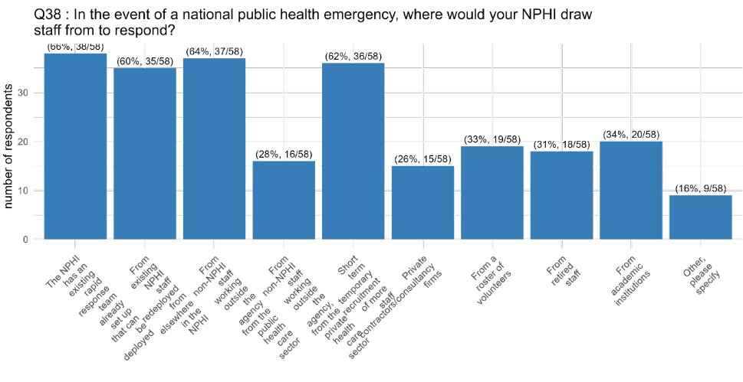
Where draw staff from for surge
NPHI has an existing rapid response team that can be deployed (66%)
From non-NPHI staff working in the public health sector (64%)
Short-term temporary recruitment of staff / contractors (62%)

Slide 24
Regional and International Health Emergency

Slide 25
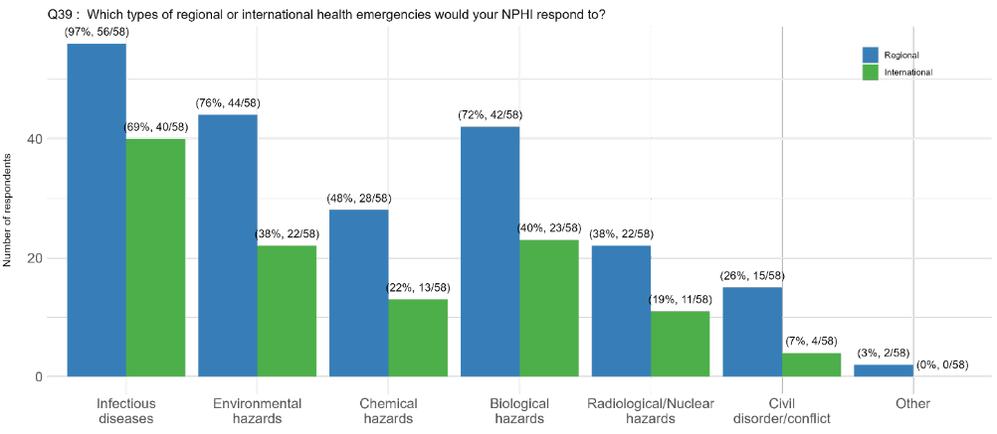
Type of regional or international emergency NPHIs will respond to
Infectious diseases
Environmental hazards
Biological hazards

Slide 26
NPHI staff deployment since 2014
50% of NPHIs deployed
Larger NPHIs have higher deployment rates
Workforce deployed similar as for national emergencies (n=29)
Epidemiology/Data and analytics staff (86%)
Public health rapid response teams (69%)
Surveillance staff (62%)
Public health technical experts (59%)
Pre-deployment training (n=28)
Health and safety (75%)
Cultural awareness and orientation (68%) (One of the integration challenges identified)
Personal security (61%)

Slide 27
NPHI staff deployment since 2014
Support for staff (n=29)
Technical (83%)
Financial (72%)
Wellbeing (48%)
Duration of staff deployment tended to be short (n=29)
1 – 3 months (34%)
<1 month (24%)
3 – 6 months (14%)
LMIC and HIC did not deploy for longer than 3 months

Slide 28
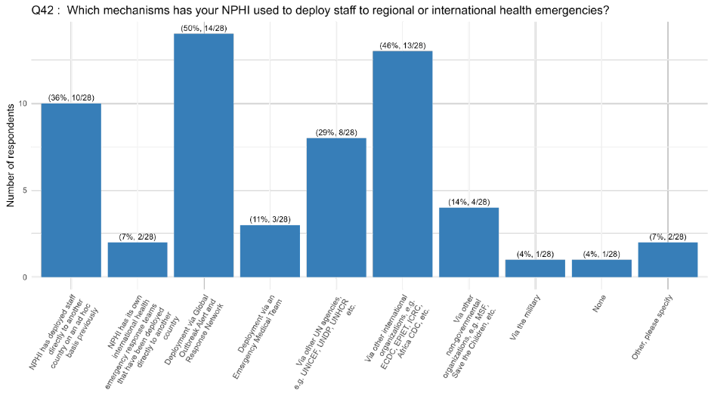
Deployment mechanisms (n=28)
Deployment via Global Outbreak Alert and Response Network (GOARN) (50%)
Other international organizations (ECDC, EPIET, ICRC, Africa CDC) (46%)
NPHI directly deployed to another country on ad hoc basis previously (36%)

Slide 29
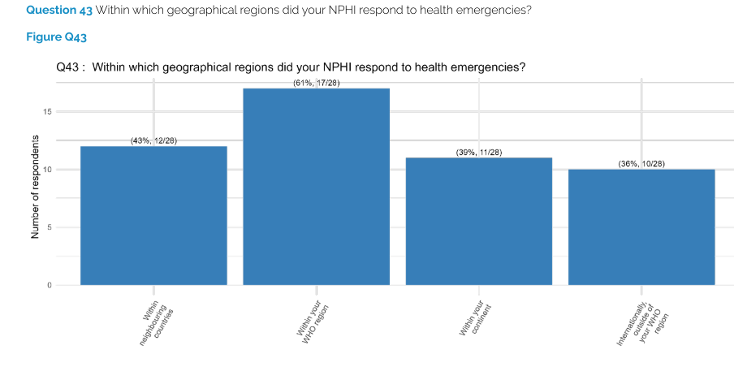
Geographical region of deployment
Within WHO region (61%)
Within neighbouring countries (43%)

Slide 30
Surge challenges
Same as for national surge
Logistical challenges to deploy staff (regional 57%, 31/54; international 43%, 23/54),
Lack of plan or protocol for deployment of staff (regional 56%, 30/54; international 50%, 27/54),
Issues with the coordination of deployments (regional 50%, 27/54; international 46%, 25/54)
Lack of staff to deploy (regional 46%, 25/54; international 39%, 21/54)
Differences were observed
LICs: lack of plan (73%) and budget (64%)
LMIC: unclear decision-making authority (75%)
HIC: Coordination of deployments at international level (53%)

Slide 31
Top priority areas for improving surge capacity (for all emergency levels)
Resources (primarily monetary)
Workforce (both capacity and level of expertise)
Emergency planning/protocols
Coordination of the deployment and response
Communication with the public and key stakeholders
Data surveillance and
Public health intelligence (e.g., greater integration of various sources of intelligence and surveillance data, and improving the speed of data analytics)

Slide 33
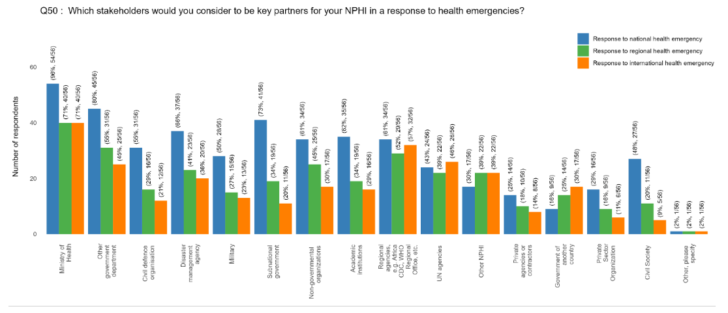
NPHI lead and partners
Most NPHIs had a high-level NPHI lead for health emergencies (84%)
Key partners for NPHI – Ministry of Health, other government departments, regional agencies
National emergency
MoH (96%)
Other government department (80%)
Subnational government (73%)
Regional emergency
MoH (71%)
Other government department (55%)
Regional agencies e.g. Africa CDC,
WHO regional office (52%)
International emergency
MoH (71%)
Regional agencies e.g. Africa CDC, WHO regional office (57%)
UN agencies (46%)

Slide 34
Collaborations
In terms of collaboration agreements with institutions from other countries for health emergency response (e.g., legal agreements, MoUs, data sharing agreements, etc)
Most NPHIs have agreements with other NPHIs and with international organizations (51%), but not with non-NPHI government agencies in other countries (10%)
Nature of collaboration varies: share health intelligence (76%), lab samples (55%), testing capacity (45%), or staff support (43%)

Slide 35
Collaborate with other NPHIs
Before health emergency
Meet with other NPHI leads (90%)
Collaboration on joint policies or projects related to health emergencies (73%)
Simulation exercises only done for 69%
During health emergency
Meet with other NPHI leads (81%)
Share information / intelligence on health threats with other NPHIs (81%)
Collaboration on joint policies or projects related to health emergencies (54%)
After health emergency
Meet with other NPHI leads (81%)
Share information / intelligence on health threats with other NPHIs (67%)
Share lessons learnt from recent incidents with other NPHIs (67%)

Slide 36
Who would NPHI contact in a health emergency
For alerting
WHO (95%)
A continental organisation or network (73%)
Other NPHI (66%)
Information sharing
WHO (84%)
Other NPHI (70%)
A continental organisation or network (70%)
To request assistance
WHO (70%)
A continental organisation or network (54%)
IANPHI (38%)
International organisation or network (38%)

Slide 37
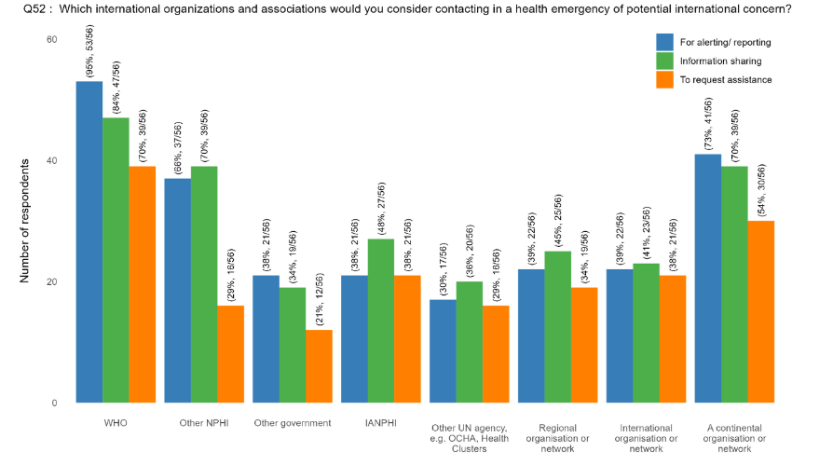
Who would NPHI contact in a health emergency
WHO (alerting, information sharing, to request assistance)
Continental organisation or network (alerting, information sharing, to request assistance)
Other NPHI (for alerting and information sharing)
IANPHI (to request assistance)
International organisation or network (to request assistance)

Slide 38
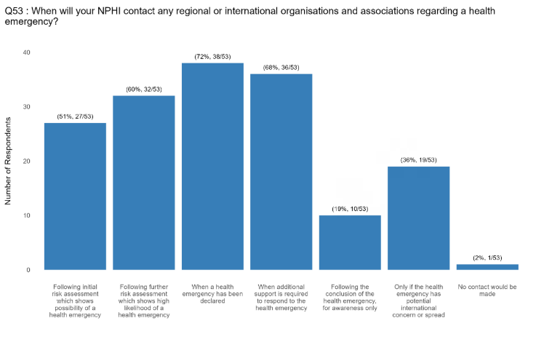
Timing of contact – When will the NPHI contact a regional or international organisation
Timing of when NPHIs might contact others in a health emergency varies
When a health emergency has been declared (72%)
When additional support is required (68%)
NPHIs in EURO and AMRO more likely to make contact early

Slide 39
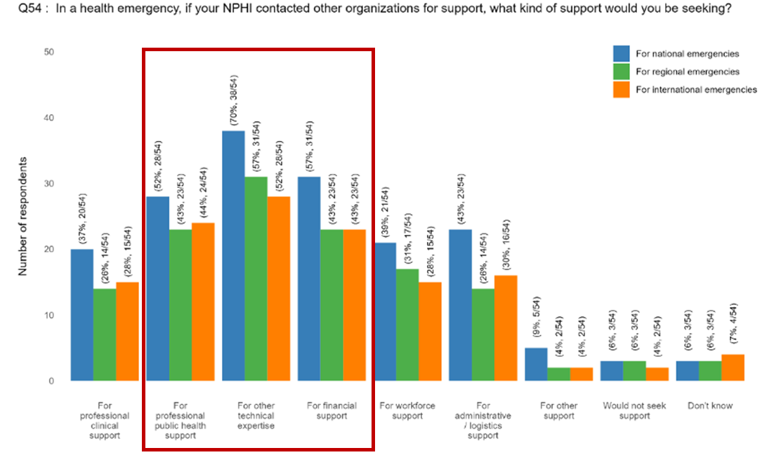
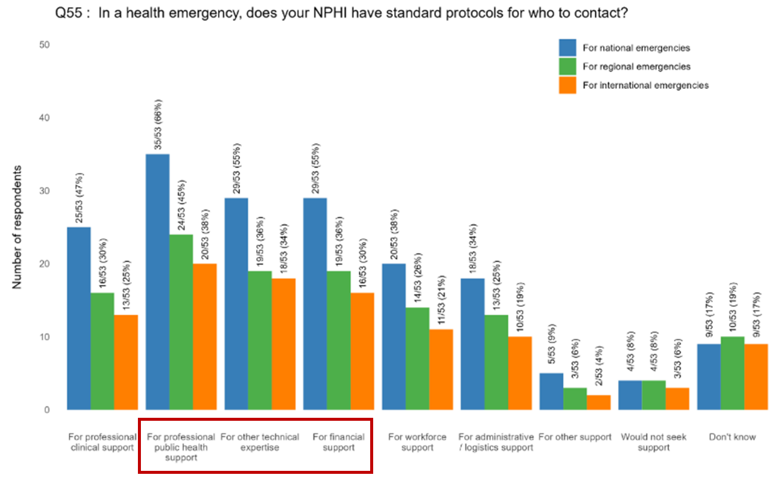
Support requested by NPHIs
Three most requested support across all levels
For technical expertise
For financial support
For professional public health support
Lack of protocols on who to contact
More protocols exist at national level
For professional public health support (66%)
Technical expertise (55%)
Financial support (55%)

Slide 40
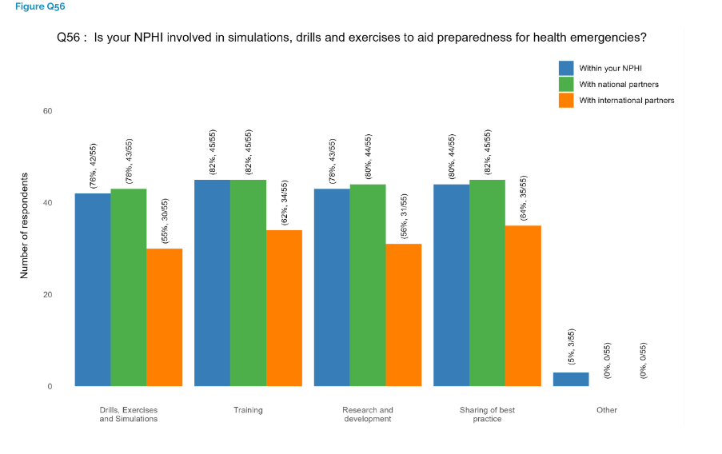
Simulations, drills, exercises and lessons learned
Most NPHIs involved in simulations, drills and exercises within NPHI and national partners
Training
Sharing of best practice
Research and development
54% of NPHIs always undertook an experience or lesson learned activity
50% of NPHIs always involve other organizations in this
55% indicated that recommendations will always be implemented

Slide 41
Key findings
NPHIs differ – driven by mandate
Not all NPHIs had a legally mandated role in health emergencies
Clarify and formalize role of NPHIs supported by legislation
NPHIs mostly focused on infectious diseases, environmental and biological hazards
Less involved in mobilization of field teams, post-disaster recovery and one health functions (animal health, environmental issues, water and sanitation)
Need for investment in public health workforce (routine functions and surge capacity)
This includes identification of skills needed and ensuring multisectoral teams are identified
Need to strengthen surge protocols and coordination mechanisms
Strengthen networks and collaboration within countries, regionally and internationally – NPHIs can act as bridge connectors
NPHIs to be involved in regional and international plans and protocols, and can share best practices through regular engagements

Slide 42
Deployments
Most NPHIs were able to deploy nationally (62%), less so internationally (51%)
Most international deployments tended to be within the same WHO Region or neighbouring countries.
More distant deployments tended to be from NPHIs in higher income countries.
Most deployments via existing mechanisms, e.g. GOARN (48%), or regional networks, e.g., ECDC, African CDC (44%).
Some deployments were on an ad hoc basis (37%), and a few via NGOs (15%)
Deployment rates are not high. Most deployments tend to be short (3 months or less). Larger NPHIs tended to be more able to deploy.

Slide 43







Acknowledgements
With thanks to the gracious support, time and participation of the many NPHIs who took part in the survey and interviews.
Also for their expert input to
Scott Dowell and Christophe Schmacthel, WHO GHEC
Ed Newman, UKHSA / GOARN
Meng Khaw, Public Health Wales / IANPHI
BMGF funding that enabled the survey work to be done.
Project team:
Erin Rees, PHA Canada; Vicky Ng, PHA Canada; Naomh Gallagher, UKHSA; Janine Bezuidenhoudt, NICD South Africa; Julie Collins, UKHSA; Alex Thompson, University of Sheffield; Jose Langa, INS Mozambique; Raphaele Ismail, IANPHI; Rosita Wigand, PHA Sweden/ IANPHI; Sadaf Lynes, IANPHI; Andrew Lee, UKHSA/University of Sheffield.

Slide 44

Findings from the connected leaders' interviews
Rosita Wigand,
Programme Manager for International Initiatives, IANPHI

Slide 45
Key Informant Interviews
Director generals or their deputies of 15 NPHIs
Different World Bank income groups
HIC 6, UMIC 3, LMIC 3, LIC 3
All WHO Regions
AFRO 6 AMRO 3 EMRO 3 SEARO 1 WPRO 2
Different types of NPHIs:
regional NPHI responsible for several countries
national level NPHIs in centralized and decentralized countries
national level NPHIs in a federated state
sub-national/provincial level NPHIs in a federation.
Notes:
In addition to the presented survey, key informant interviews were held with a selection of senior leaders of 15 NPHIs including one sub-national and one supra-national public health agency.

Slide 46
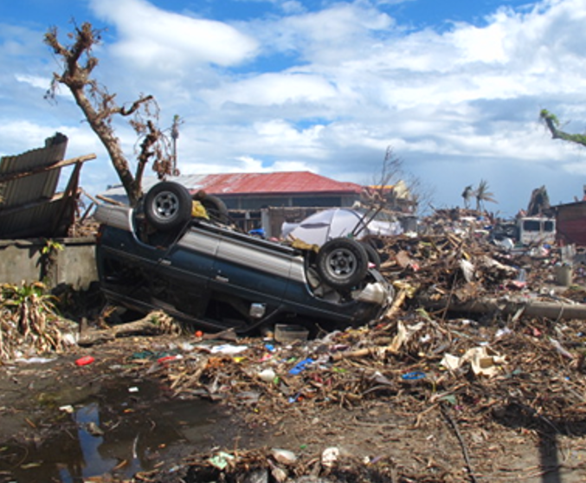
Objectives of Key Informant Interviews
To explore the concept of connected leadership for all-hazards emergencies, from sub-national, national, regional and international perspectives
To discuss enablers and barriers to NPHIs responding to national, regional and international health emergencies
Image source: A Lee

Slide 47
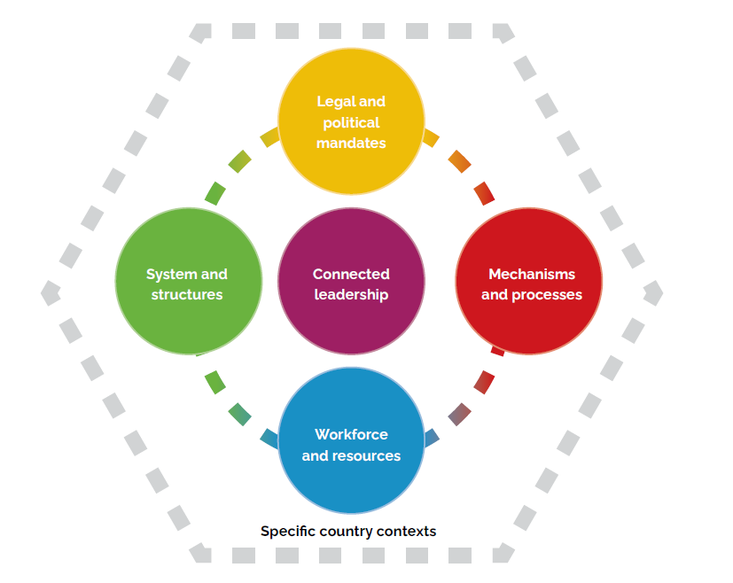
Key Themes Emerging from Interviews

Slide 48
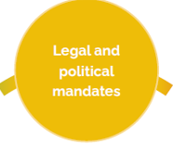
Legal and Political Mandates
Legal mandate and governance framework dictate the permissions, remit and autonomy that an NPHI has to operate in health emergencies
Remit for health emergencies may be split
Considerable variability in the legal mandate
Political support
Appeared to correlate with degree of resourcing for the NPHI and remit
Political context both enabler or constraint on NPHIs activities in health emergencies and in global health engagement

Slide 49
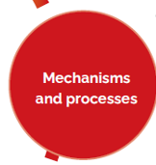
Mechanisms and Processes
Need for clear mechanisms for mobilizing surge capacity from their own staff
Coordination of surge responses
Multiple routes: NPHI-NPHI, ministry-ministry, government-government, WHO, partner collaboration networks, GOARN
Mechanisms in place, bilateral agreements, EU Health Task Force
Issues with deploying a response
late engagement, legislative requirements
Need for “prepared and tested logistics”
Government approval for international deployments
Clear request for assistance
Speed of the decision-making process
Notes:
Related to both national and international emergencies

Slide 50

Workforce and Resources, 1
Resource mobilization, a major barrier or enabler
Need to apply for funds from MoF
Delays in the process
Dependence on donors and development partners
Shrinking NPHI budgets
Some emergency resources needed found outside the NPHI
Sustained and predictable funding including for emergency preparedness:
”In a crisis there will be funding. The funds become available when the house is on fire. The challenge is to have funding before it is aflame”

Slide 51
Workforce and Resources 2
Capacity and surge capacity gaps
Difficult to deploy staff (numbers, experience, day-jobs, length of deployment)
Existing capacity gaps (right staffing, skill mix)
Training and capacity building, not just for national but also sub-national levels
Contextual awareness (particularly international deployments)
Staff retention
Knowledge, data and information sharing
To be sustained ”in peace time” between emergencies
Facilitate information and knowledge exchange, good practice and learning within and between countries (eg. simex)

Slide 52

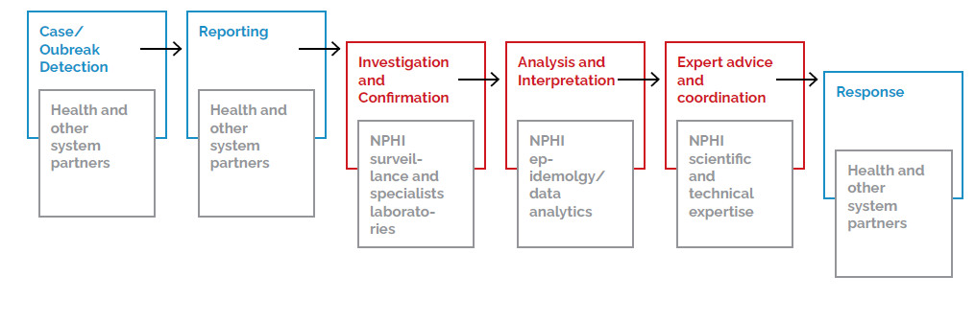
System and Structures, 1
Notes:
The ability of the public health system to respond to a health emergency was noted to be contingent on the health infrastructure in place
Figure illustrates the the pathway from surveillace to pbulic health response and different partner roles.

Slide 53
Systems and structures, 2
Multi-sectoral and multi-agency coordination and collaboration at all levels – subnational, national, regional and international
Need to strengthen the internal capacity in every country to respond to emergencies
Build regional capacities in pre-emergency period
Notes:
Many NPHI leaders emphasised that:
Public health emergency response is not a singe agency domaine but a multi-sectoral and multi-agency endeavour, involving multiple ministries, agencies, NGOs, communities, development partners, etc.
Hence requiring multi-sectoral and multi-agency collaboration and coordination at various levels – sub-national, national, regional and international levels.
Such capacitites need to be built in peace times, before emergencies.

Slide 54

Connected leadership
Need for ”collaborative leadership”
”Bridge connectors”, who build bridges within the NPHI and outside the sector
Relationships of trust
Promote international collaboration, though weighted towards regional collaboration
Opportunities for collaboration with an aim ”to prepare together”
Good pre-crisis relationship, an enabler for effective emergency responses
Notes:
Need for ”collaborative leadership”
To be defined: engagement with other actors, strengthen relationships, bridging different sectors
Weighted towards Regional collaboration:
Our neighbors’ problems are our problems, and our problems are our neighbors’ problems”
Perceived mutual benefit and reciprocity between NPHIs

Slide 55
Specific country contexts
Contexts and environments in which NPHIs operate in are highly diverse
”the administrative culture in your society”
Flexible guidance and frameworks to be translated into local solutions
Fit local context

Slide 56
Collaborative, connected leadership is key
A leadership approach that emphasizes collaboration, communication, coordination, and relationship-building across various sectors, organizations, and communities to effectively manage and respond to various crises.
Connected leaders’ networks need to be strengthened to create a network of networks that operates according to country context at all levels and across sectors.
NPHIs must be empowered as national and regional bridge-builders, translating global frameworks into context-specific action

Slide 57
Call for Actions and Next Steps
Sadaf Lynes,
Director of Collaborative Surveillance, Workforce and Health Emergencies, IANPHI

Slide 58
Speakers:
Professor Tahmina Shirin,
Director, Institute of Epidemiology, Disease Control and Research
&
Professor Aamer Ikram,
Vice-President, IANPHI
Moderator:
Sadaf Lynes,
Director of Collaborative Surveillance, Workforce and Health Emergencies, IANPHI
NPHI perspectives and reflections on the findings

Slide 59
Q&A SESSION​
​
If you wish to ask a question, please raise your hand and wait for the moderator to give you the floor. You can also write your question in the chat.​

Slide 60
Concluding remarks
Sadaf Lynes,
Director of Collaborative Surveillance, Workforce and Health Emergencies, IANPHI

Slide 61
Thank you!​

