Slide 1

THE ROLE OF NPHIs IN HEALTH EMERGENCIES
DISCLAIMER: The views and opinions expressed in this webinar are those of the authors and do not necessarily reflect the official policy or position of IANPHI.

Slide 2
Findings from the connected leaders' interviews
Rosita Wigand,
Programme Manager for International Initiatives, IANPHI

Slide 3
Key Informant Interviews
Director generals or their deputies of 15 NPHIs
Different World Bank income groups
HIC 6, UMIC 3, LMIC 3, LIC 3
All WHO Regions
AFRO 6 AMRO 3 EMRO 3 SEARO 1 WPRO 2
Different types of NPHIs:
regional NPHI responsible for several countries
national level NPHIs in centralized and decentralized countries
national level NPHIs in a federated state
sub-national/provincial level NPHIs in a federation.
Notes:
In addition to the presented survey, key informant interviews were held with a selection of senior leaders of 15 NPHIs including one sub-national and one supra-national public health agency.

Slide 4
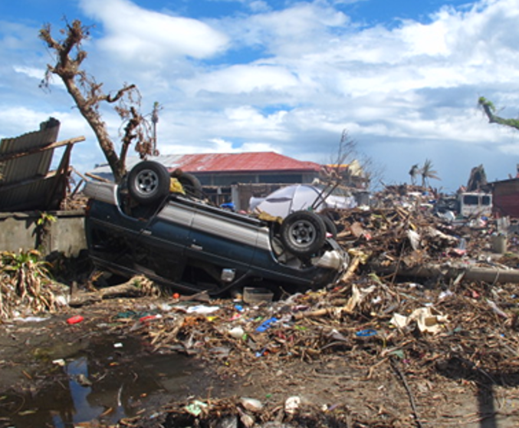
Objectives of Key Informant Interviews
To explore the concept of connected leadership for all-hazards emergencies, from sub-national, national, regional and international perspectives
To discuss enablers and barriers to NPHIs responding to national, regional and international health emergencies
Image source: A Lee

Slide 5
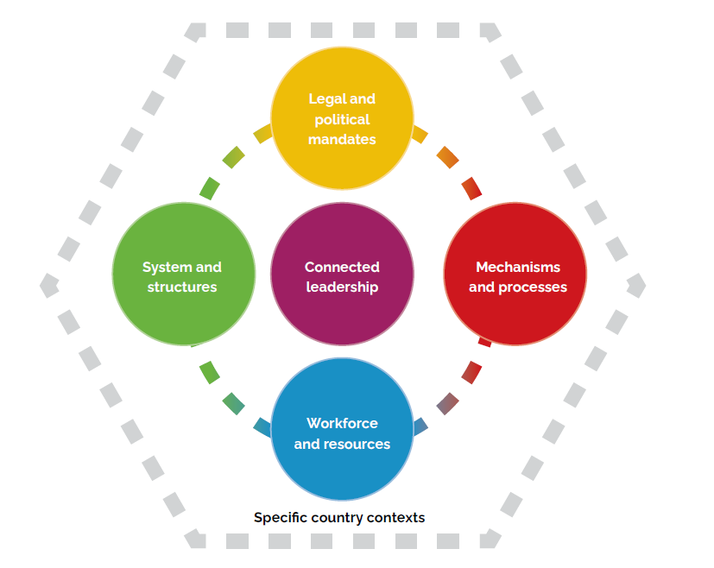
Key Themes Emerging from Interviews

Slide 6
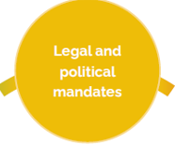
Legal and Political Mandates
Legal mandate and governance framework dictate the permissions, remit and autonomy that an NPHI has to operate in health emergencies
Remit for health emergencies may be split
Considerable variability in the legal mandate
Political support
Appeared to correlate with degree of resourcing for the NPHI and remit
Political context both enabler or constraint on NPHIs activities in health emergencies and in global health engagement

Slide 7
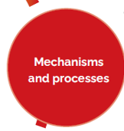
Mechanisms and Processes
Need for clear mechanisms for mobilizing surge capacity from their own staff
Coordination of surge responses
Multiple routes: NPHI-NPHI, ministry-ministry, government-government, WHO, partner collaboration networks, GOARN
Mechanisms in place, bilateral agreements, EU Health Task Force
Issues with deploying a response
late engagement, legislative requirements
Need for “prepared and tested logistics”
Government approval for international deployments
Clear request for assistance
Speed of the decision-making process
Notes:
Related to both national and international emergencies

Slide 8

Workforce and Resources, 1
Resource mobilization, a major barrier or enabler
Need to apply for funds from MoF
Delays in the process
Dependence on donors and development partners
Shrinking NPHI budgets
Some emergency resources needed found outside the NPHI
Sustained and predictable funding including for emergency preparedness:
”In a crisis there will be funding. The funds become available when the house is on fire. The challenge is to have funding before it is aflame”

Slide 9
Workforce and Resources 2
Capacity and surge capacity gaps
Difficult to deploy staff (numbers, experience, day-jobs, length of deployment)
Existing capacity gaps (right staffing, skill mix)
Training and capacity building, not just for national but also sub-national levels
Contextual awareness (particularly international deployments)
Staff retention
Knowledge, data and information sharing
To be sustained ”in peace time” between emergencies
Facilitate information and knowledge exchange, good practice and learning within and between countries (eg. simex)

Slide 10

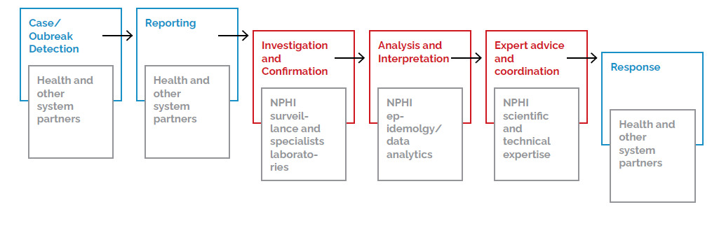
System and Structures, 1
Notes:
The ability of the public health system to respond to a health emergency was noted to be contingent on the health infrastructure in place
Figure illustrates the the pathway from surveillace to pbulic health response and different partner roles.

Slide 11
Systems and structures, 2
Multi-sectoral and multi-agency coordination and collaboration at all levels – subnational, national, regional and international
Need to strengthen the internal capacity in every country to respond to emergencies
Build regional capacities in pre-emergency period
Notes:
Many NPHI leaders emphasised that:
Public health emergency response is not a singe agency domaine but a multi-sectoral and multi-agency endeavour, involving multiple ministries, agencies, NGOs, communities, development partners, etc.
Hence requiring multi-sectoral and multi-agency collaboration and coordination at various levels – sub-national, national, regional and international levels.
Such capacitites need to be built in peace times, before emergencies.

Slide 12

Connected leadership
Need for ”collaborative leadership”
”Bridge connectors”, who build bridges within the NPHI and outside the sector
Relationships of trust
Promote international collaboration, though weighted towards regional collaboration
Opportunities for collaboration with an aim ”to prepare together”
Good pre-crisis relationship, an enabler for effective emergency responses
Notes:
Need for ”collaborative leadership”
To be defined: engagement with other actors, strengthen relationships, bridging different sectors
Weighted towards Regional collaboration:
Our neighbors’ problems are our problems, and our problems are our neighbors’ problems”
Perceived mutual benefit and reciprocity between NPHIs

Slide 13
Specific country contexts
Contexts and environments in which NPHIs operate in are highly diverse
”the administrative culture in your society”
Flexible guidance and frameworks to be translated into local solutions
Fit local context

Slide 14
Collaborative, connected leadership is key
A leadership approach that emphasizes collaboration, communication, coordination, and relationship-building across various sectors, organizations, and communities to effectively manage and respond to various crises.
Connected leaders’ networks need to be strengthened to create a network of networks that operates according to country context at all levels and across sectors.
NPHIs must be empowered as national and regional bridge-builders, translating global frameworks into context-specific action

Slide 15
Thank you!​

