Slide 1

THE ROLE OF NPHIs IN HEALTH EMERGENCIES
DISCLAIMER: The views and opinions expressed in this webinar are those of the authors and do not necessarily reflect the official policy or position of IANPHI.

Slide 2
The Role of National Public Health Institutes (NPHIs) in Health Emergency Confirmation
Prof. Dr. Tahmina Shirin
Director
Institute if Epidemiology Disease, Control and Research (IEDCR), Bangladesh
IANPHI Webinar

Slide 3
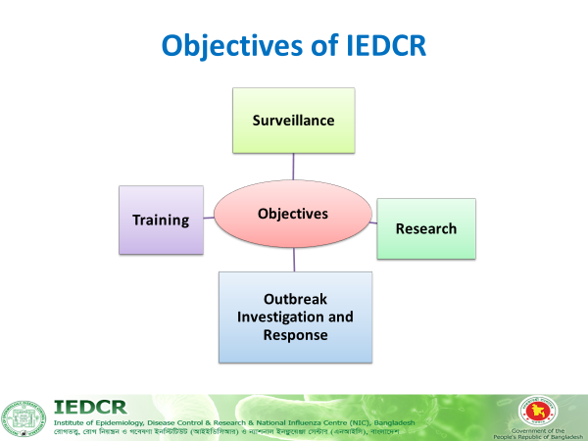
Mandate & Objectives of NPHI in Bangladesh
Indicator-based and Event-based surveillance
Outbreak investigation and response
Training & workforce development (FETP,B, PHEM, RRT)
WHO IHR Focal Point & NIC
National Reference Laboratories for Influenza, Nipah, SARS-CoV2 and AMR

Slide 4
Public Health Emergency Response of Bangladesh
Routine indicator based surveillance
Event based surveillance
Public Health Emergency reporting/ notification
PHEOC at IEDCR
Emergency response
NRRT
Multi-sectoral collaborative approach
DRRT
URRT
Notes:
PHEOC plans and procedures
Q: What PHEOC plans and procedures are in use..?
Describe the plans and procedures
SOPs
Activation procedure in case of emergency
Routine reporting and type of data collected to generate report; including a sample of the report
Information and communication technology; i.e. teleconference, computer network, etc.
Tools and software used; e.g. GIS mapping tools, data analytical software, etc.

Slide 5
3 Modes of PHEOC / NRRT
Watch mode (Collection of PHI information): Media monitoring, Hotline, Surveillance & lab data, Incident Notification
Alert mode: Incident verification, Demographic & epidemiological data collection, analysis, Situational awareness
Response mode: Mobilization of RRT, Briefing Incident Management Team (IMT)
7-1-7 matrix

Slide 6
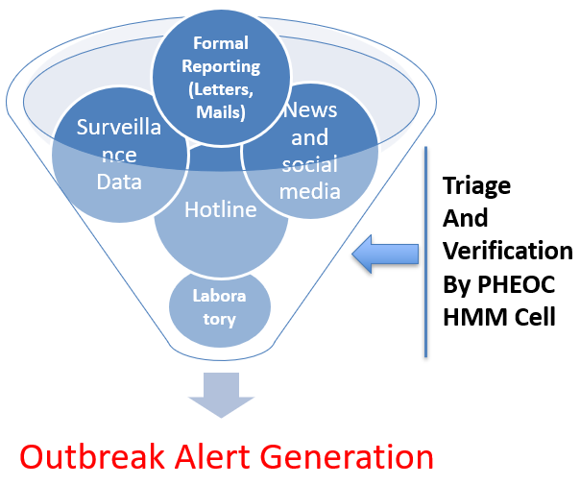
Core Functions of NPHIs in Emergency Confirmation
Continuous surveillance and early warning (including media and hotline monitoring).
Signal detection, triage, and verification of potential threats.
Real-time incidence reporting.
Laboratory testing and genomic sequencing & digital sequence information
Rapid risk assessment and analysis.
Provide policy advice to trigger national response.

Slide 7
Next steps
Sharing of outbreak investigation report
Local authority
Directorate General of Health Services (DGHS)
After action review
Intra action review
Dissemination among the relevant stakeholders
Media orientation
Large scale outbreak
Commutation with MoH through DGHS & other relevant ministry if required
Outbreak investigation of notifiable disease
Repot to IHR focal point
WHO country office to SEARO
Cross border issue
Involvement of MoFA

Slide 8
Outbreak investigation of zoonotic diseases
Existing One Health
Operational System: Bangladesh
Budget support
Ministry of Health, CDC Operational budget
Development partners (USAID, GHD, FAO, WHO)
Inter-Ministerial Steering Committee
Led by Secretary, MoHFW
Technical Advisory Committee
Establishment: 2008
Representatives from 12 national and international organizations
Under Govt. supervision
Led by DG of DGHS
One Health Bangladesh
Civil Society
Coordination Committee
Led by Director of IEDCR
Establishment: 2017
3 deputed full-time officers (Human Health, Animal Health, Forestry Department)
One Health Secretariat

Slide 9
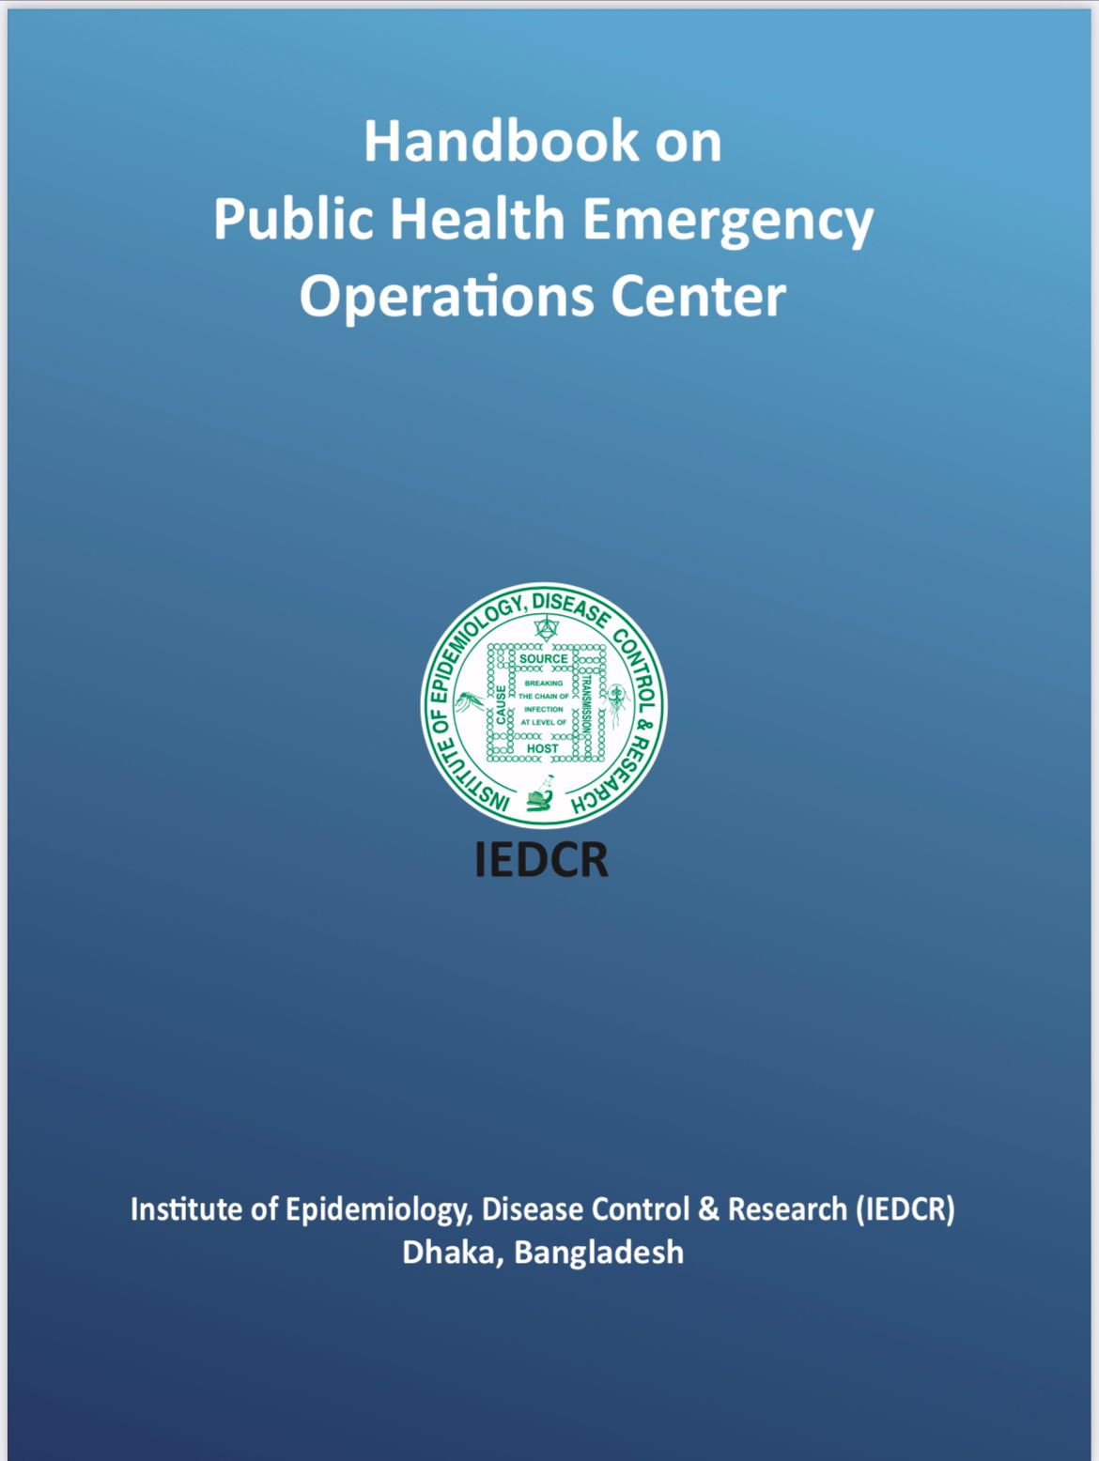
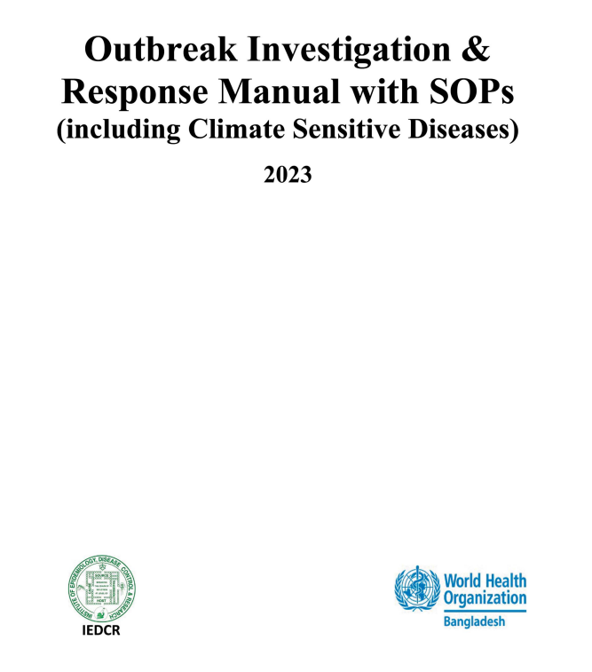

Outbreak Investigation and Response Manuals by IEDCR

Slide 10
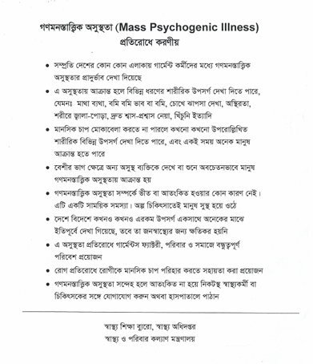
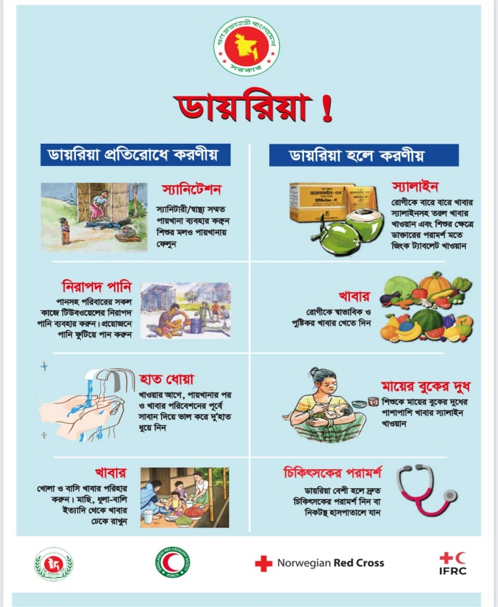
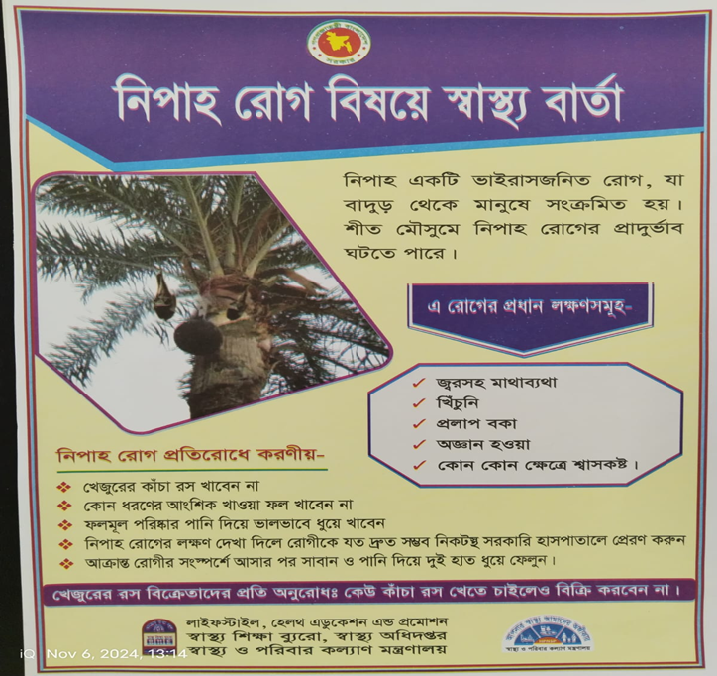

RCCE Materials

Slide 11

Thank you

Slide 12
Thank you!​

